Slide 1



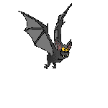
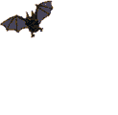
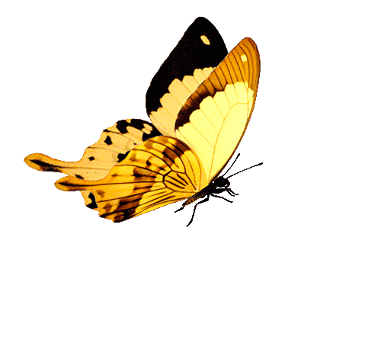
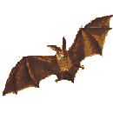






BAT AND BUTTERFLIES
“CREATING THE BASIS FOR COEXISTENCE, RESPECT AND COOPERATION”
2018-1-RO01- KA229-049097_5
EDUCATIONAL GAMES
HRISTO BOTEV PRIMARY SCHOOL, Sliven,Bulgaria

Slide 2
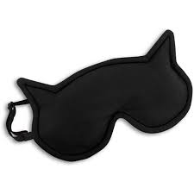
Materials needed:
EYE MASK
“CREATING THE BASIS FOR COEXISTENCE, RESPECT AND COOPERATION”
2018-1-RO01- KA229-049097_5
HRISTO BOTEV PRIMARY SCHOOL, Sliven,Bulgaria

Slide 3
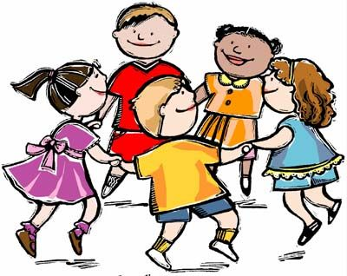
DESCRIPTION :
Children gather in a circle.
“CREATING THE BASIS FOR COEXISTENCE, RESPECT AND COOPERATION”
2018-1-RO01- KA229-049097_5
HRISTO BOTEV PRIMARY SCHOOL, Sliven, Bulgaria

Slide 4
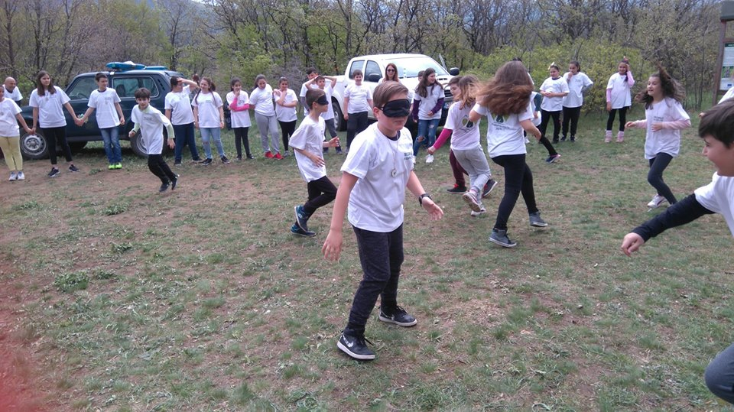
DESCRIPTION :
2. Choose a volunteer to be the “bat” standing blindfolded in the middle of the playground.
“CREATING THE BASIS FOR COEXISTENCE, RESPECT AND COOPERATION”
2018-1-RO01- KA229-049097_5
HRISTO BOTEV PRIMARY SCHOOL, Sliven, Bulgaria

Slide 5
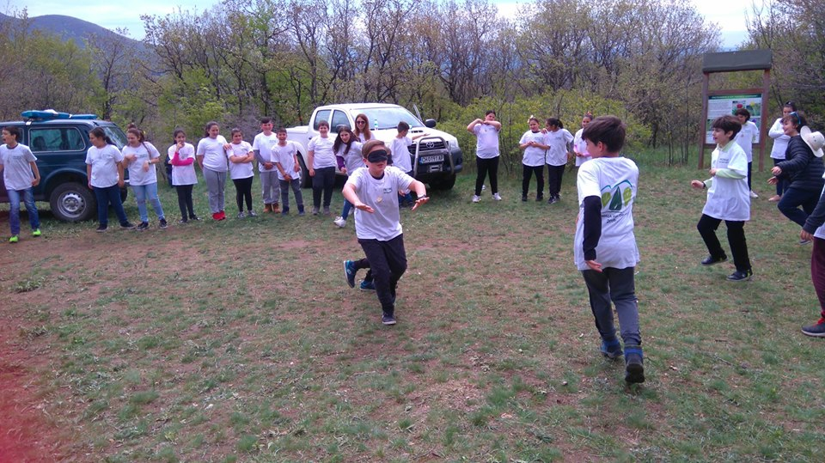
DESCRIPTION :
3. Choose one or two “butterflies” who also enter the circle clapping their hands or making a “BEEP-BEEP” sound.
“CREATING THE BASIS FOR COEXISTENCE, RESPECT AND COOPERATION”
2018-1-RO01- KA229-049097_5
HRISTO BOTEV PRIMARY SCHOOL, Sliven, Bulgaria

Slide 6
DESCRIPTION :
4. The goal is for the bat to catch / touch a butterfly in order to eat it.
“CREATING THE BASIS FOR COEXISTENCE, RESPECT AND COOPERATION”
2018-1-RO01- KA229-049097_5
HRISTO BOTEV PRIMARY SCHOOL, Sliven, Bulgaria

Slide 7
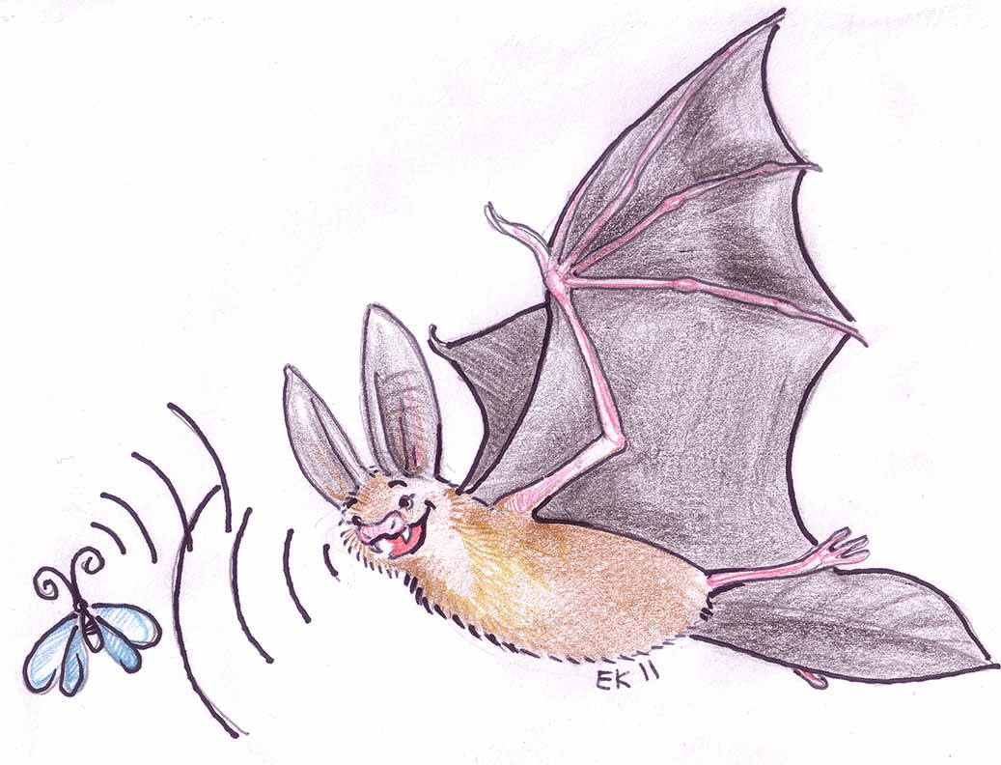
DESCRIPTION :
5. Perform some more game rounds with different bats.
“CREATING THE BASIS FOR COEXISTENCE, RESPECT AND COOPERATION”
2018-1-RO01- KA229-049097_5
HRISTO BOTEV PRIMARY SCHOOL, Sliven, Bulgaria

Slide 8
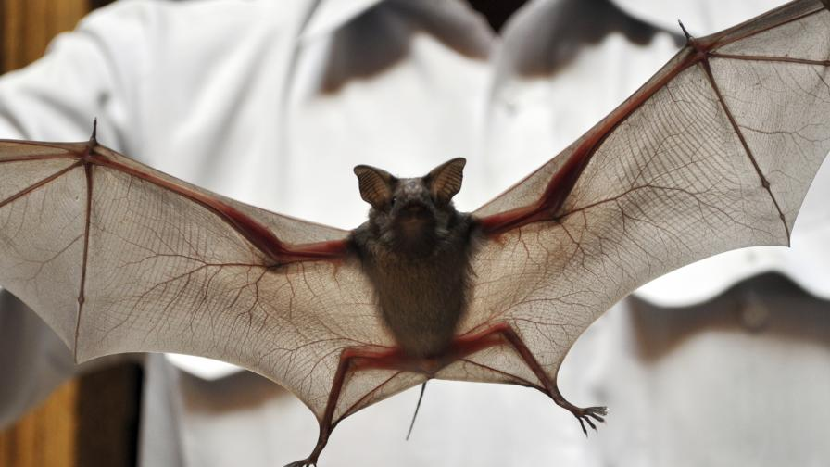
AIM OF THE GAME :
The game resembles reality - bats feed on butterflies without seeing them, but orient themselves by sounds.
“CREATING THE BASIS FOR COEXISTENCE, RESPECT AND COOPERATION”
2018-1-RO01- KA229-049097_5
HRISTO BOTEV PRIMARY SCHOOL, Sliven, Bulgaria

