Slide 1
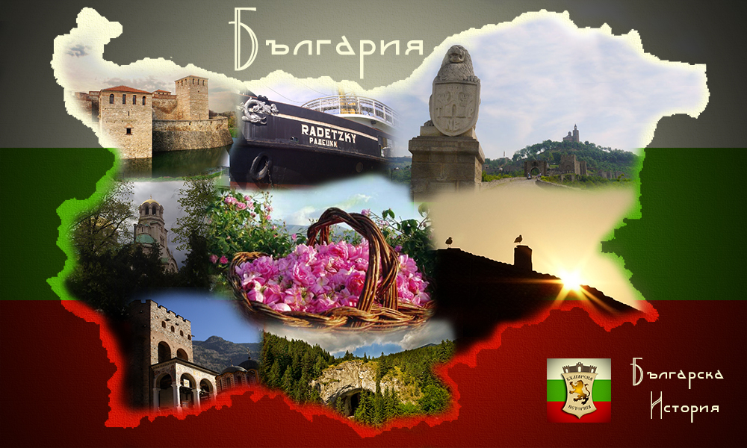

Slide 2
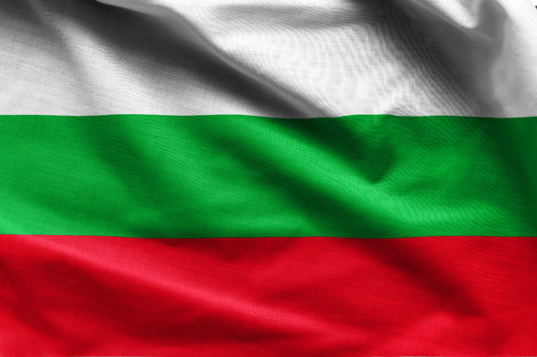
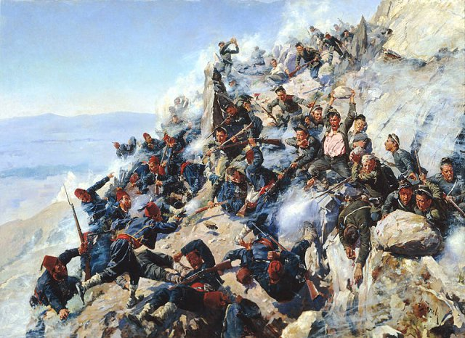
The formation of the Bulgarian state began after the settlement of Slavic and Pro-Bulgarian tribes on the peninsula. In 681y. The first Bulgarian state was founded and it existed until 1018y., when it came under the rule of Byzantium.

Slide 3
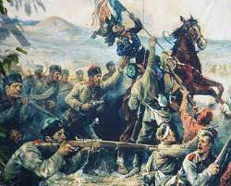
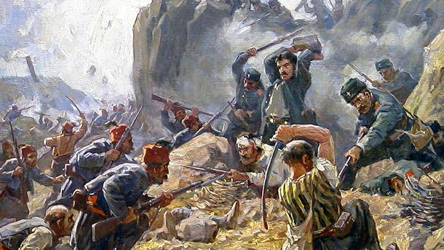
The period of foreign domination continued until 1185y.,when the Second Bulgarian State was established as a result of the uprising. It existed as an independent unit until the end of the 14th century, when a new power emerged on the peninsula-the Ottoman Empire.

Slide 4
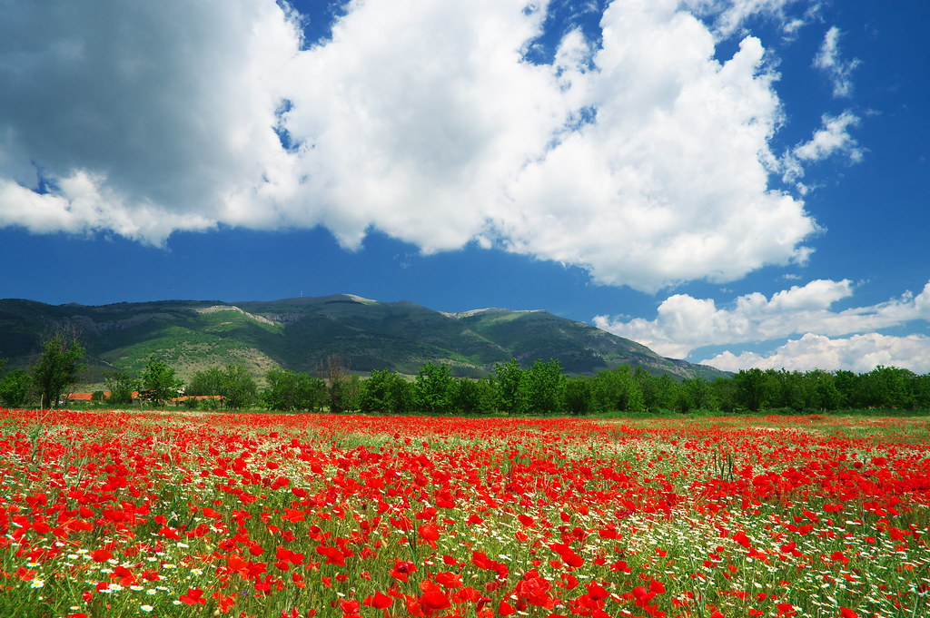
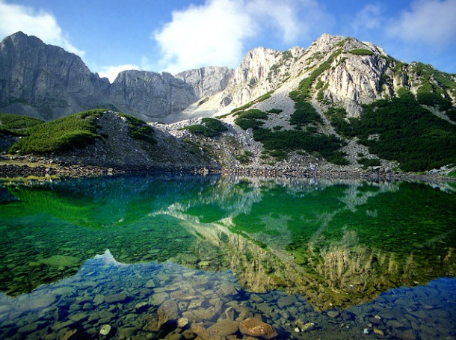
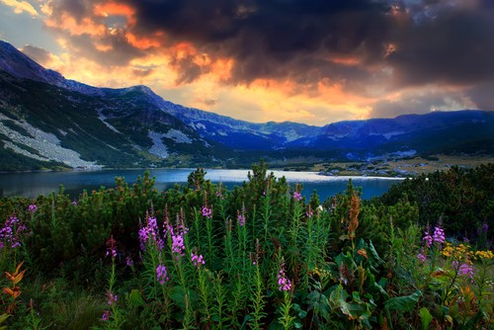
Bulgaria also has many natural attractions.Here are some of them.

Slide 5
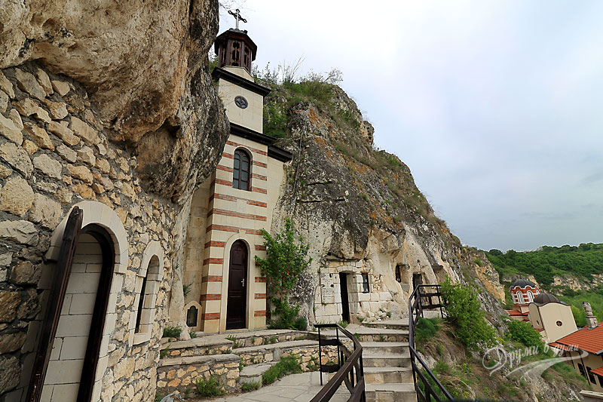
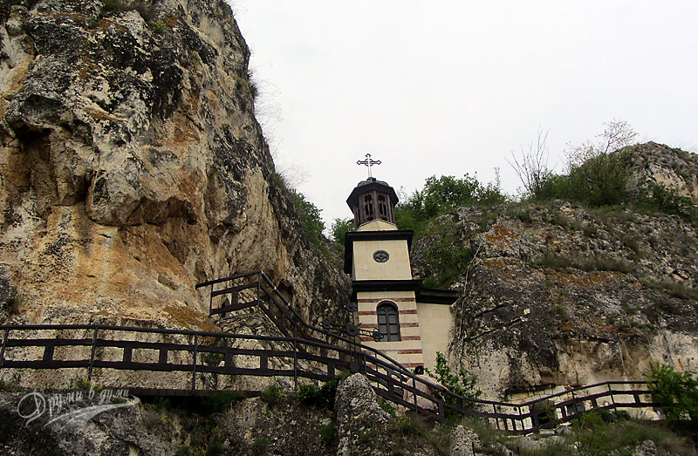
Basarbovsky rock monastery
The monastery dates back to the period of of the Second Bulgarian Kingdom, but the earliest data dates back to the Ottoman tax registers of 1431y. The most famous inhabitant is St. Dimitar Basarbovsky.

Slide 6
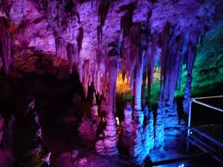
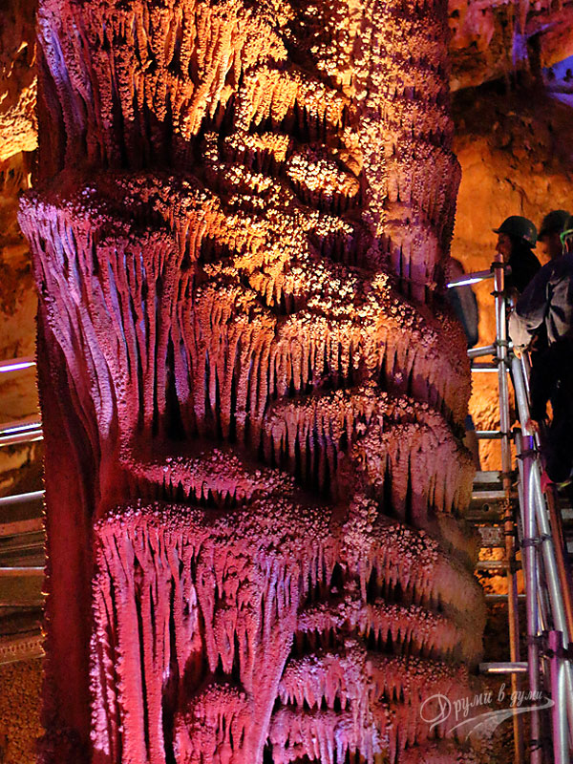
The cave Venetsa
The cave has many different formations. You can see ice crystals, stalactites, stalagmites, aragonite crystals, calcite formations and more. There is an entity similar to Deva Maria.

Slide 7
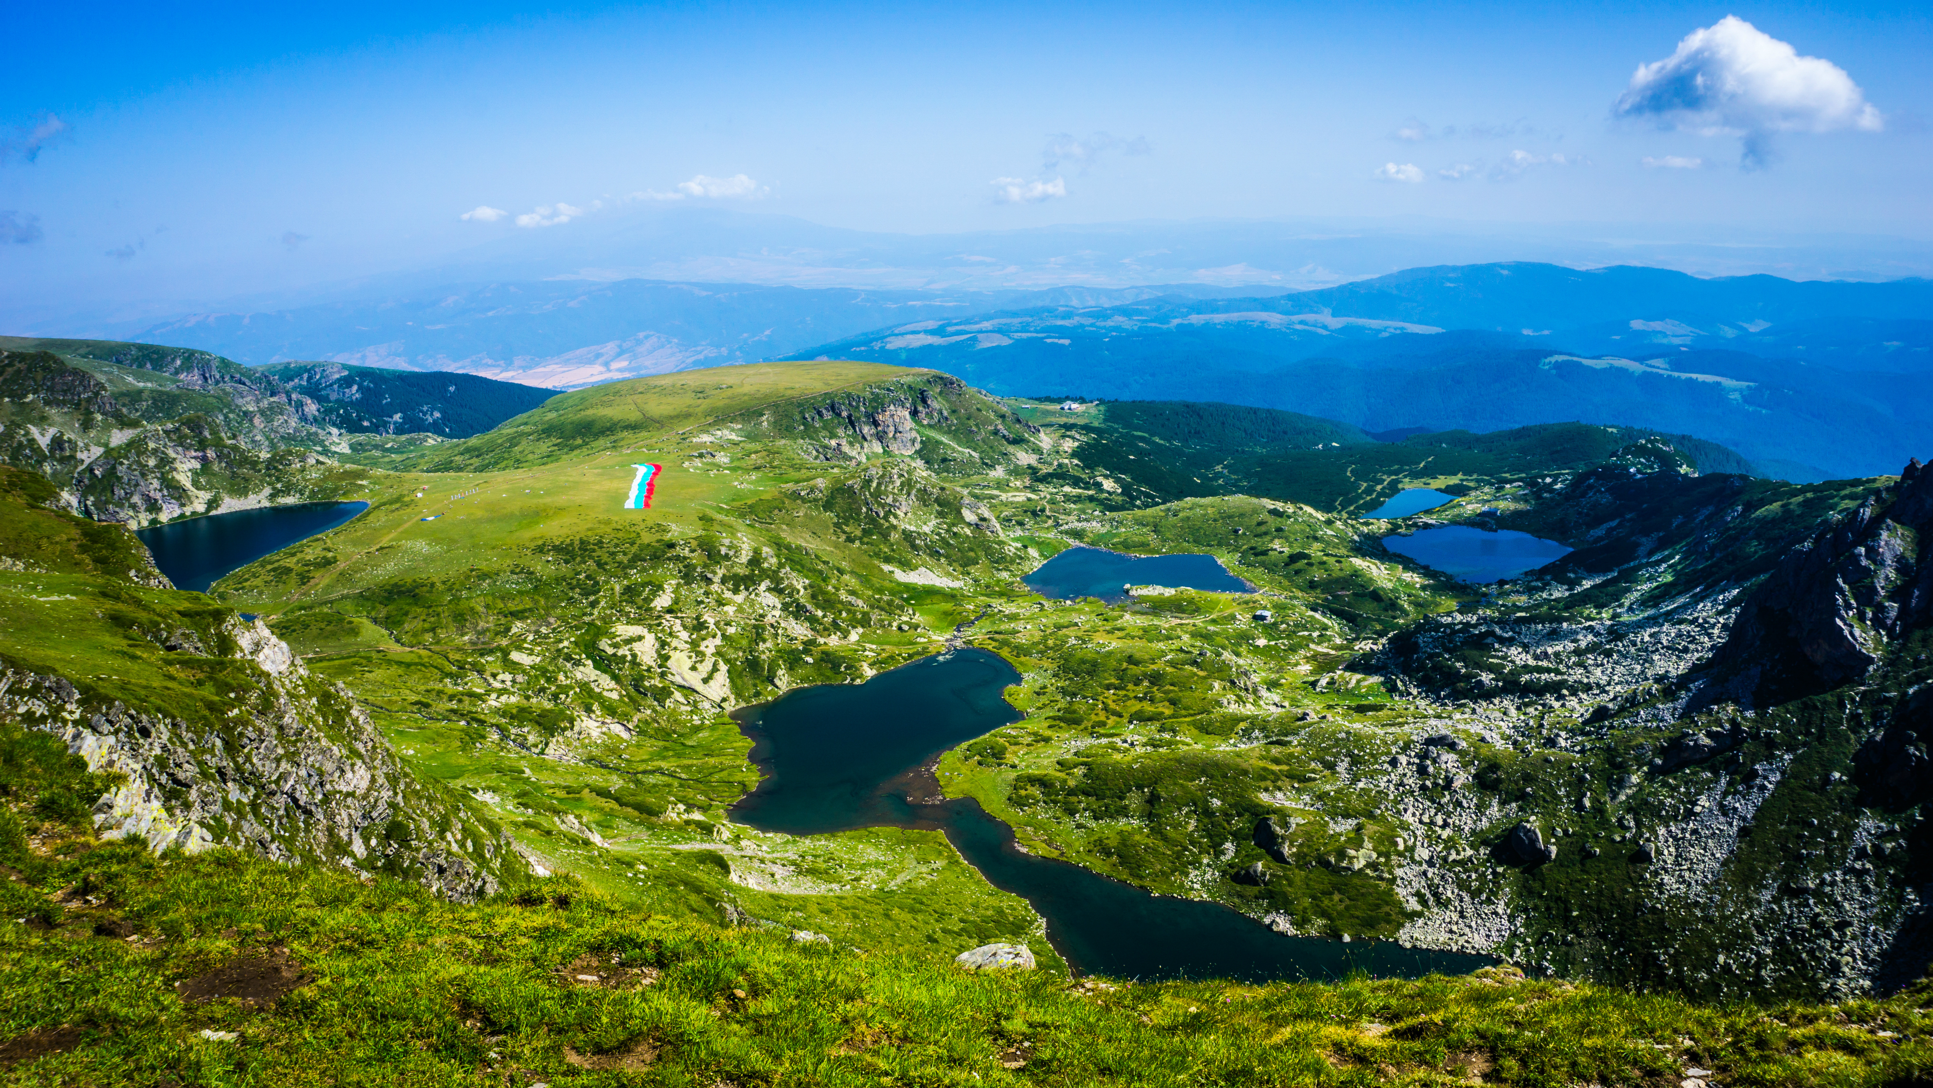
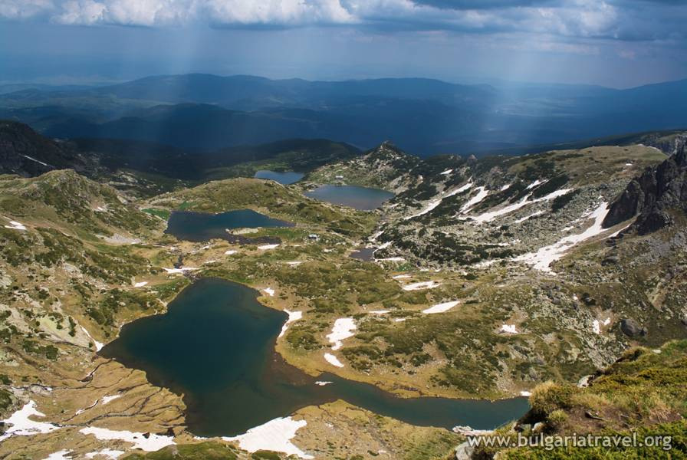
The Seven Rila Lakes
The Seven Rila Lakes is a group of glacial lakes located in the Rila Mountains. The first three lakes – the Tear, the Eye, and the Kidney-drain each separately into the Gemini, from which the water flows successively through the Trefoil, the Fish and the Bottom.

Slide 8
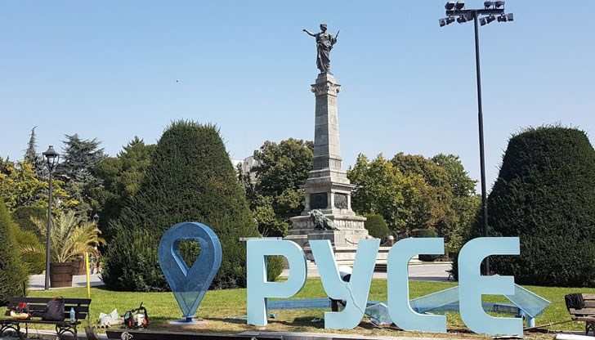
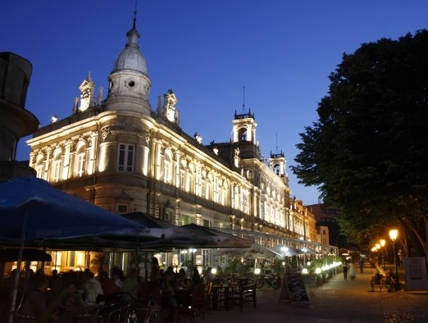
Rousse
Rousse is the largest Bulgarian city along the Dunav River and the fifth largest city in the country. It is located on the north-east border of the country with Romania.

Slide 9
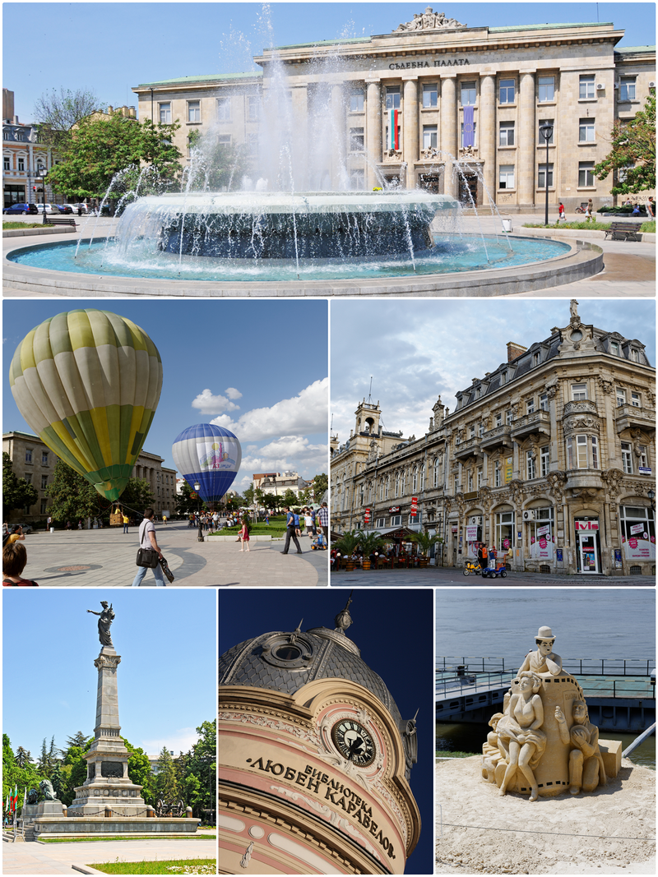
Rousse is the birthplace of a number of Bulgarian national revivalists, patrons of the Bulgarian spirit, revolutionaries and participants in the Liberation.

Slide 10
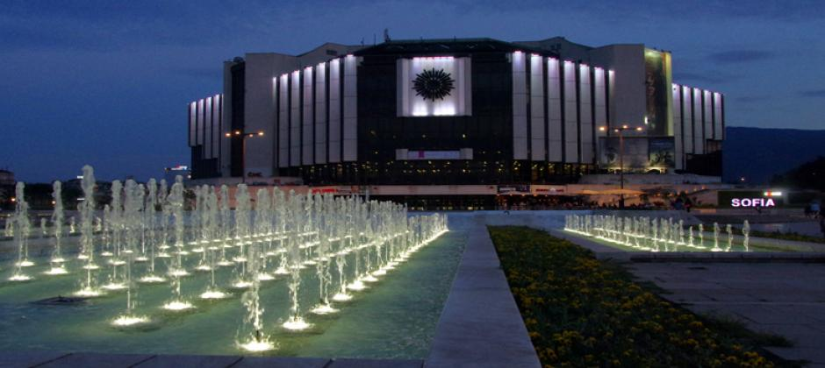
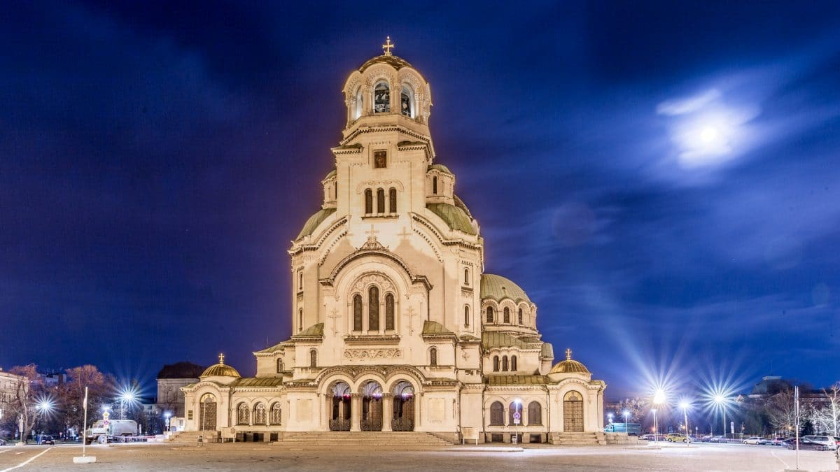
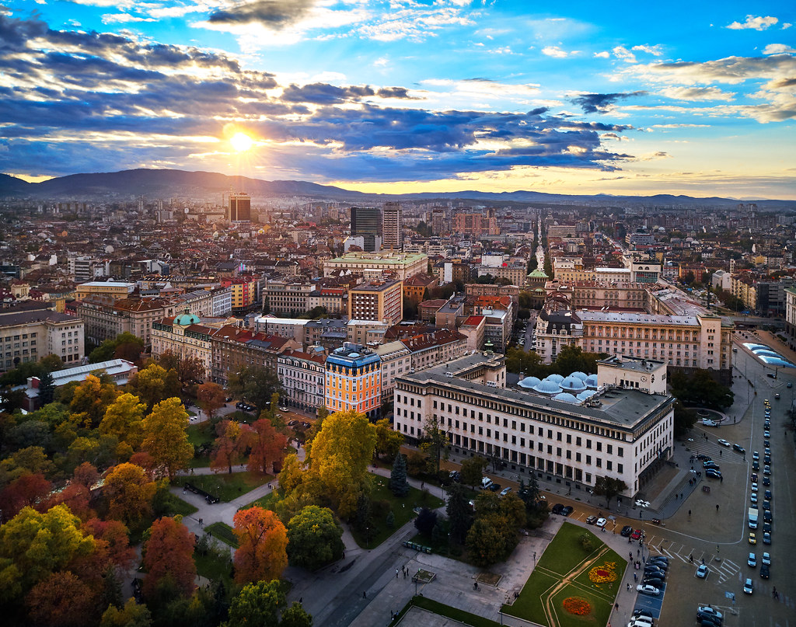
Sofia
Sofia is the capital and largest city of Bulgaria. The city is at the foot of Vitosha Mountain in the western part of the country.

Slide 11
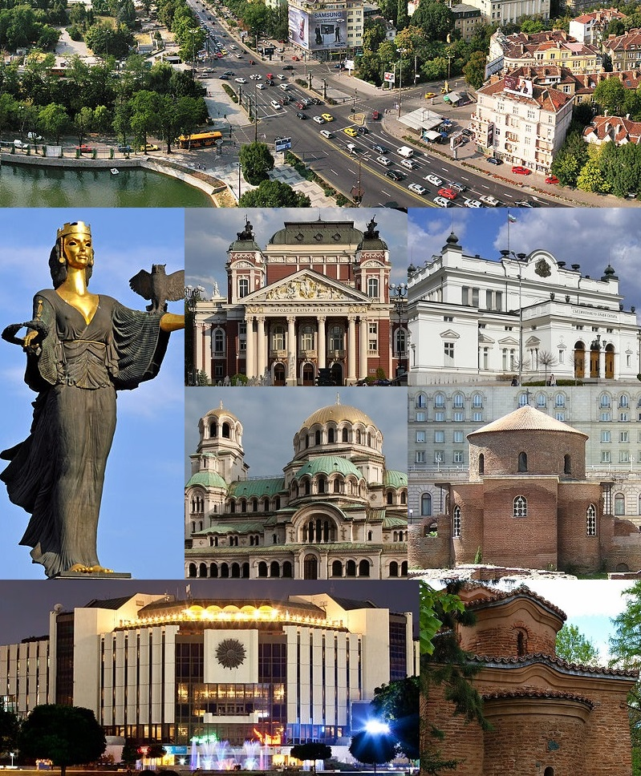
Being in the centre of the Balkans, it is midway between the Black Sea and the Adriatic Sea, and closest to the Aegean Sea.

Slide 12

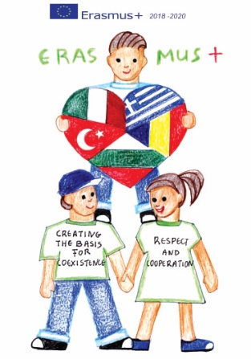
Thank you for your attention!
“CREATING THE BASIS FOR COEXISTENCE, RESPECT AND COOPERATION”
2018-1-RO01- KA229-049097_5
HRISTO BOTEV PRIMERY SCHOOL, Bulgaria, Sliven

