Slide 1
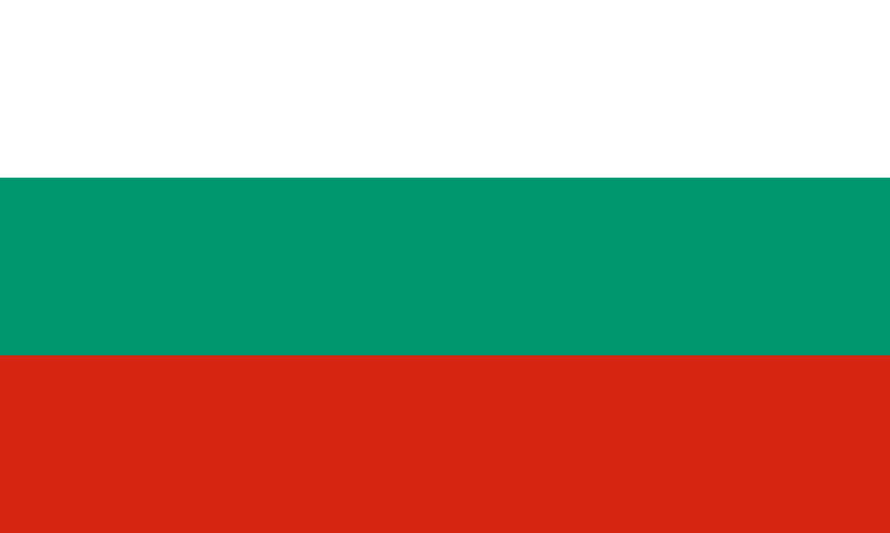
Bulgaria

Slide 2

Do you know anything about my country Bulgaria?
No? I will show you in next 10 minutes ☺

Slide 3
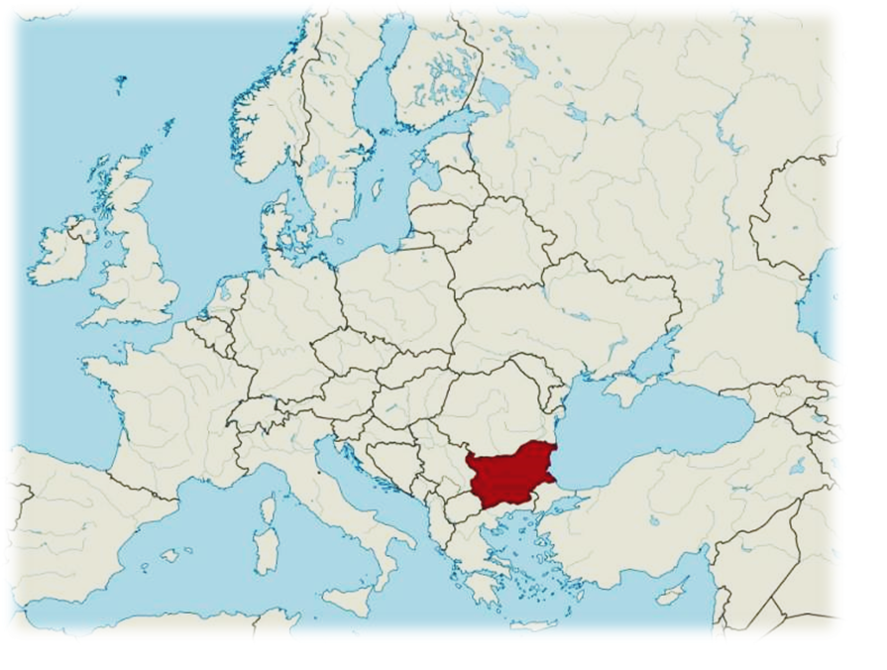
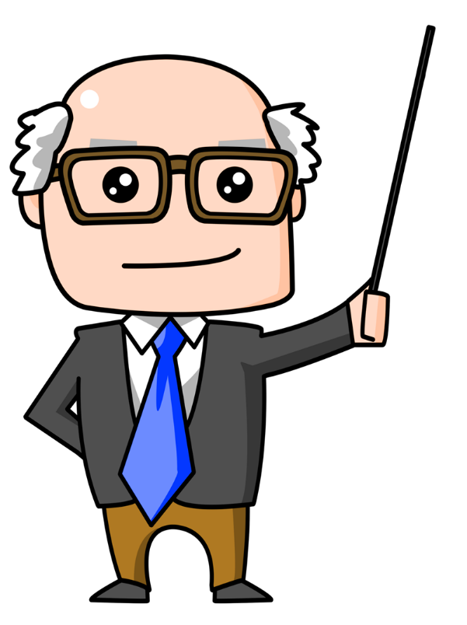
Area 110,993.6 km2
Population 7,000,039
Official language Bulgarian
Government:
Unitary parliamentary republic
• President - Rumen Radev
Location of Bulgaria

Slide 4
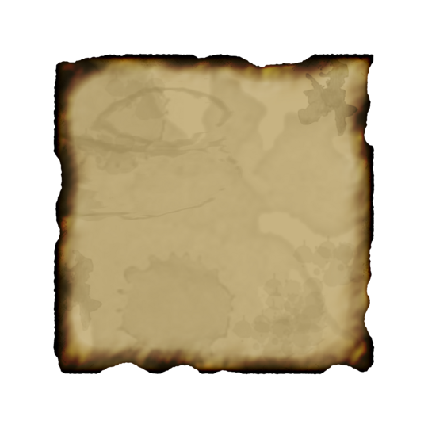

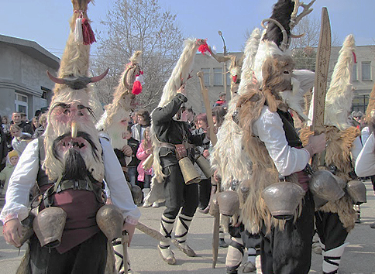
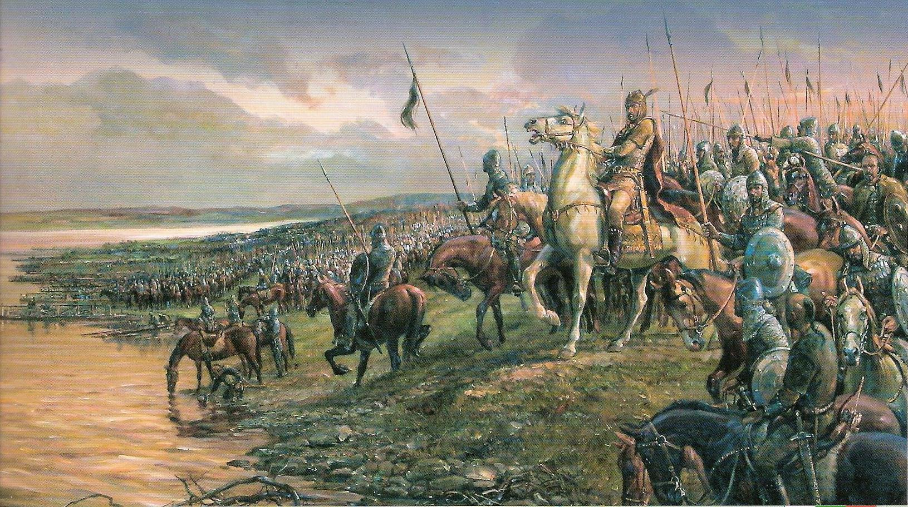
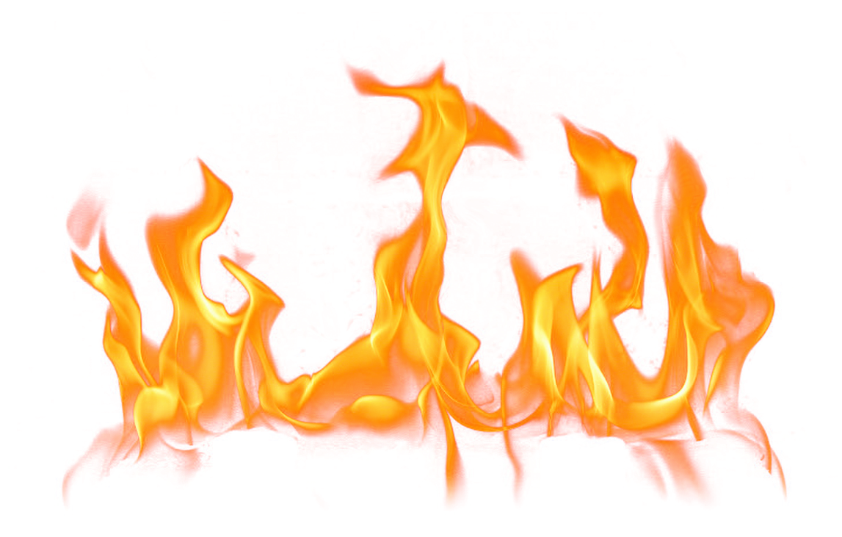
Bulgaria is one of the oldest European countries with 20-century-old history and traditions.

Slide 5
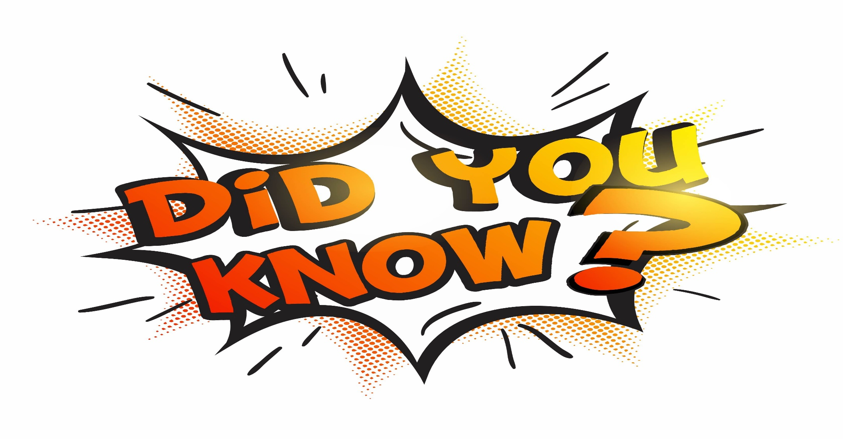
-Bulgaria is the only country in Europe which has kept its name till now?

Slide 6
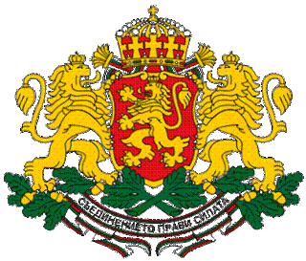
The crest of Republic Bulgaria
Motto:
Съединението прави силата
(Bulgarian)
“ Unity makes strength"

Slide 7
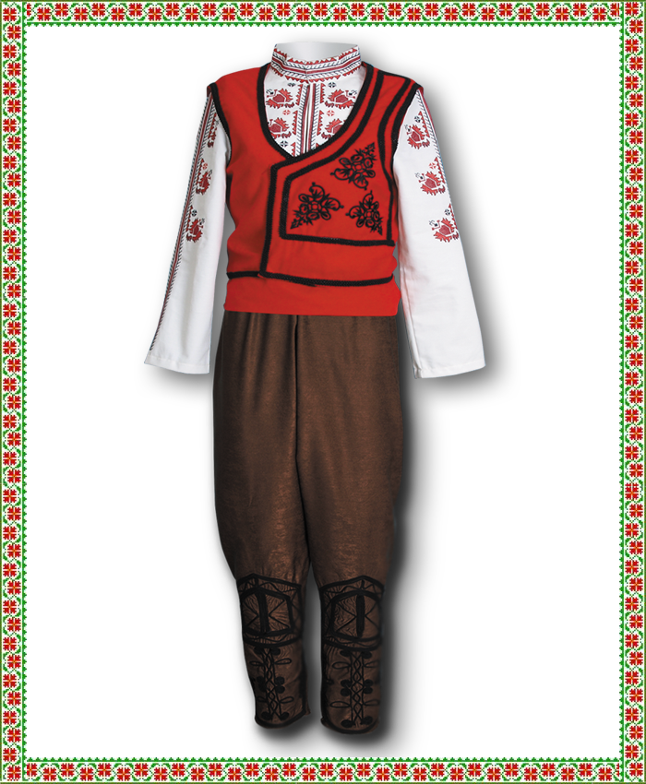
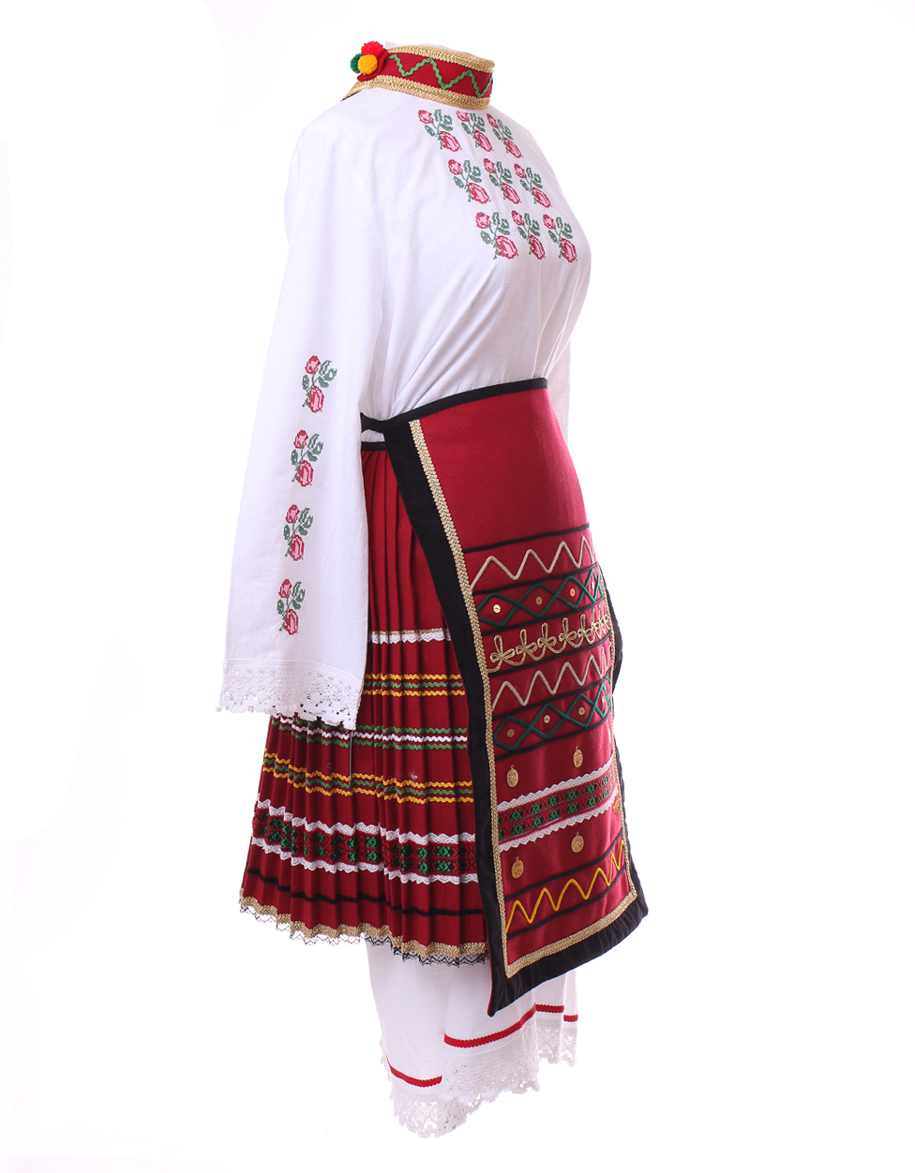
T r a d
I t
I o n a l
C
L
O
T
H
I
N
g

Slide 8
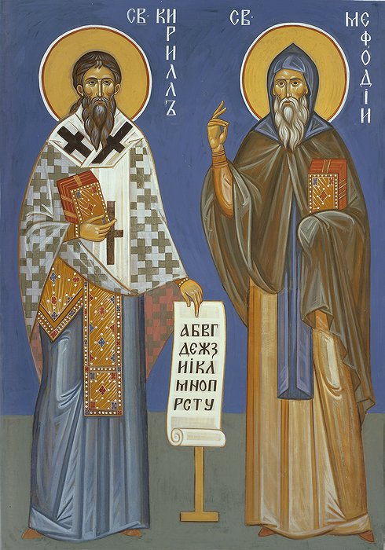
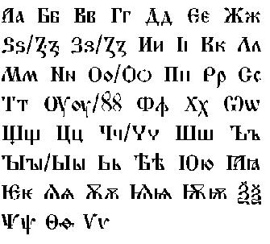
The official language is Bulgarian.
Our alphabet was created by
the brothers Cyril and Methodius.

Slide 9
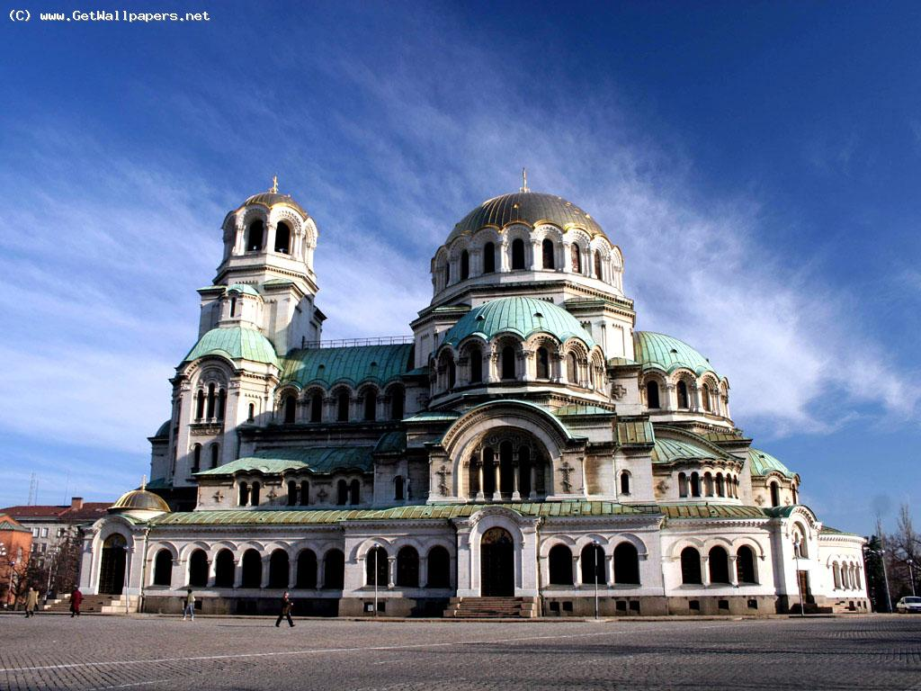
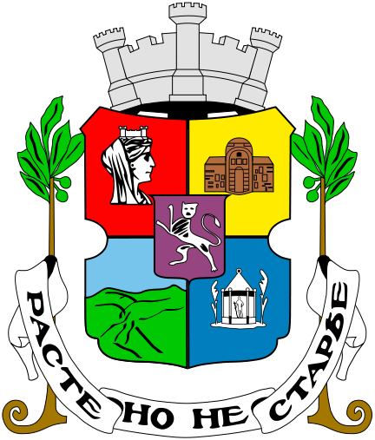
SOFIA – the capital

Slide 10
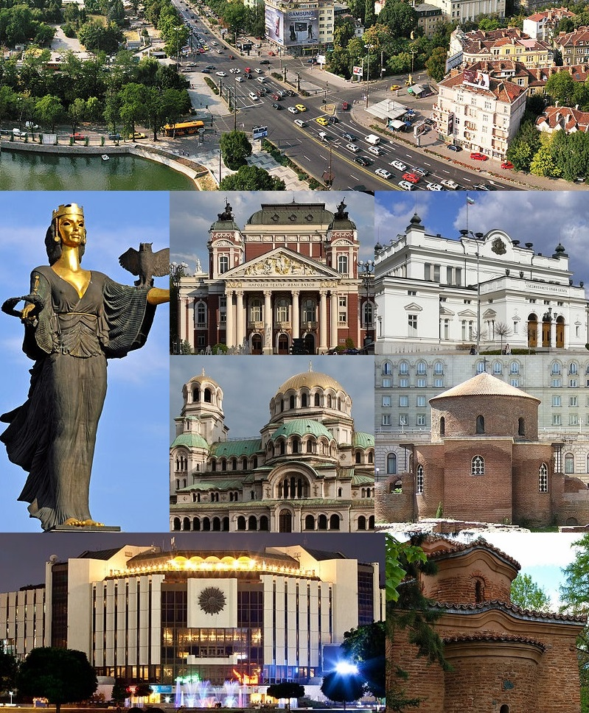
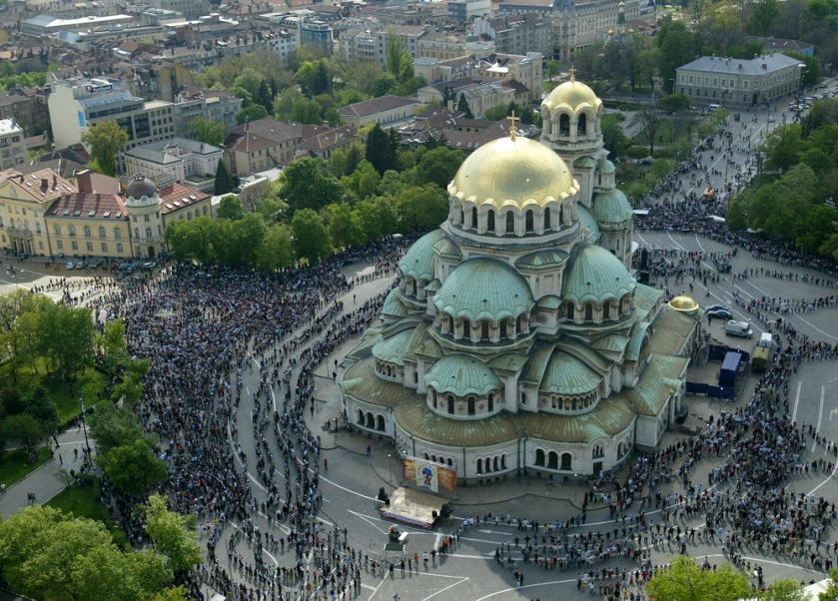
Sofia is the largest city. Founded thousands of years ago, today the city continues to develop . At present, the city has a population of 1,250,000.
Motto: Grows, but does not age
(Расте, но не старее)

Slide 11
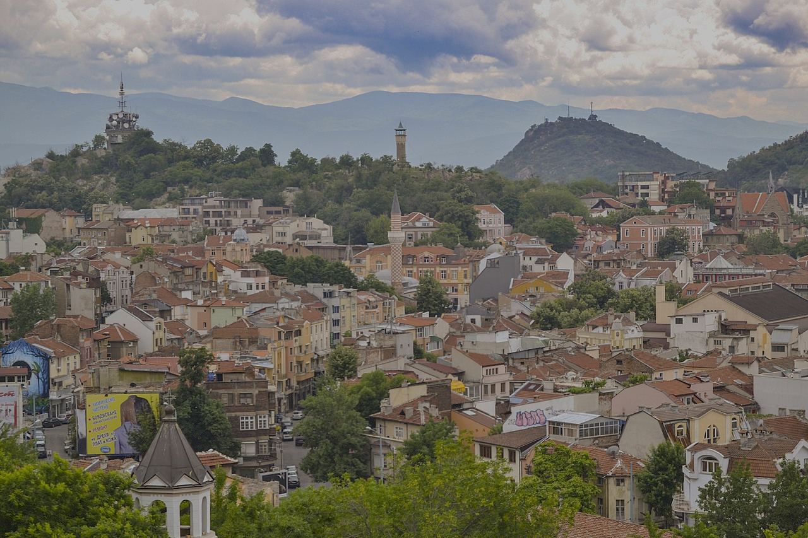
Plovdiv
Plovdiv is the culture capital of Bulgaria.

Slide 12
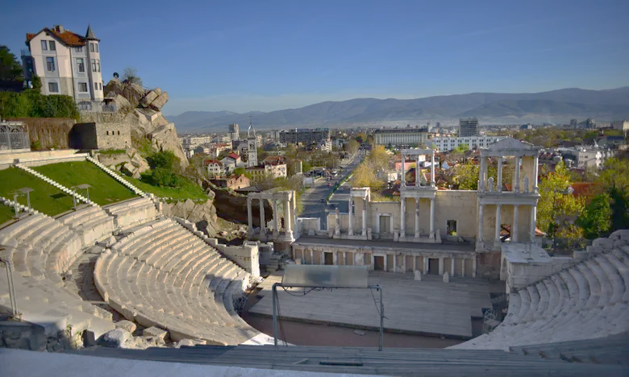
The Ancient Theatre is Plovdiv’s most famous cultural landmark.

Slide 13
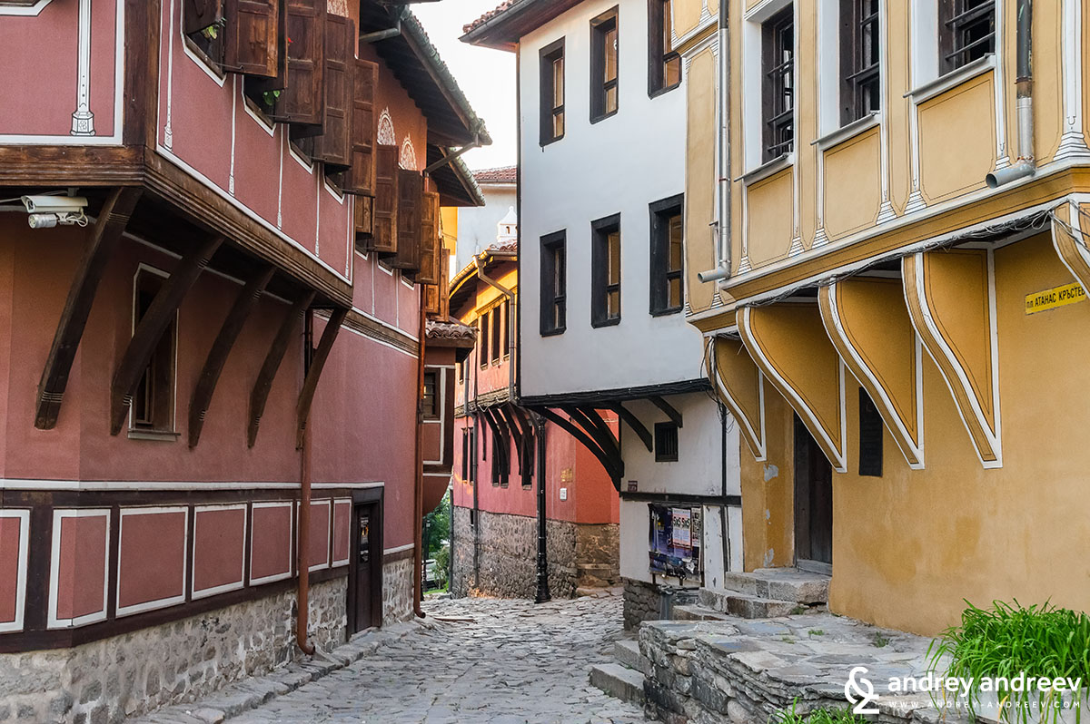
The old town

Slide 14
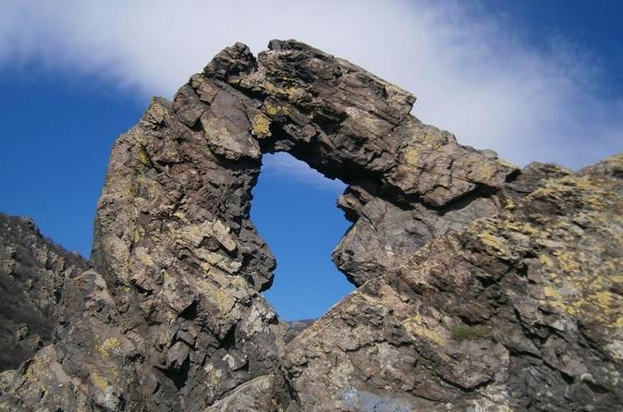
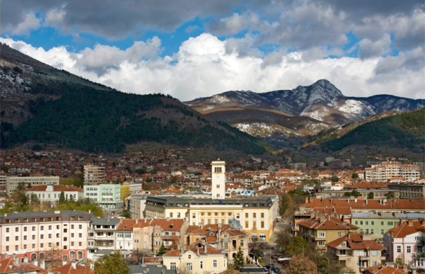
My city Sliven
Halkata - The Ring
This is one of the symbols of Sliven

Slide 15
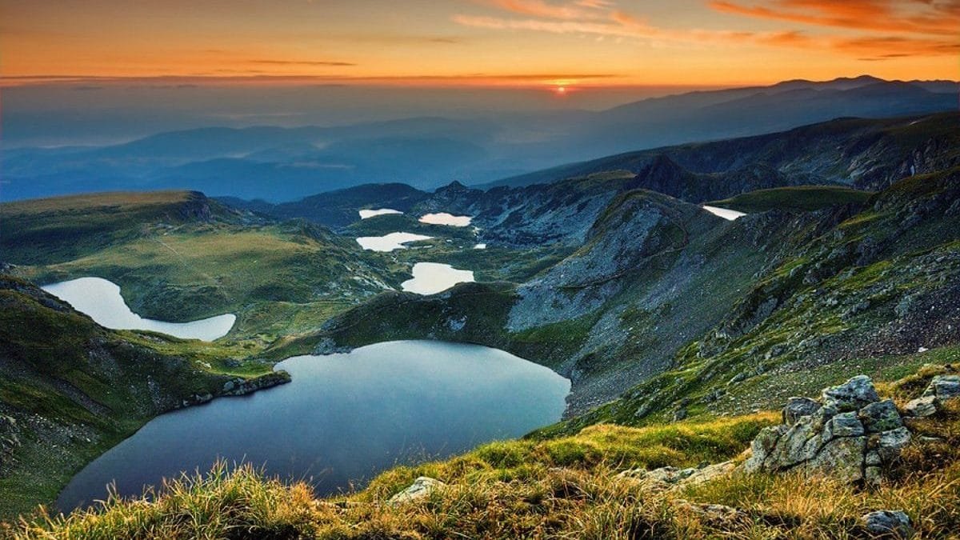
7 Rila Lakes
The 7 Rila lakes are one of the most interest views in Bulgaria.

Slide 16
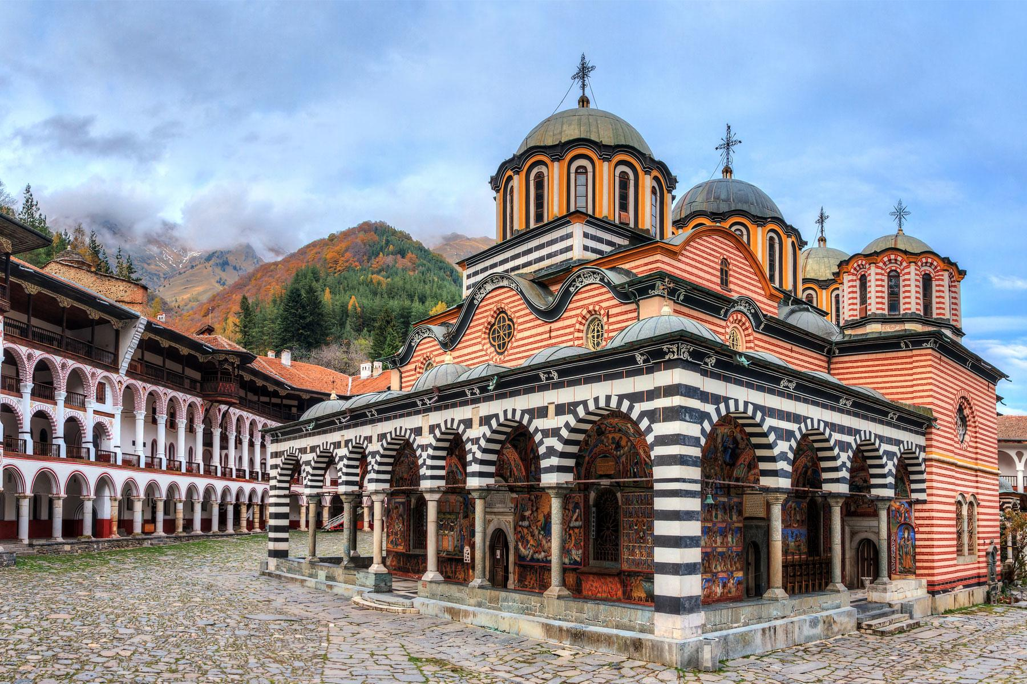
Rilla Monastery

Slide 17
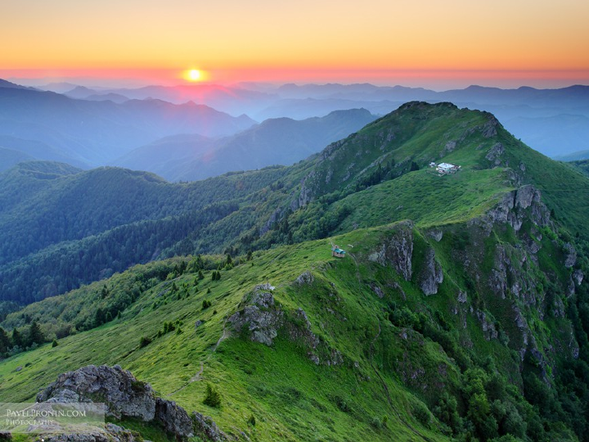
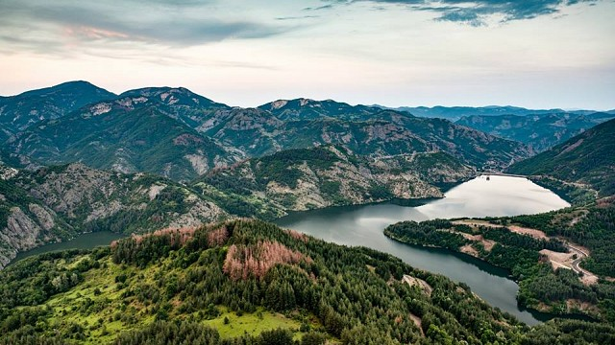
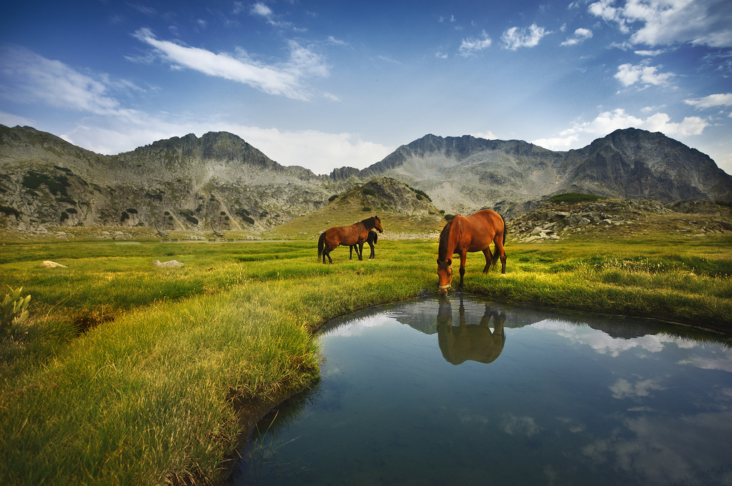
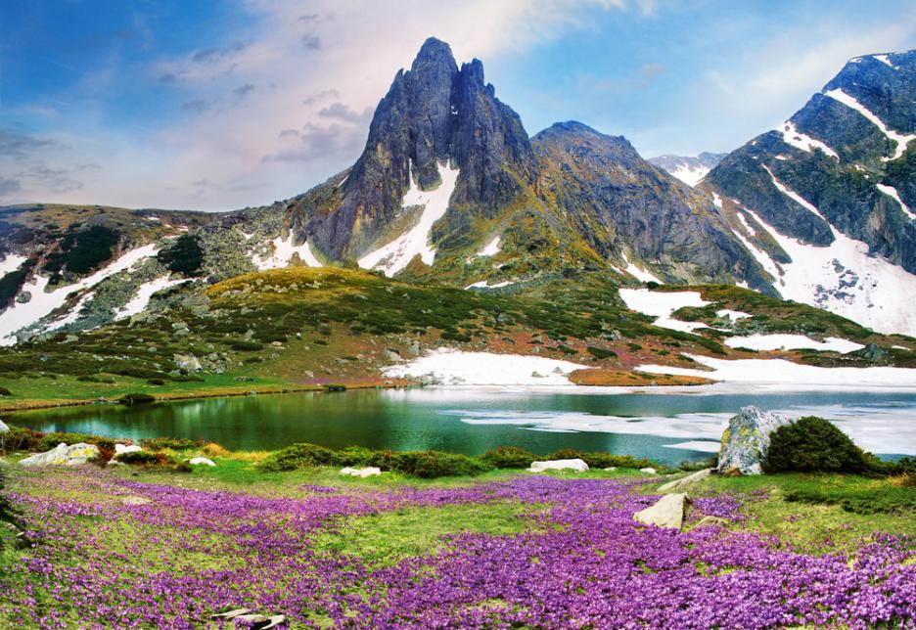
M o u n t a
I n s
Balkan mountain – the longest mountain
Rhodope – the most extensive mountain
Pirin mountain
Rila – the highest mountain

Slide 18
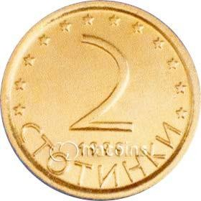
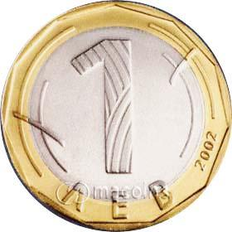
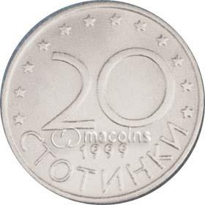
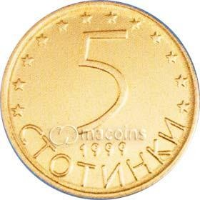
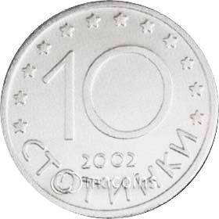
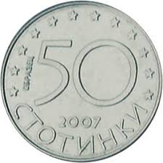
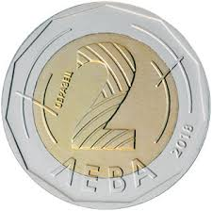
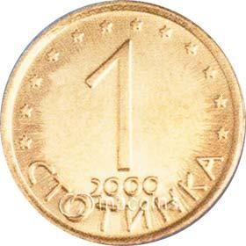
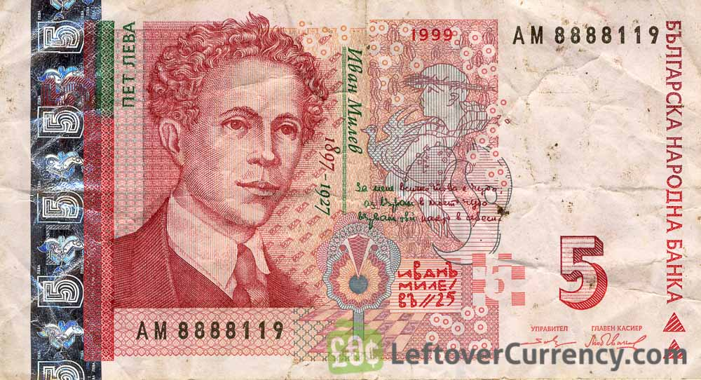
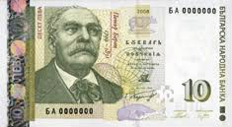
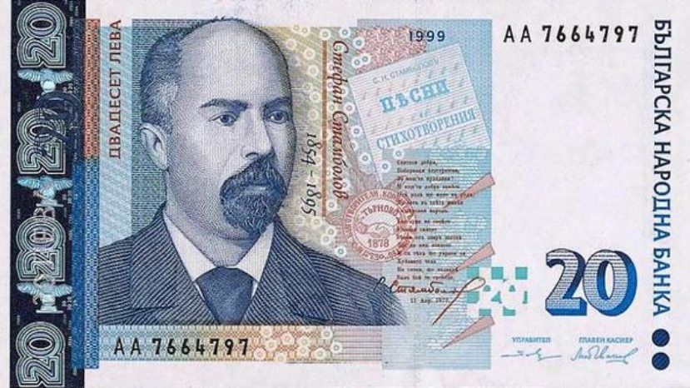
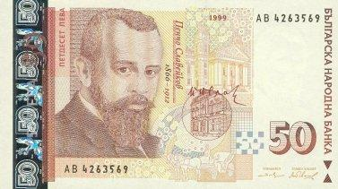
Bulgarian money

Slide 19
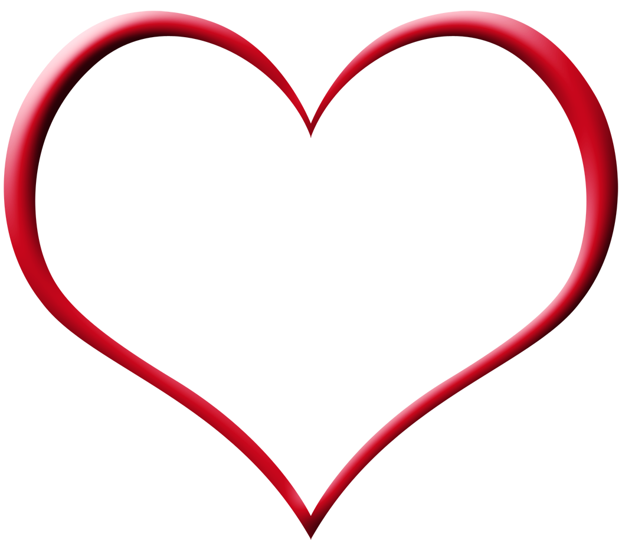
We love our county not because of its power and wealth but because it`s OURS!

Slide 20

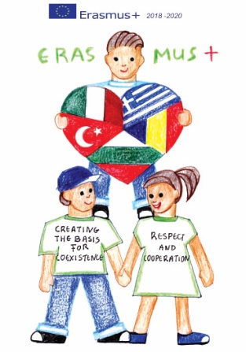
“CREATING THE BASIS FOR COEXISTENCE, RESPECT AND COOPERATION”
2018-1-RO01- KA229-049097_5
Thank you
For attention ☺
Maksim Kaludov
HRISTO BOTEV PRIMARY SCHOOL, Bulgaria, Sliven

