Slide 1

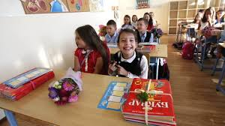
THE BULGARIAN EDUCATIONAL SYSTEM

Slide 2

INTRODUCTION :
The education system in the Republic of Bulgaria has a centuries-old tradition, which makes it a national educational system with extensive experience.
In this presentation, we will briefly outline the changes that have taken place in the education system since the entry into force of the new Law on Preschool and School Education.
HRISTO BOTEV PRIMARY SCHOOL, Sliven,Bulgaria

Slide 3
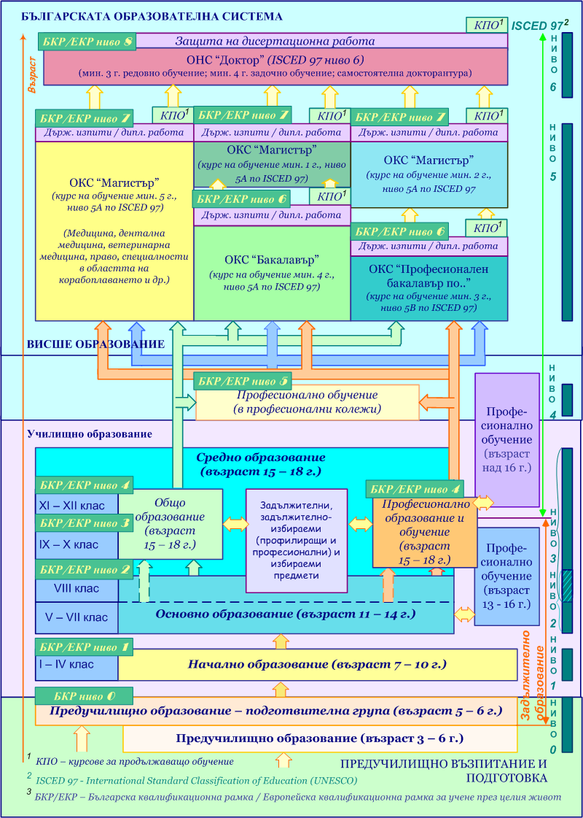
I. Structure of the education system
In the Republic of Bulgaria, school education up to the age of 16 is compulsory. The training process is organized as follows:

Slide 4
I. Structure of the education system

Slide 5

Preschool education
I. Structure of the education system
Preschool education in Bulgaria includes children from 3 years of age up to enrollment in the first grade (6/7 years). The pre-school preparation of the children two years before their enrollment in the first grade is compulsory.
The main goal of pre-school education in Bulgaria is to build skills and values for the school environment in children. The compulsory two-year pre-school preparation is organized in preparatory groups in kindergartens or in preparatory groups at school and no tuition fee is paid.

Slide 6

School education
I. Structure of the education system
School education in Bulgaria starts at the age of 7. At the discretion of parents / guardians, 6-year-old children may attend school if their physical and mental development permits.
School education is by grade level and secondary, and by content the preparation is general and professional.

Slide 7
Secondary education
I. Structure of the education system
Secondary general education is provided in general education schools (3 and 4 years of education) and in specialized schools (4 and 5 years of education).
Students are admitted to specialized or vocational schools after passing the entrance exams after VII or VIII class in Bulgarian language and literature, Mathematics, humanities, etc., or under the terms and conditions of Ordinance No. 11 of March 28, 2005 for admission students in public and municipal schools. Restrictions based on race, nationality, gender, ethnic and social background, religion, and social status are not allowed.

Slide 8
Higher education
I. Structure of the education system
With regard to higher education, it should be noted that the Law in Bulgaria provides full autonomy in the activities of higher education institutions. The higher education system organizes post-secondary education to obtain the following educational qualifications:
Bachelor's Degree, for which the acquisition in accordance with the curriculum requires:
not less than 180 credits with a period of study of not less than three years - "professional bachelor of ...";
not less than 240 credits with a training period of not less than 4 years - "bachelor".
The training in the degree "bachelor" under para. 1, item 1 in accordance with the curriculum provides broad-based training or specialized vocational training in professional fields and specialties.

Slide 9
Higher education
I. Structure of the education system
Master's Degree, which requires:
not less than 300 credits according to the syllabus with a training period of not less than 5 years;
not less than 120 credits after having acquired a professional bachelor's degree in ...;
not less than 60 credits after obtaining a Bachelor's Degree.
The Master's degree program provides a thorough fundamental preparation combined with profiling in a particular specialty.

Slide 10
Higher education
I. Structure of the education system
Doctoral Educational and Scientific Degree - The training is organized in doctoral programs after having obtained a Master's Degree. The period of preparation and independent research work for full-time and independent form of training is up to 3 years, and for part-time and distance learning - up to 4 years. By way of derogation, as may be specified in the regulations of the relevant higher education institution or scientific organization, the period may be extended by up to one year.

Slide 11
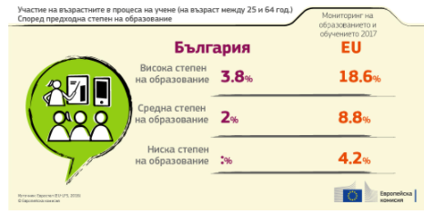
Adult education and training
I. Structure of the education system
Adult education and training has been accepted as a tool for the development of human resources in several strategies and in the national plan of Bulgaria. The main goal of adult learning and education is to improve the level of qualification of unemployed and employed persons and to enable them to adapt to the rapidly changing work and living environment.

Slide 12
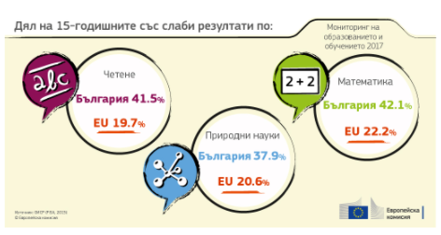
II. Where is Bulgarian education in Europe?
In Bulgaria, more attention is paid to inclusive education.
Bulgaria continues to lag behind most of the EU average on individual indicators in the field of education. Inequality remains a major problem and an objective to overcome within the Union.

Slide 13
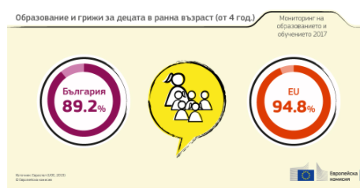
Increasing participation in high quality education and care for young children is a challenge

Slide 14
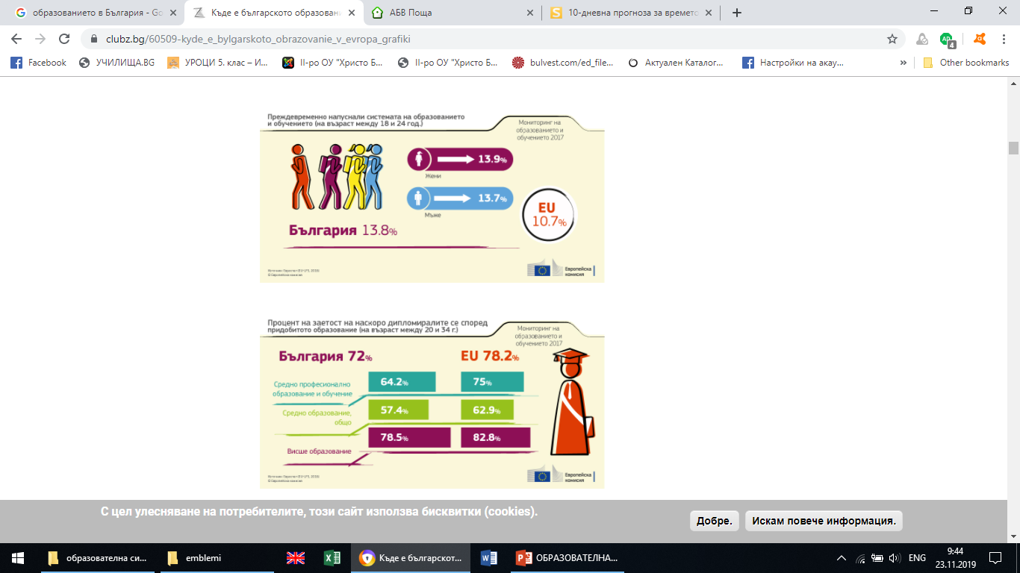
Early school leaving (ESL).
II. Where is Bulgarian education in Europe?

Slide 15
In Bulgaria, teaching staff is among the fastest aging in the EU.
II.Where is Bulgarian education in Europe?

Slide 16
THANK YOU FOR YOUR ATTENTION!

