Slide 1
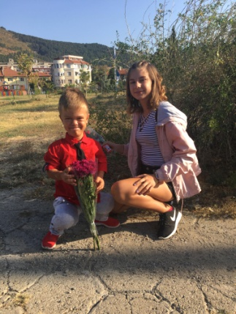
Hello, I'm Staniela Ivanova! I am 13 years old. I have a brother. His name is Nikolay. He is younger than me. He is 9 years old .

Slide 2
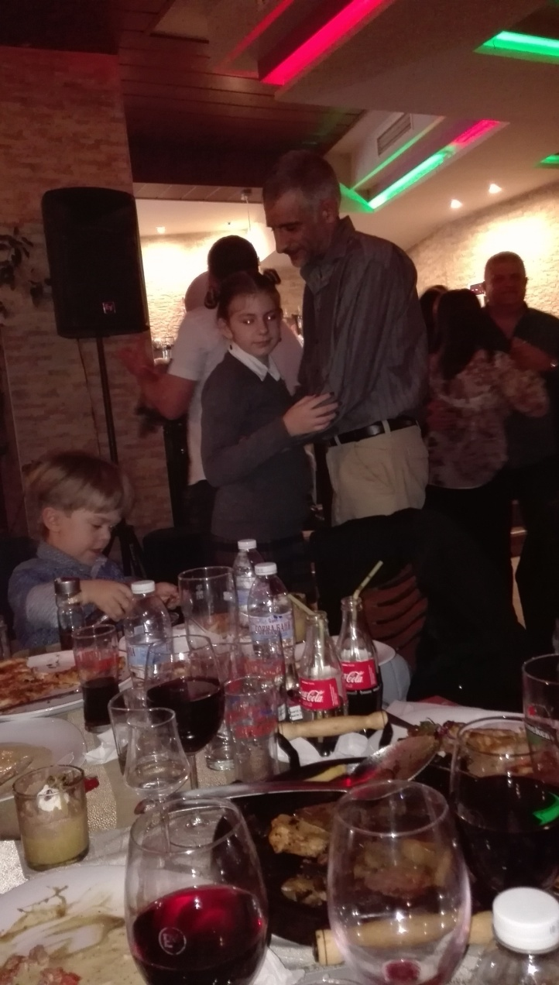
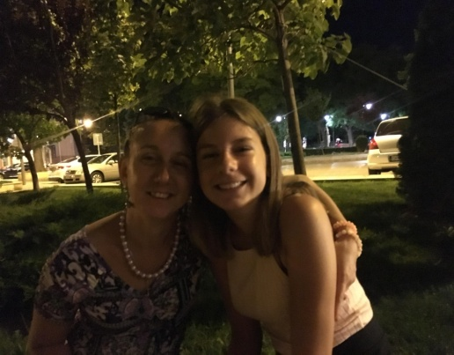
My father’s name is Krasimir and my mother’s name is Daniela. I love my family a lot.

Slide 3
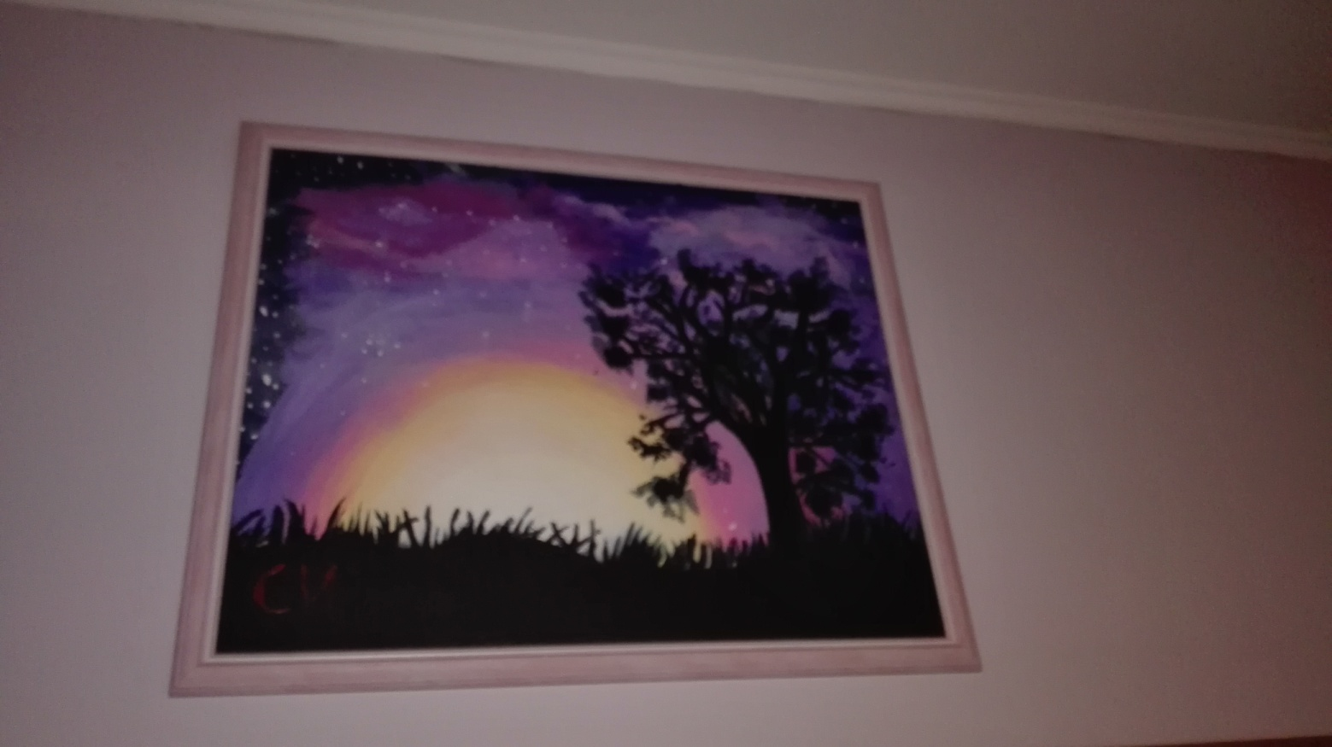
My hobby is drawing. I have been going to draw lessons since 2016 and I’m getting better

Slide 4
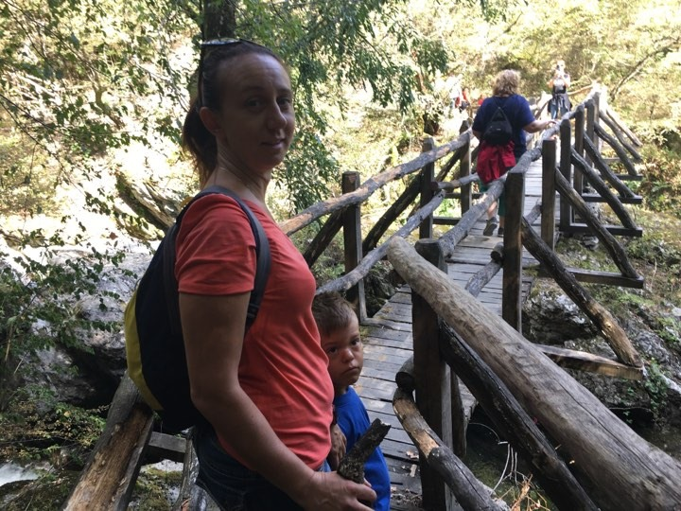
I like to have fun with my family and my friends. My family and me like to travel, take walks in nature and spend more time together. We recently visited the town of Kalofer. This is the hometown of Hristo Botev.

Slide 5
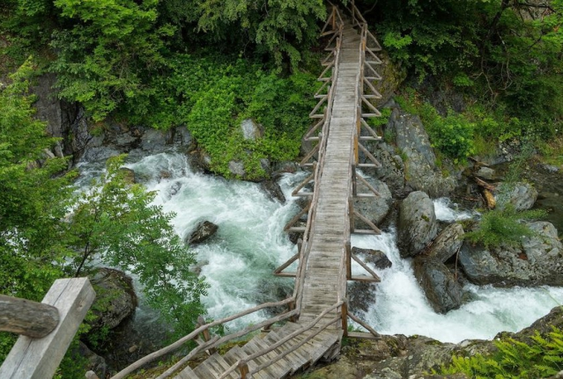
There is an eco path called White River there. Together we managed to pass it in five and a half hours

Slide 6
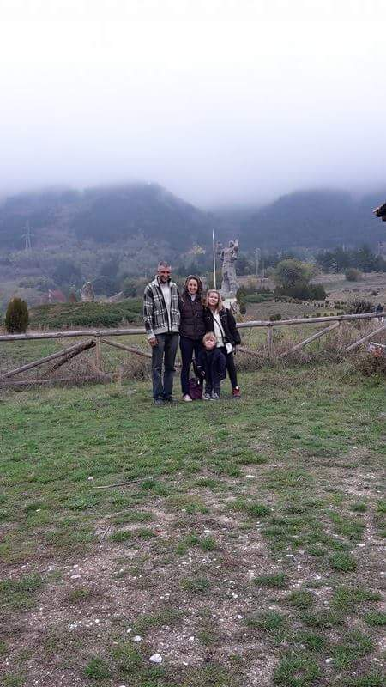
In conclusion, I would like to say that
I love my family and friends a lot!

