Slide 1
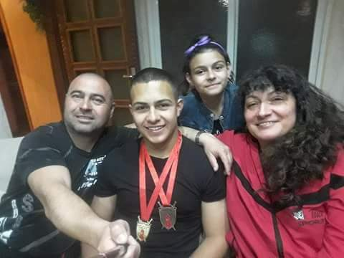
Me and my family.

Slide 2
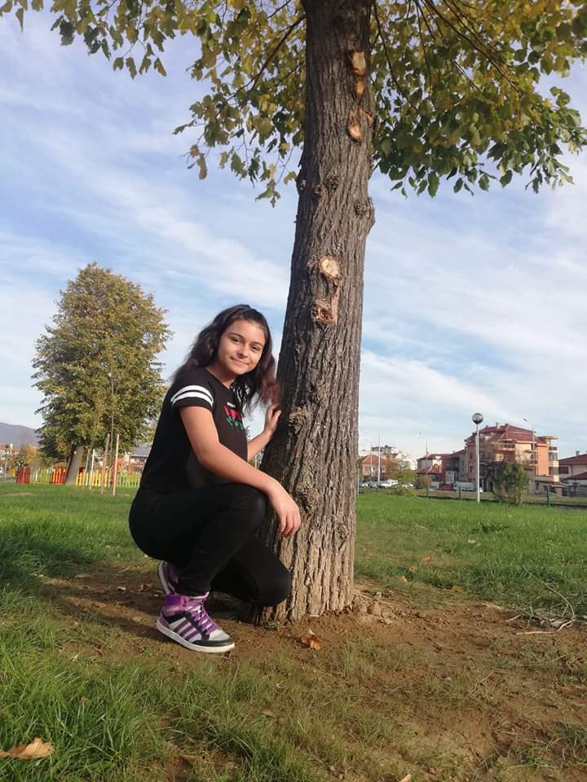
I`m Alexandra.I`m thirteen years old.I live in Bulgaria-Sliven.

Slide 3
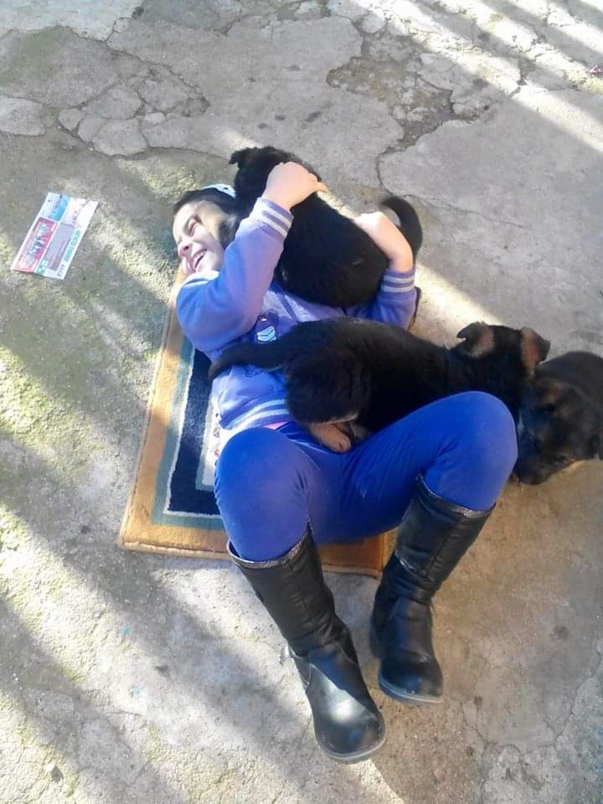
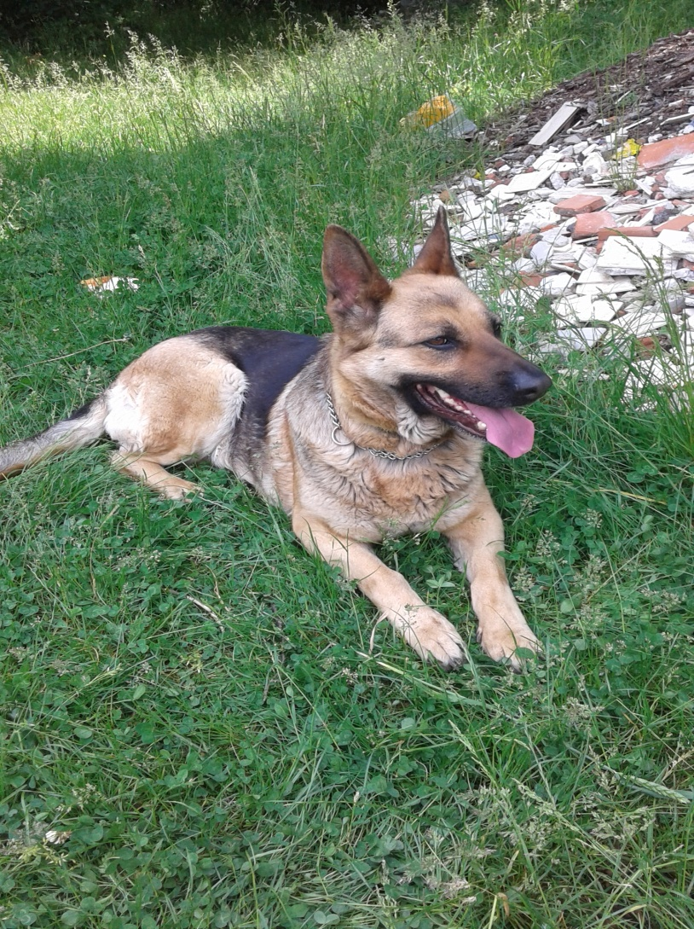
I love animals and this is my dog Abby. She is very good.

Slide 4
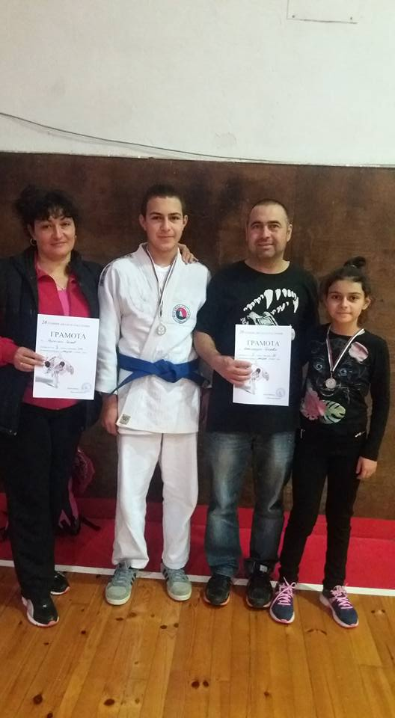
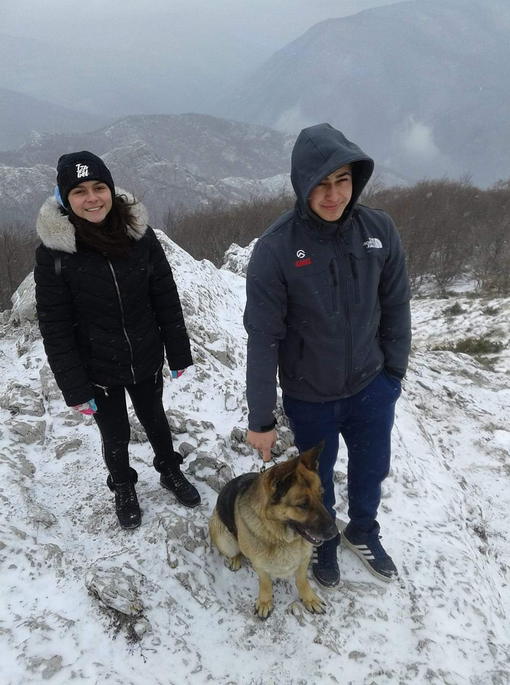
This is my brother.His name is Radostin and he is seventeen years old . Both of us train judo and we win a lot of medals.

Slide 5
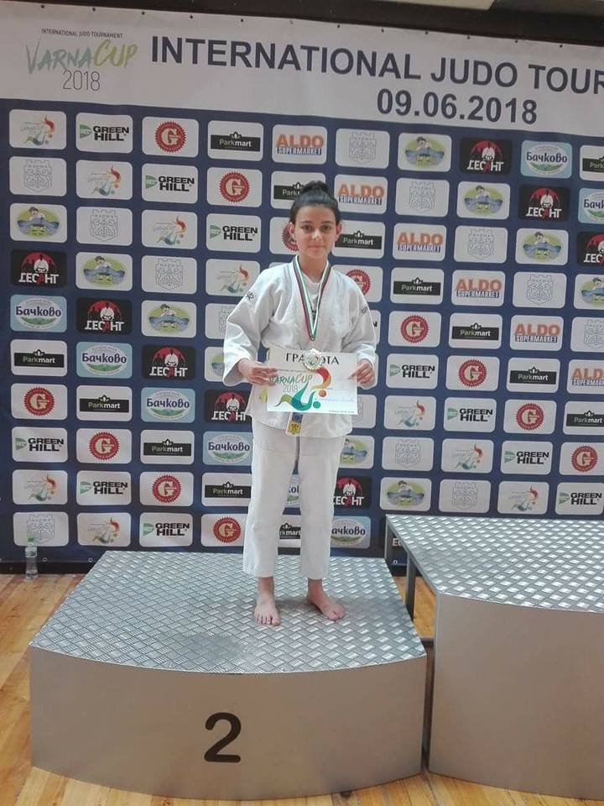

We both take place in international judo racing.

Slide 6
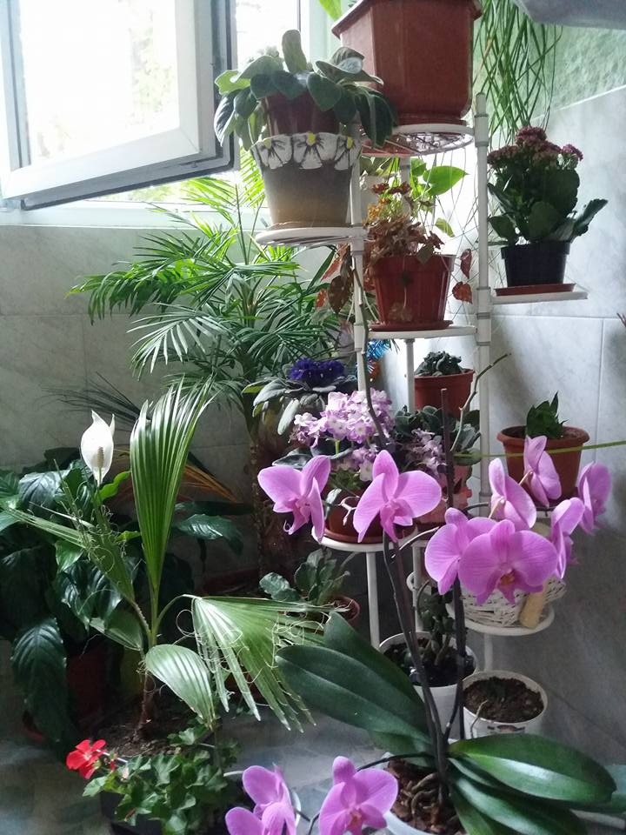
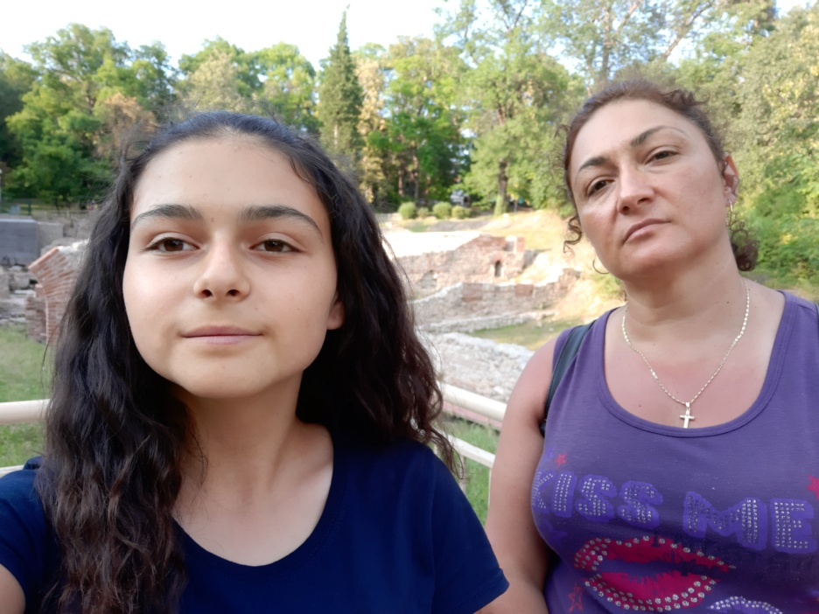
My mum loves flowers.

Slide 7
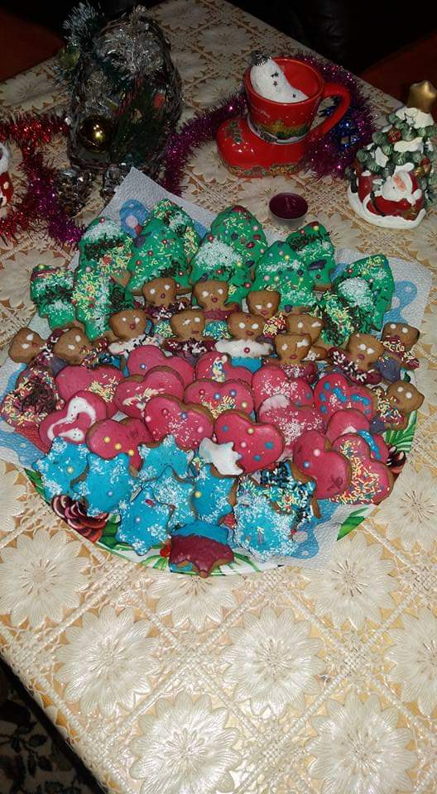
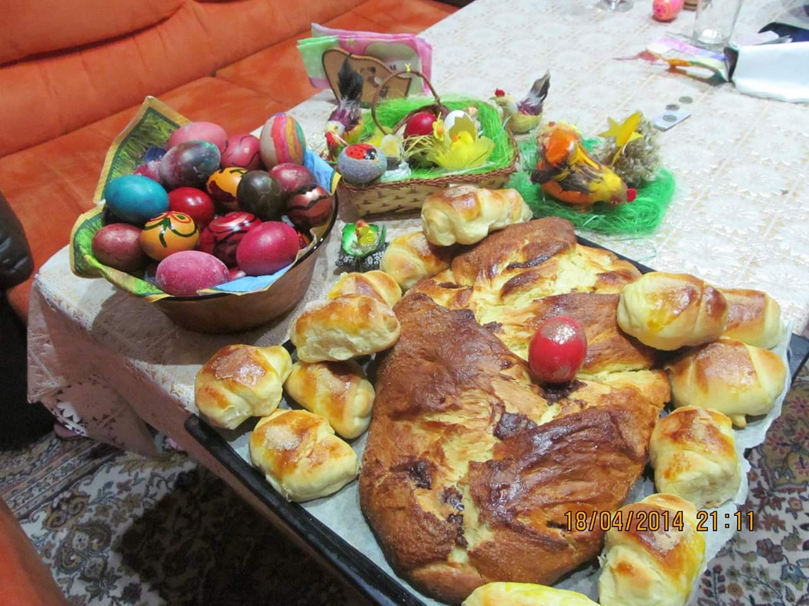
We both like baking biscuits and cakes for the holidays.

Slide 8
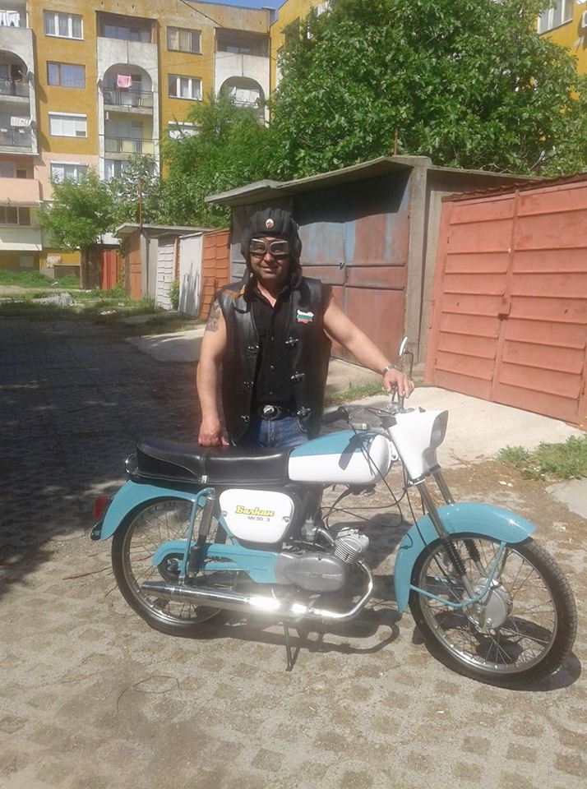
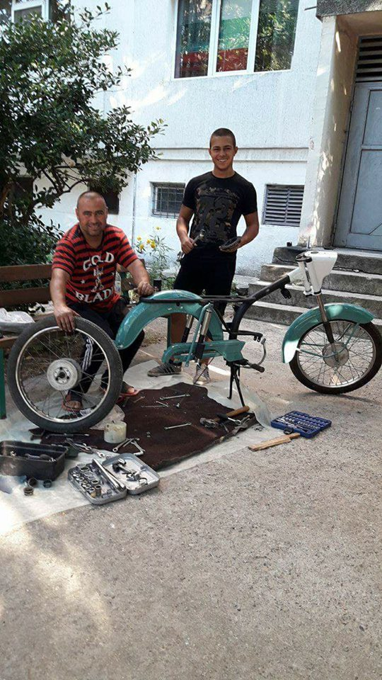
My dad loves old cars and motorbikes.

Slide 9
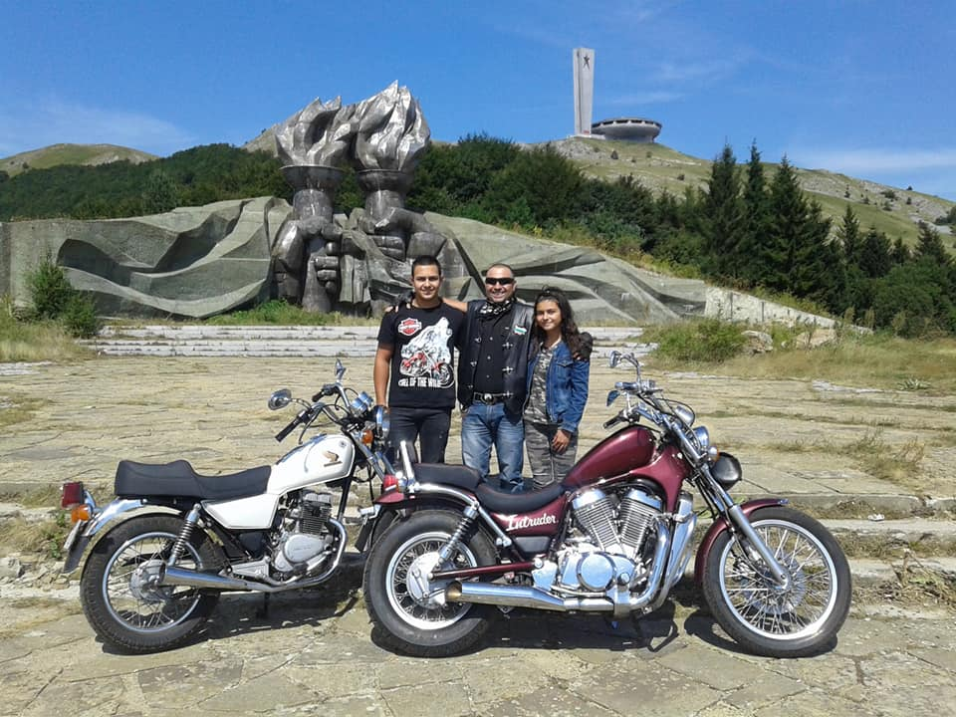
We often go on road trips by motorbike together.

Slide 10
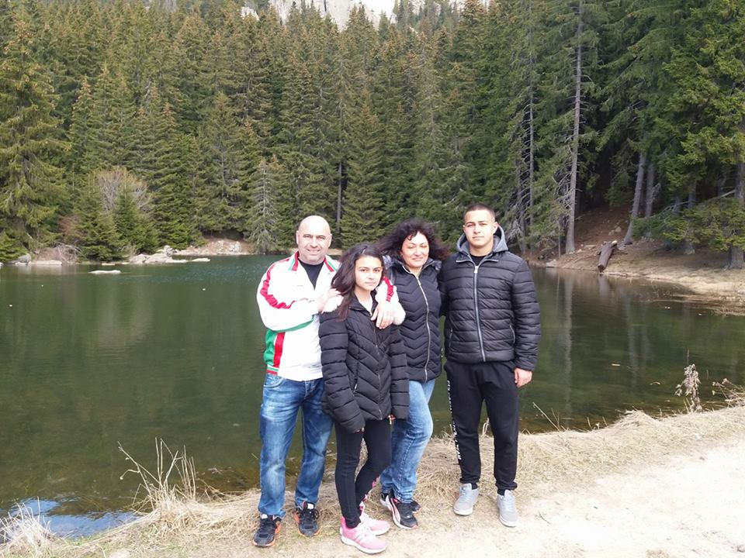
I LOVE MY FAMILY.

Slide 11



THANKS FOR THE ATTENTION
“CREATING THE BASIS FOR COEXISTENCE, RESPECT AND COOPERATION”
2018-1-RO01- KA229-049097_5
HRISTO BOTEV PRIMARY SCHOOL, Bulgaria, Sliven

