Slide 1
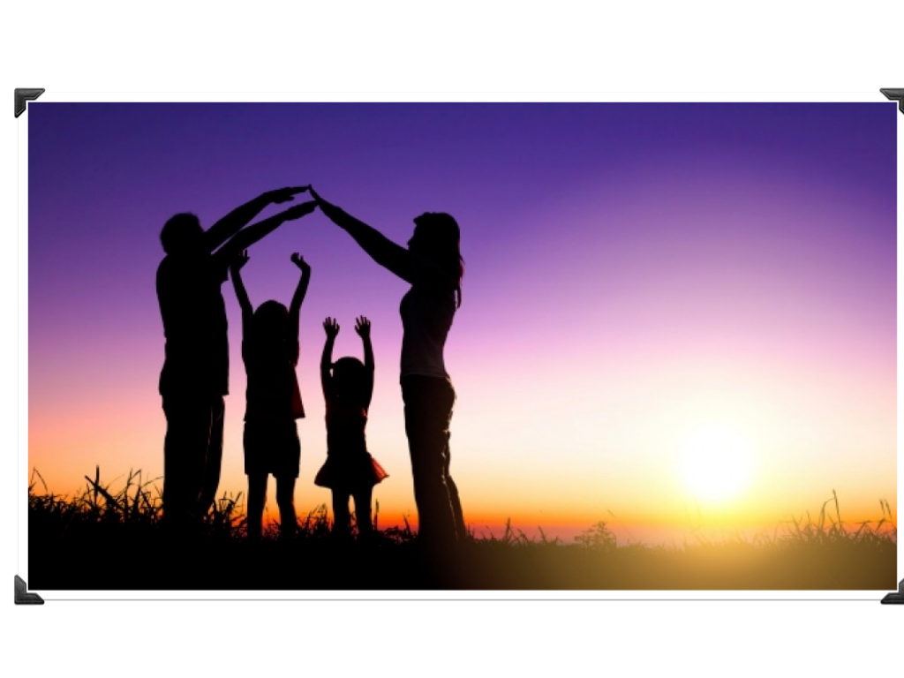
My family

Slide 2
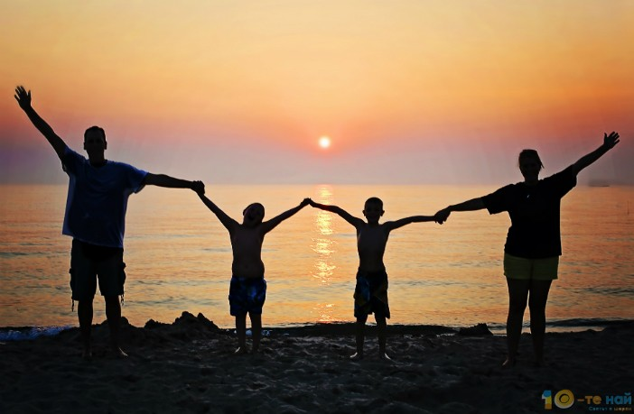
My name is Konstantin Atanasov, I am 13 years old and I live in the village of Samuilovo. I live together with my mother Jana and my older sister Veselina. My family is small, but united.

Slide 3
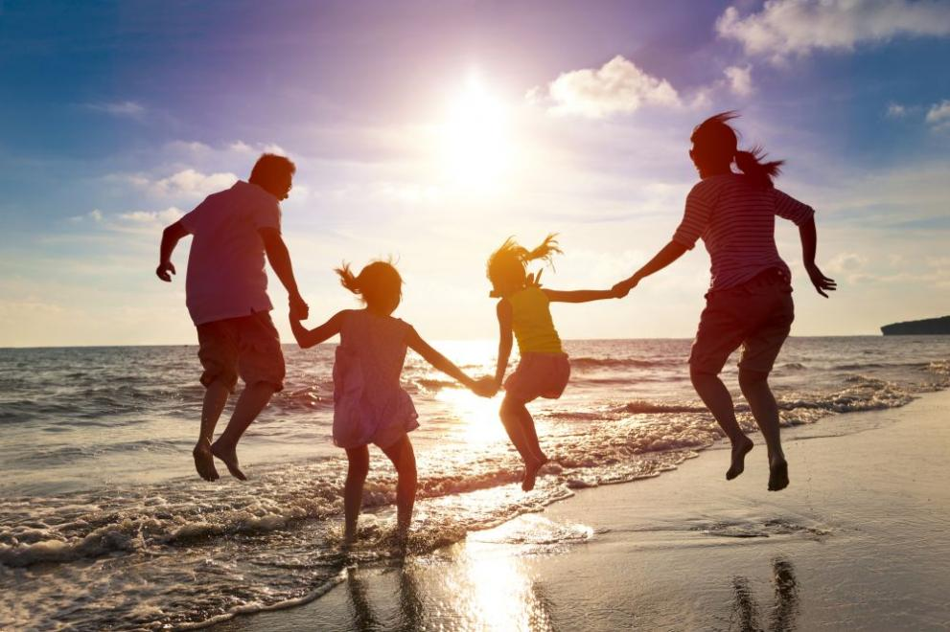
My mother is an agronomist and my sister is a student in Sofia. My grandfather, who is alone, lives in our village. I visit him every day and he supports me a lot in all my schoolwork. When he was young he was involved in wrestling and later he became a coach, and now he is retired.

Slide 4
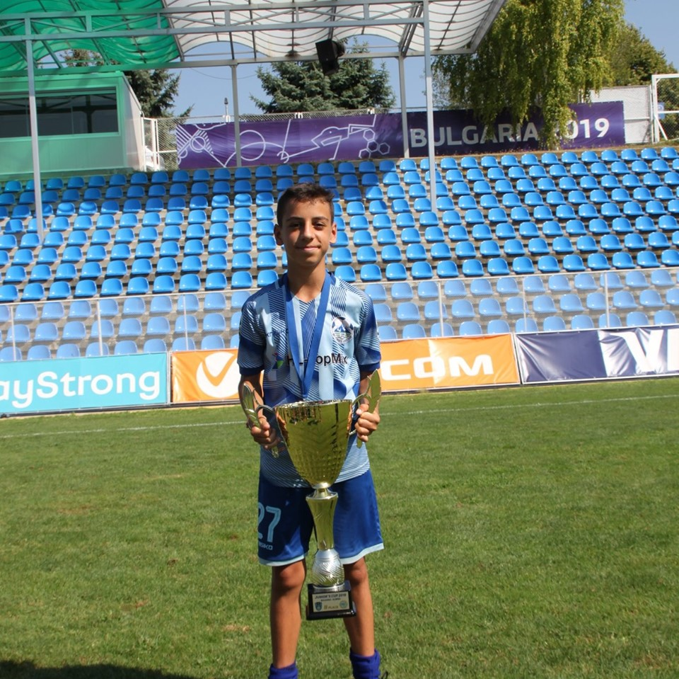
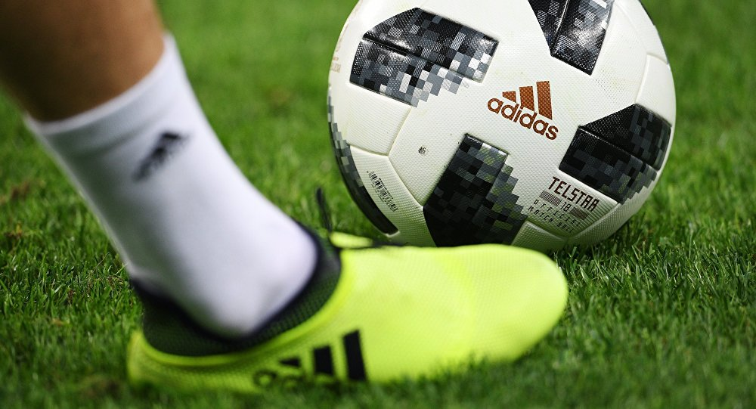
The sport I love the most is football. I train in the team of Sliven ,,Sinite Kamani”/ the Blue Rocks. I’m in the team for about one year, but all of my teammates are doing very well with me and I don’t think I will give up on my dream to become a good football player.

Slide 5


“CREATING THE BASIS FOR COEXISTENCE, RESPECT AND COOPERATION”
2018-1-RO01- KA229-049097_5
Thank you for your attention!
By Konstantin Atanasov.

