Slide 1
My story briefly

Slide 2
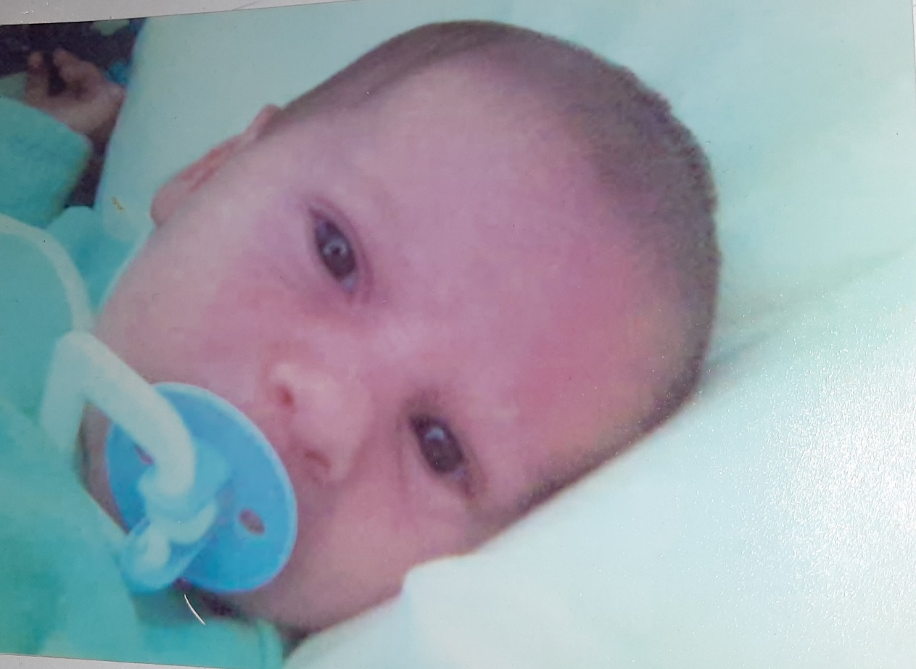
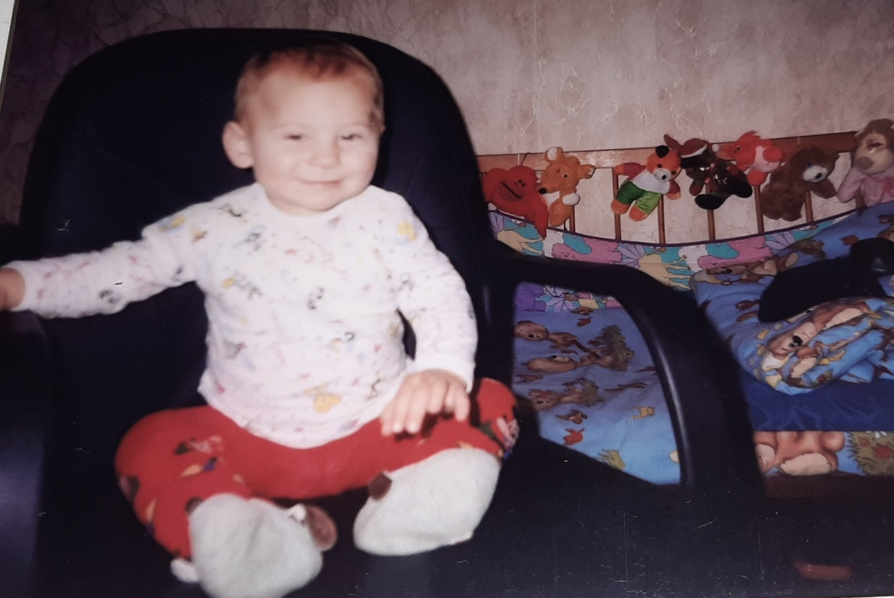
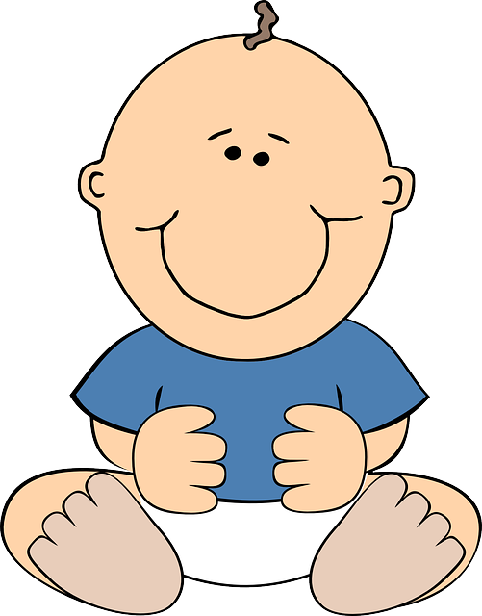
I was born in 13th of November,2006 year

Slide 3
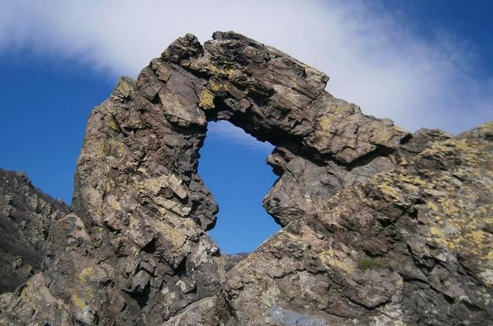
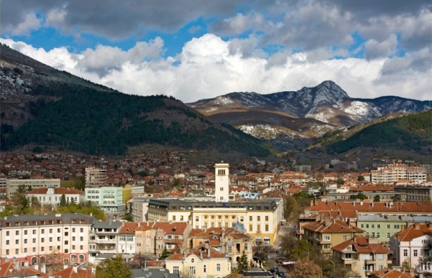
My town Sliven
Halkata - The Ring
This is one of the symbols of Sliven

Slide 4
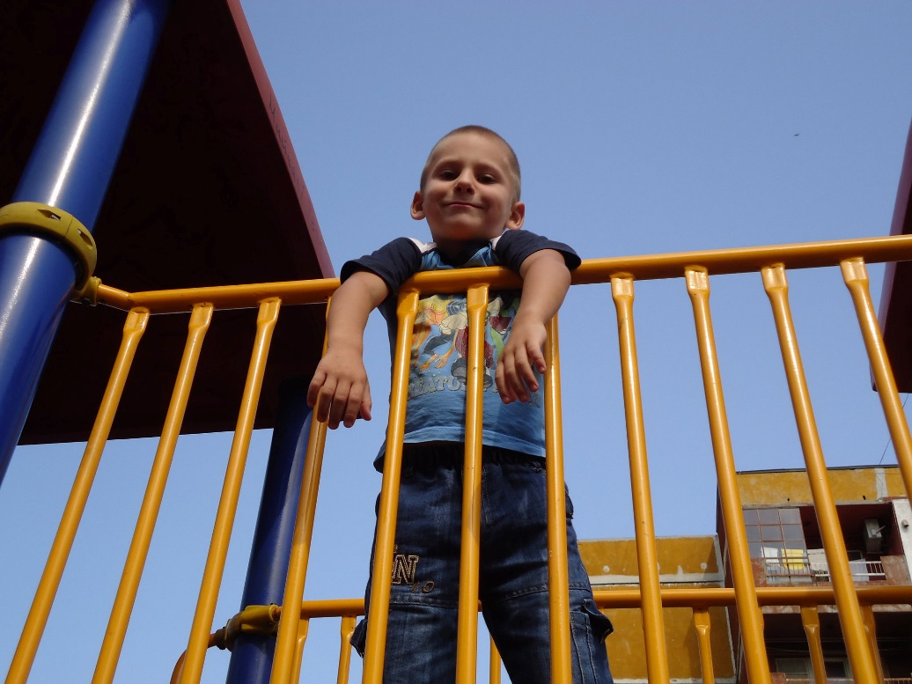
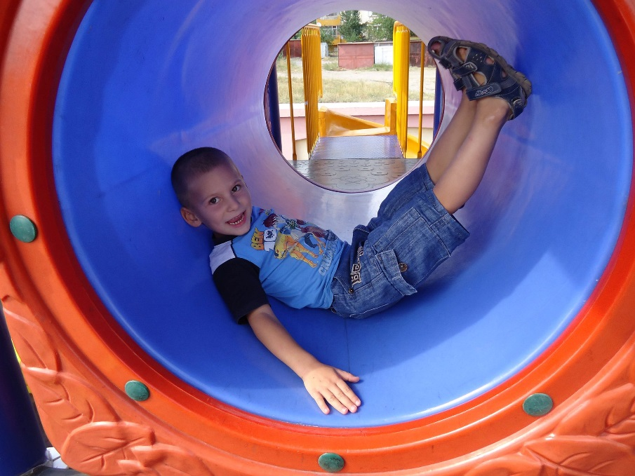
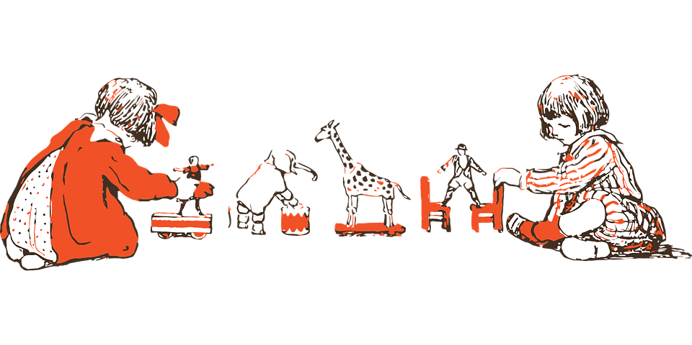
I had a beautiful childhood related to many games and fun.

Slide 5
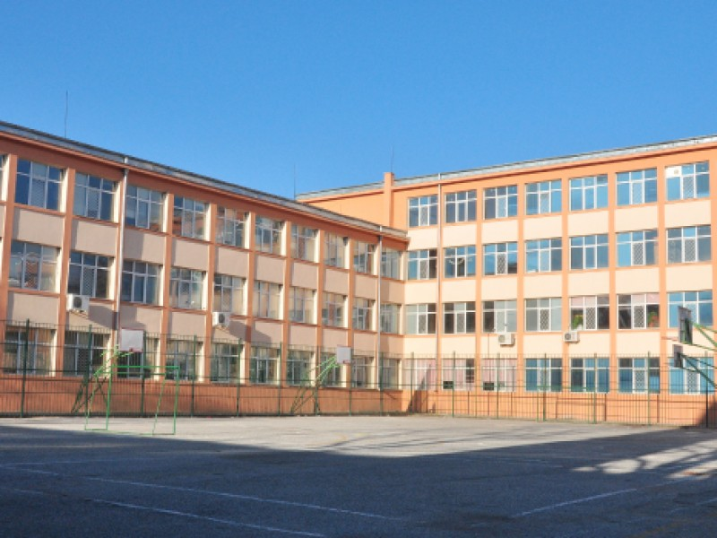
Now I am a student at the best school in sliven-hristo botev primary school

Slide 6
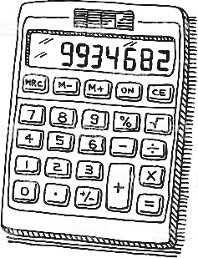
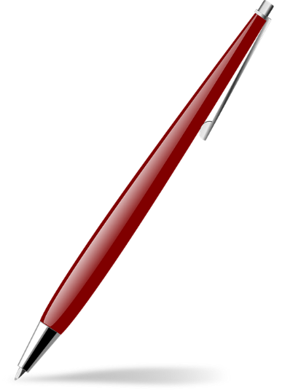
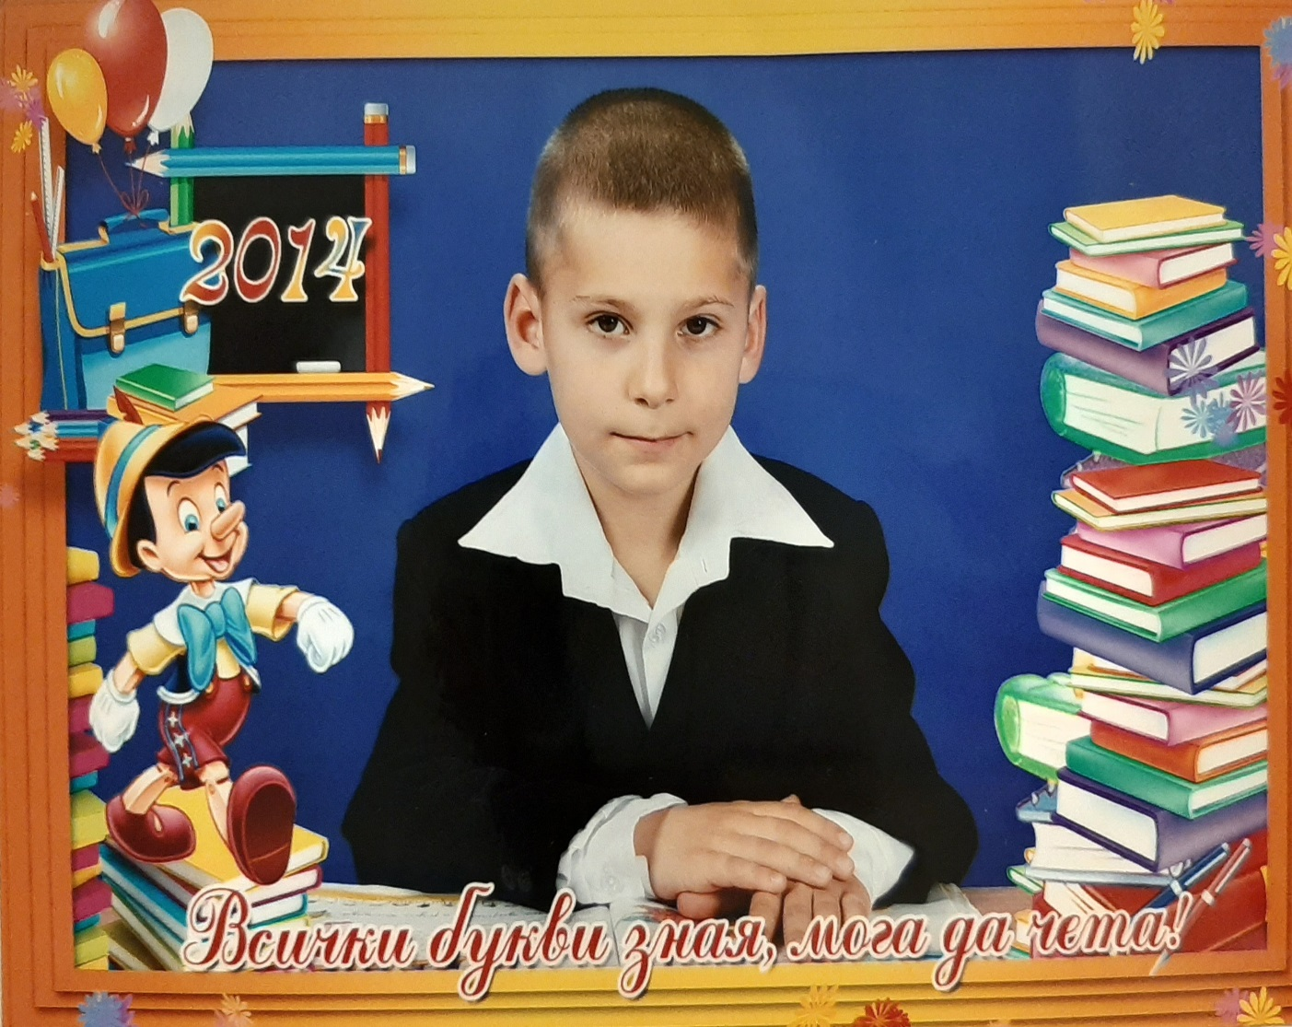

My favorite objects
My favorite objects
are history
and
bulgarian language

Slide 7

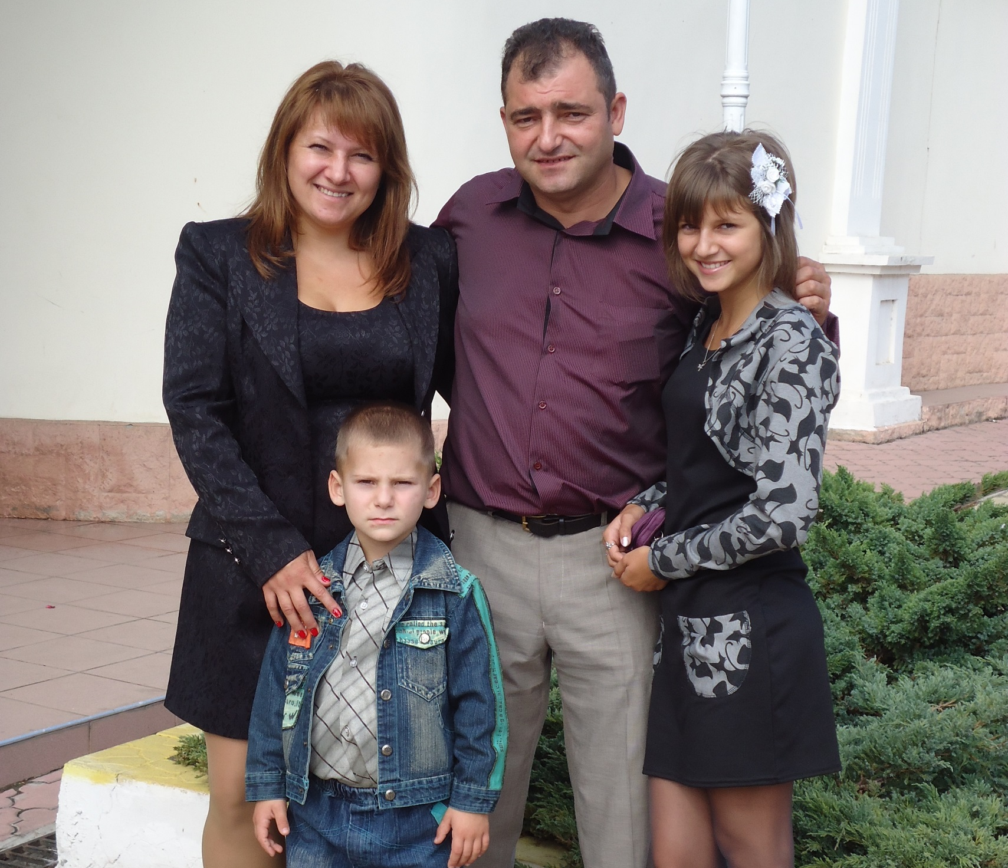
My family
My family has 4
members:
mom,
dad,
sister
and
me.

Slide 8
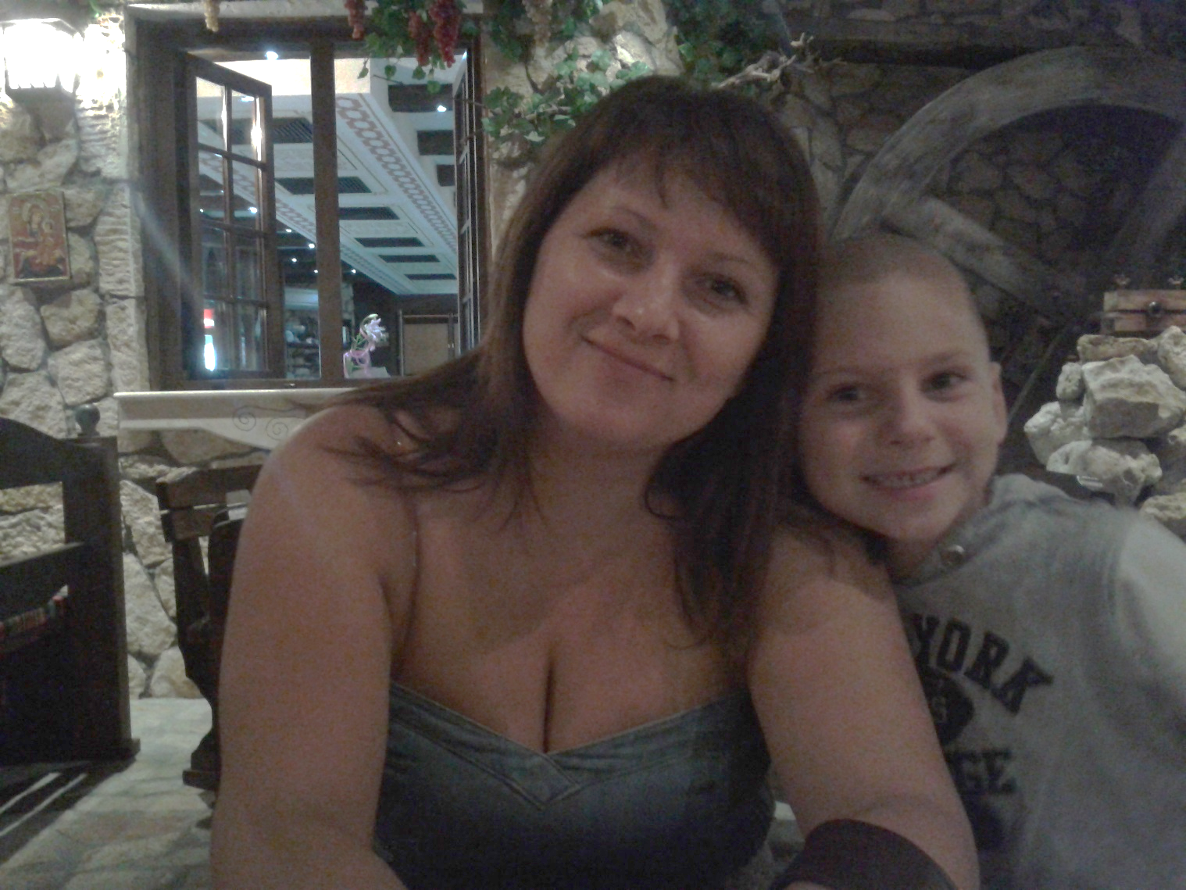

MY MOTHER
She has brown hair and brown eyes.

Slide 9
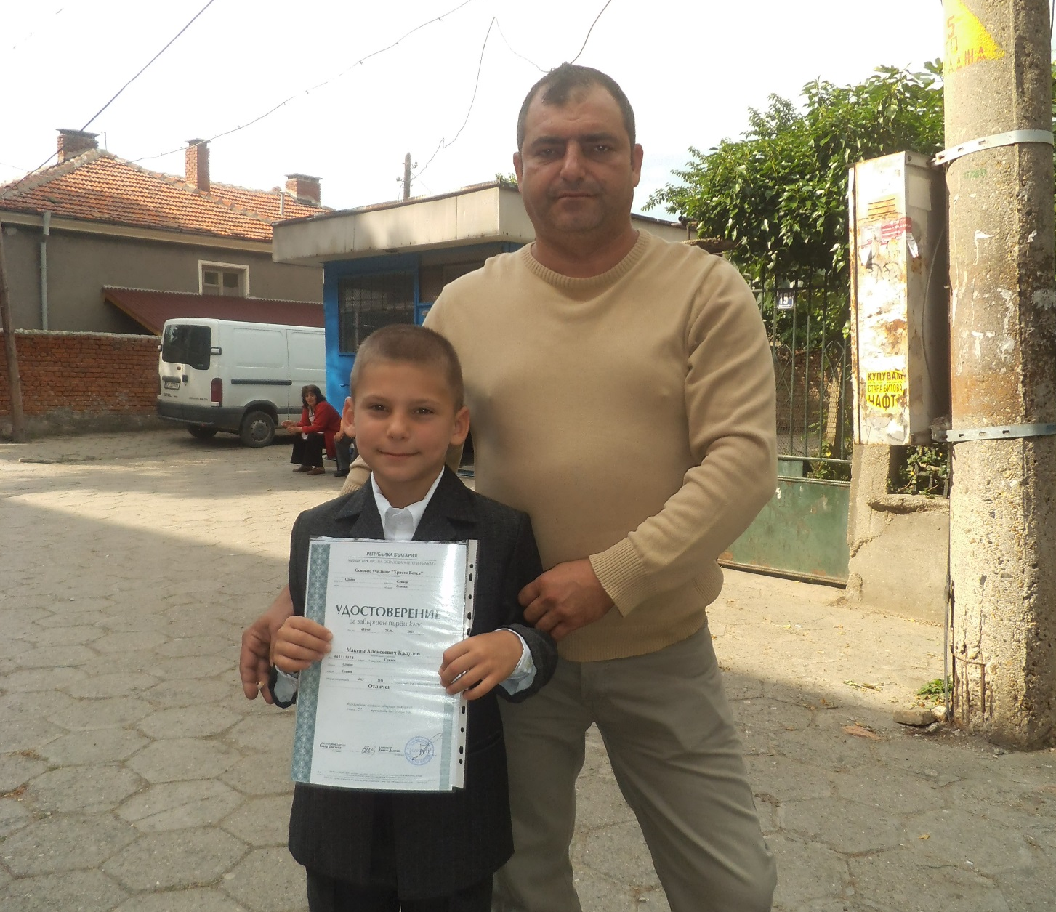
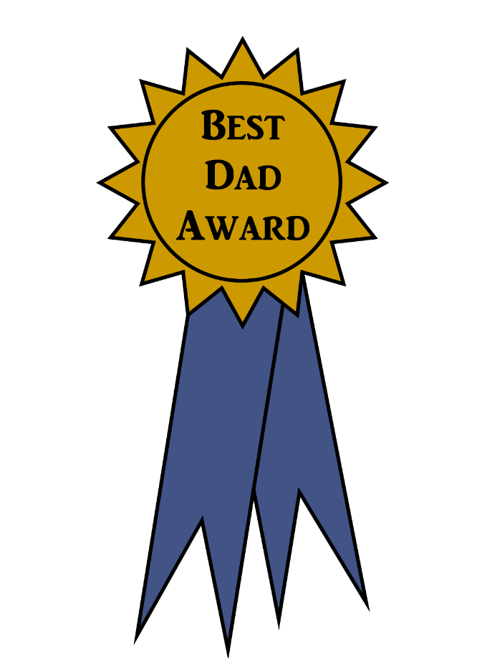
MY FATHER
Aleksei
Kaludov
He has short dark hair and brown eyes

Slide 10
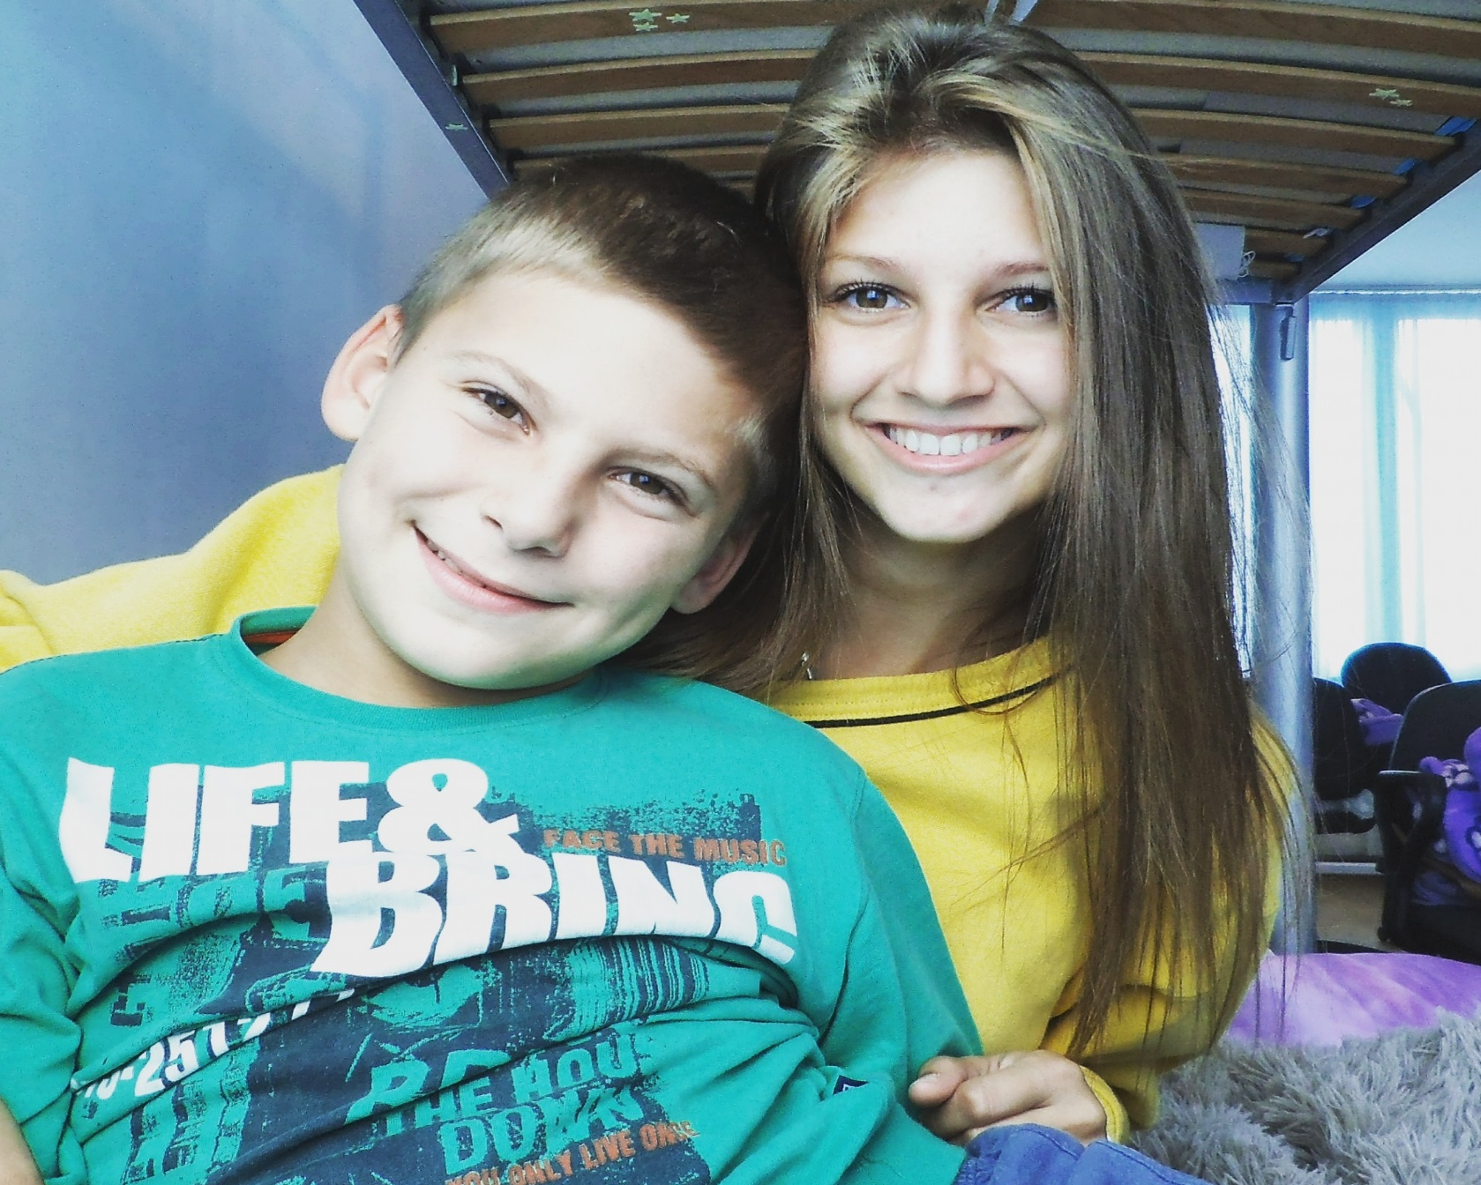

MY SISTER
Her name is Klara Kaludova.
She is 21 years old and she is a student.

Slide 11

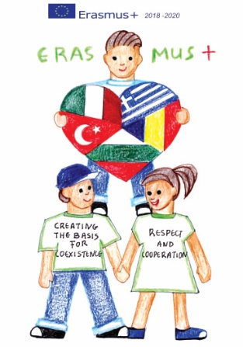
end
“CREATING THE BASIS FOR COEXISTENCE, RESPECT AND COOPERATION”
2018-1-RO01- KA229-049097_5
Thank you for attention!
Maksim Kaludov
HRISTO BOTEV PRIMARY SCHOOL, Bulgaria, Sliven

