Slide 1
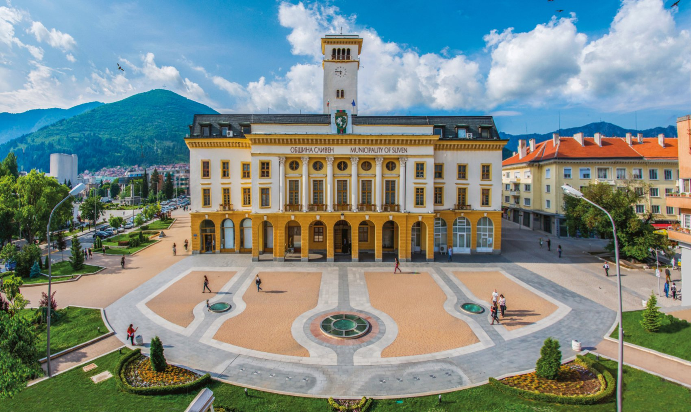
i`m aleksandra teneva from bulgaria and this is my home town-sliven

Slide 2
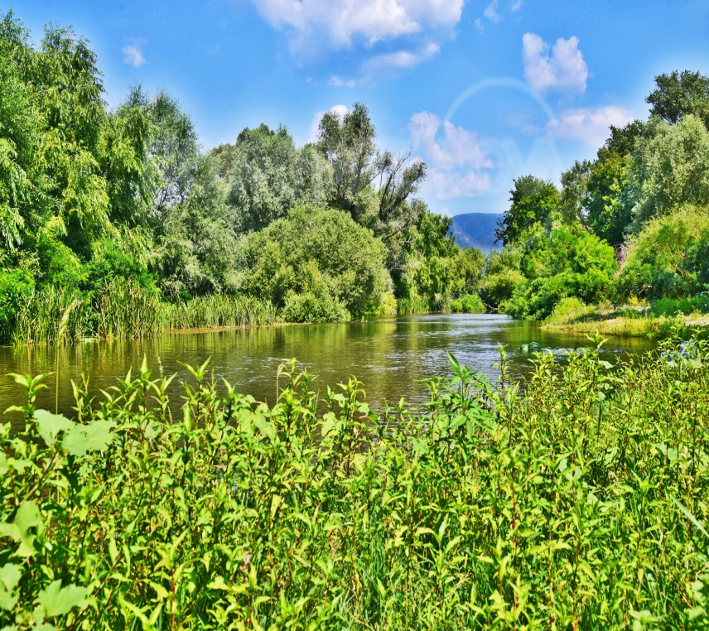
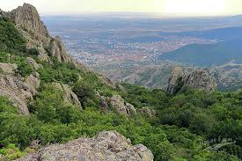
Sliven is known for its beautiful nature.

Slide 3
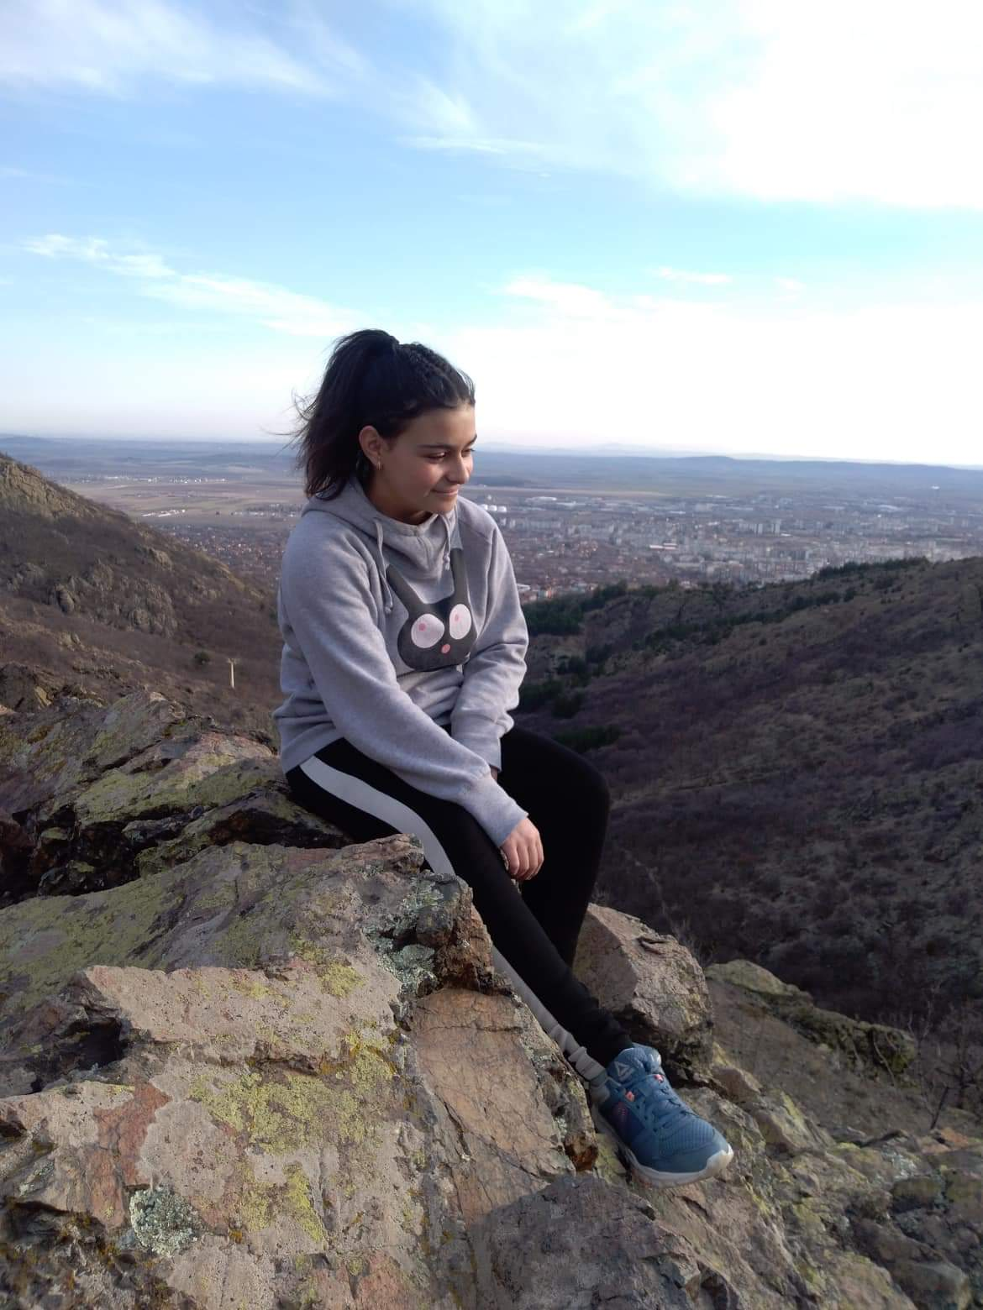
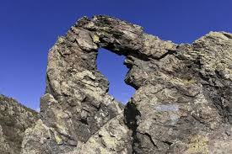
I Love taking a walk in the mountains
My favourite place in Sliven is the Ring

Slide 4
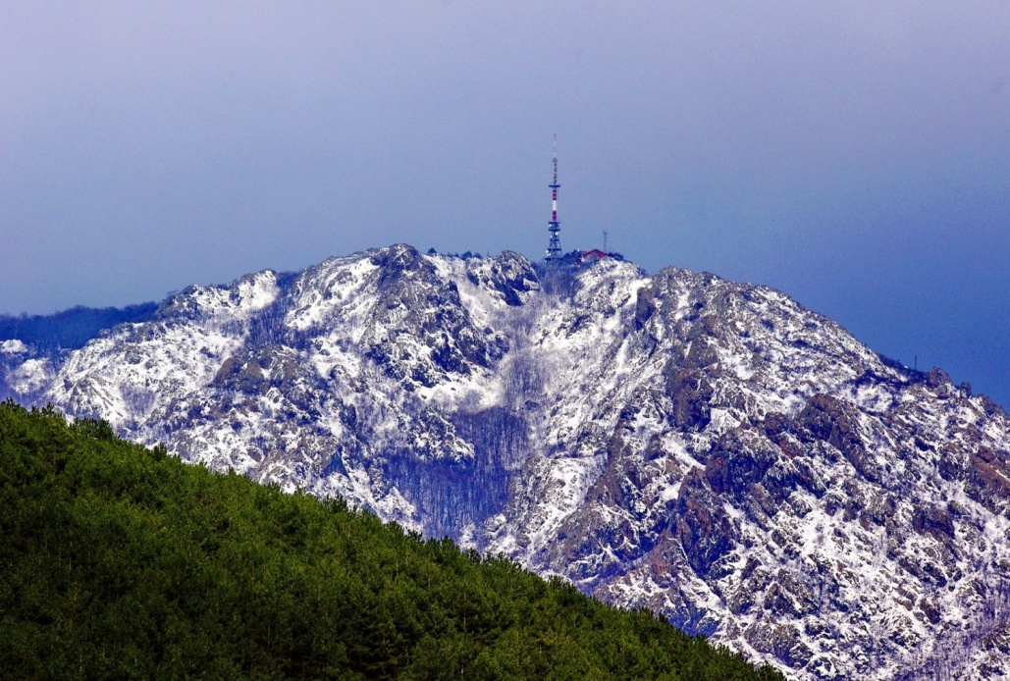
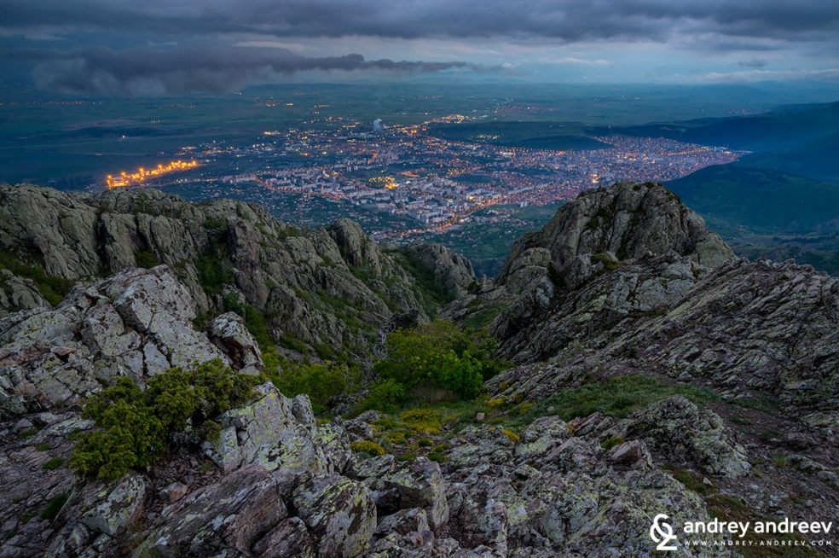
It is in the region of the blue rocks

Slide 5
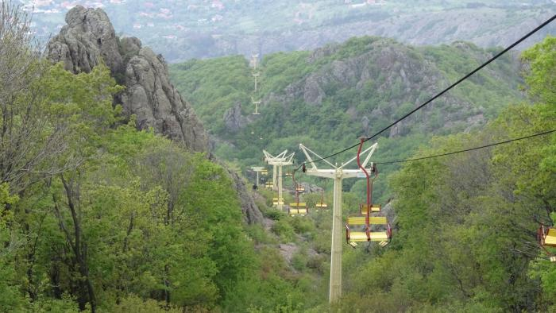
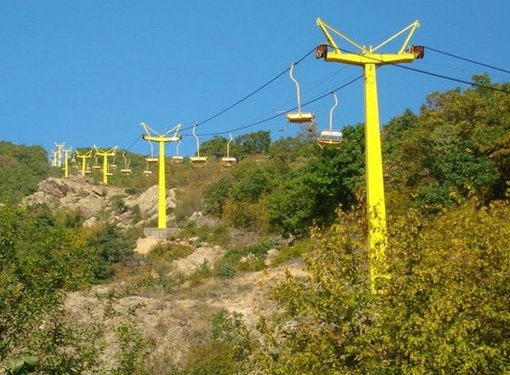
You get to the top by lift

Slide 6
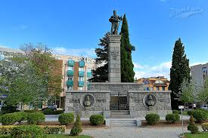
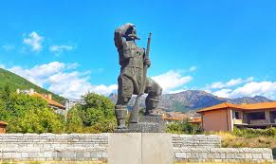
Sliven is also known as The city of the hundred voivodes

Slide 7
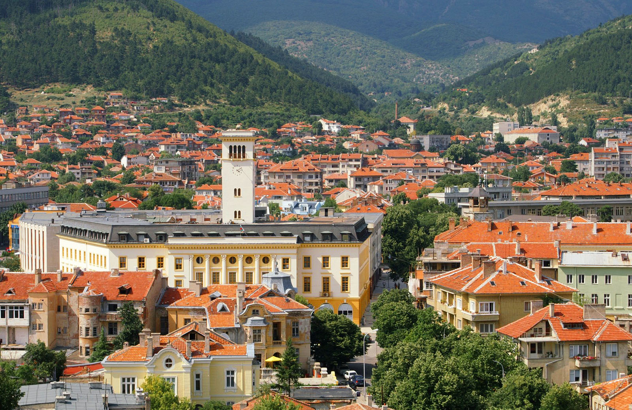
I’m proud of my city

Slide 8
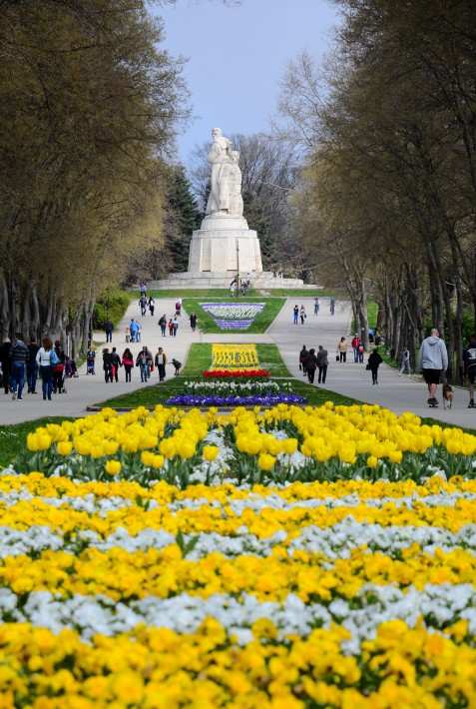
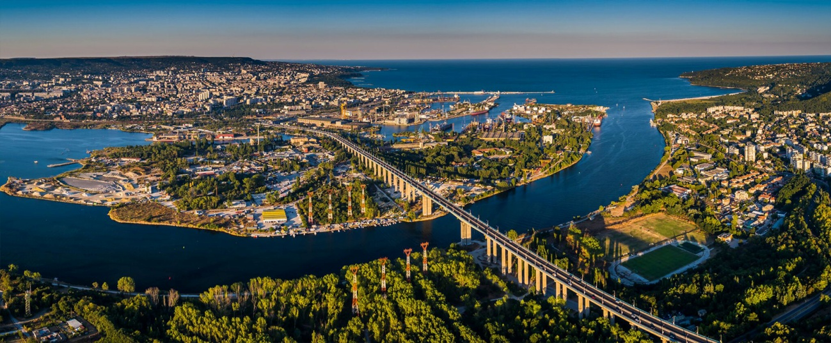
my favourite city is the sea capital -varna

Slide 9
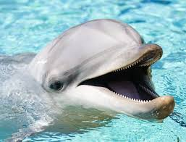
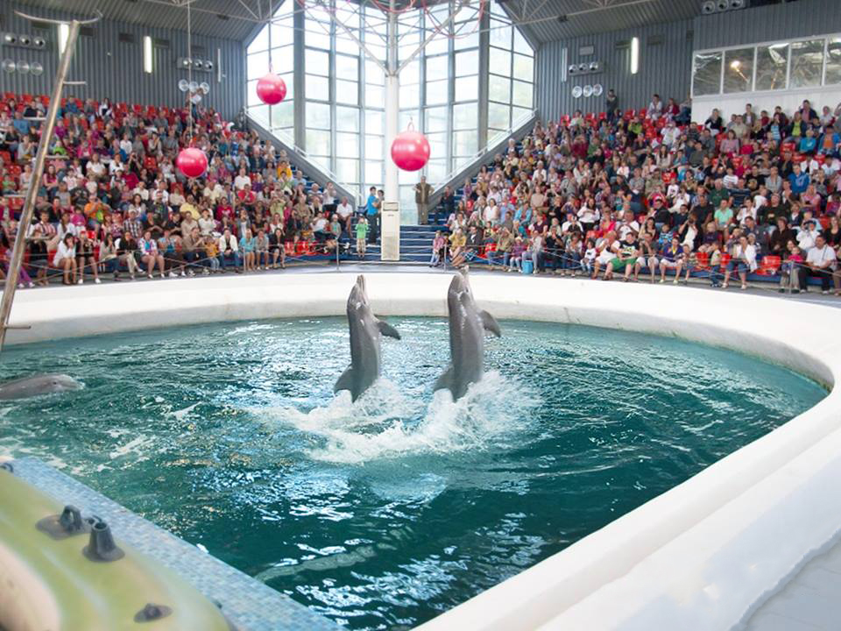
There is also a dolphinarium that`s why I love this city

Slide 10



Thanks for the attention.
“CREATING THE BASIS FOR COEXISTENCE, RESPECT AND COOPERATION”
2018-1-RO01- KA229-049097_5
HRISTO BOTEV PRIMARY SCHOOL, Bulgaria, Sliven

