Slide 1

FAMOUS BULGARIAN PEOPLE

Slide 2
I. MEDIEVAL TIME

Slide 3
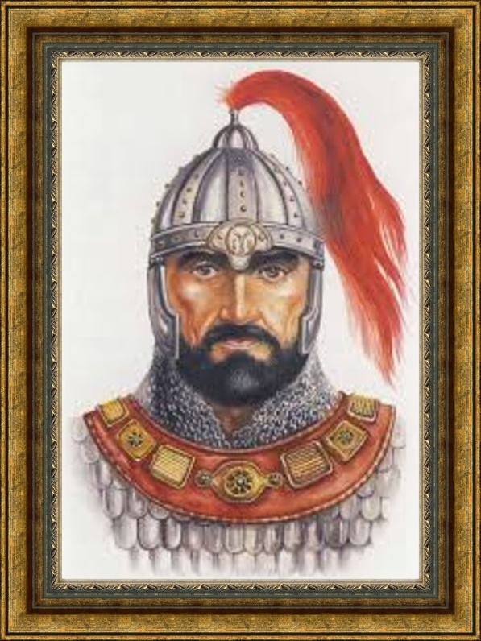
KHAN ASPARUKH
(about 640-701)
BRAVE WARRIOR AND LEADER, FOUNDER OF DANUBE BULGARIA.

Slide 4
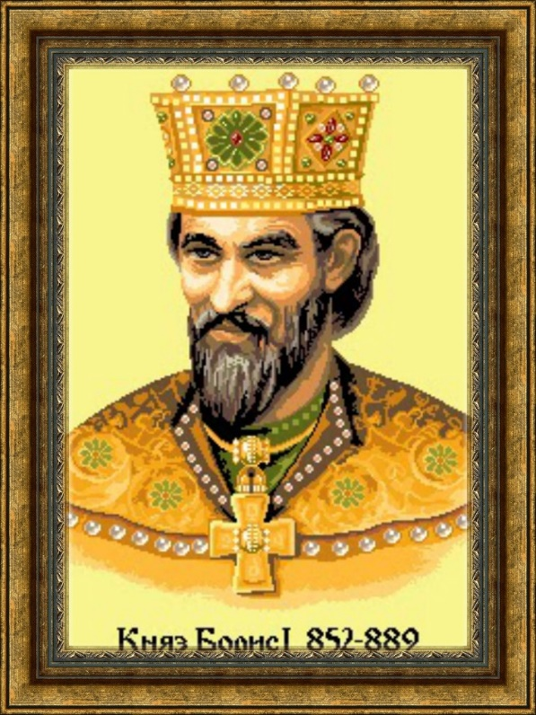
Knyaz ST. BORIS THE FIRST
(828-907)
Great warrior and diplomat. During his mighty rule Bulgaria became a Christian kingdom. The Slavic alphabet was made a base for creating books in Bulgarian language.

Slide 5
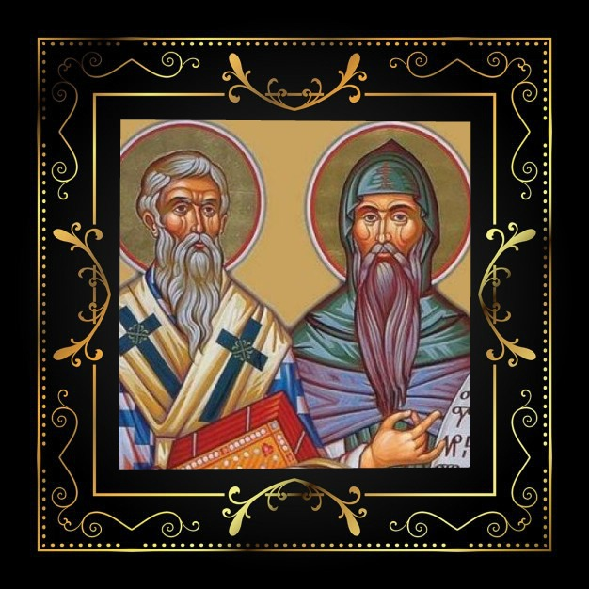
ST. KIRIL AND ST. METHODIY
THE brothers were born in Tessaloniki, Greece, in a Bulgarian family. They got a good education and created the Slavic alphabet, which was at first called Glagolitsa.

Slide 6
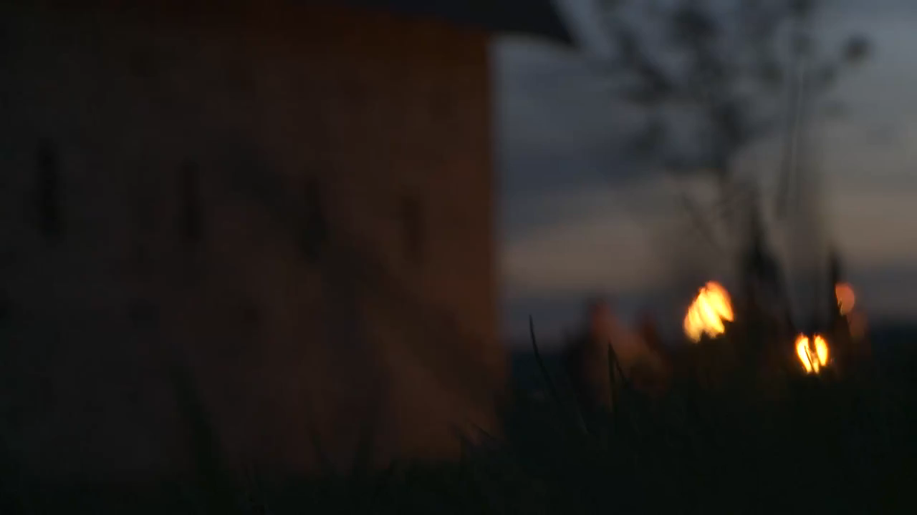
St. Cyril and Methodius

Slide 7
ST. KIRIL AND ST. METHODIY
They were great diplomats.
Kiril and Methodiy were canonized by the Orthodox Church for their educational work.

Slide 8
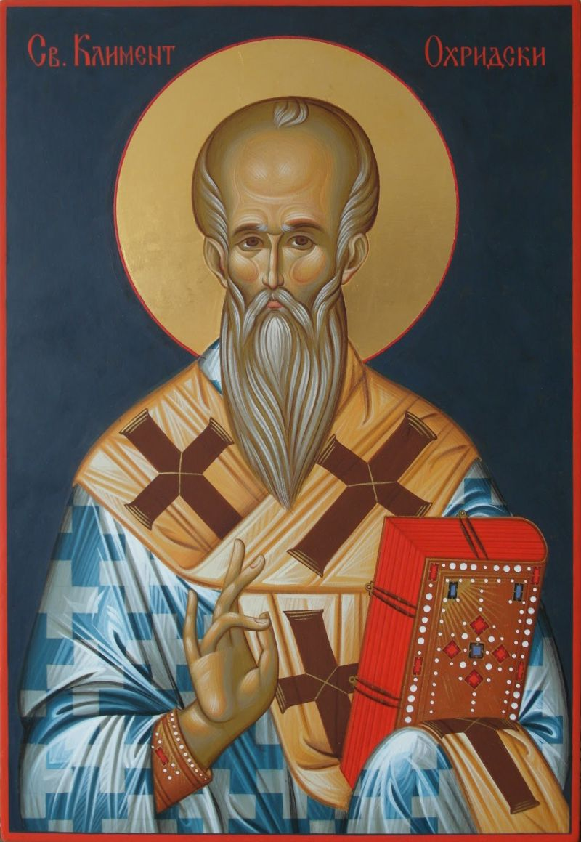
ST. KLIMENT OHRIDSKY
(about 840 - 916)
THE FIRST BISHOP PREACHING IN BULGARIAN LANGUAGE. FOUNDER OF THE OHRID BOOK SCHOOL.
NOWADAYS – PATRON OF SOFIA UNIVERSITY.

Slide 9
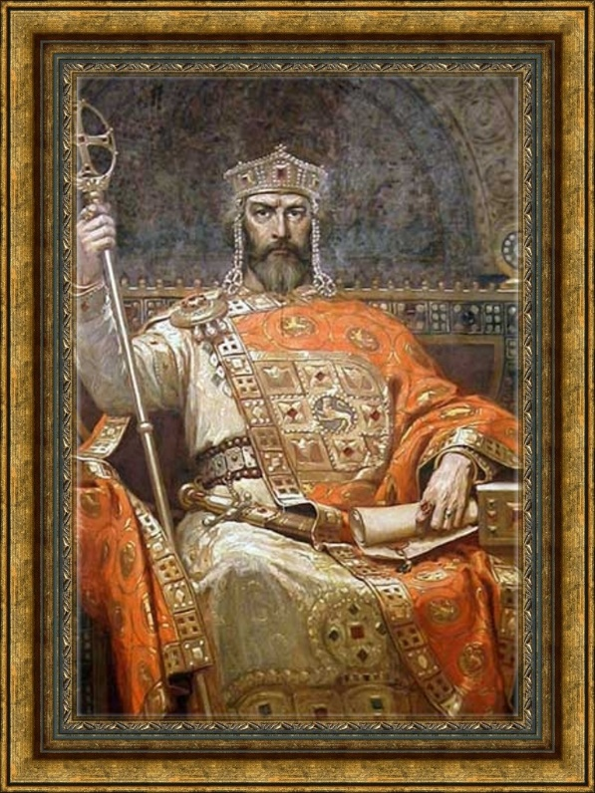
TSAR SIMEON THE GREAT
(864-927)
MIGHTY RULER. GREAT DIPLOMAT. DURING HIS TIME BULGARIA BECAME A KINGDOM WITH BORDERS ON THREE SEAS. HIS RULE WAS CALLED THE "GOLDEN AGE OF BULGARIAN CULTURE“.

Slide 10
II. REVIVAL TIME

Slide 11
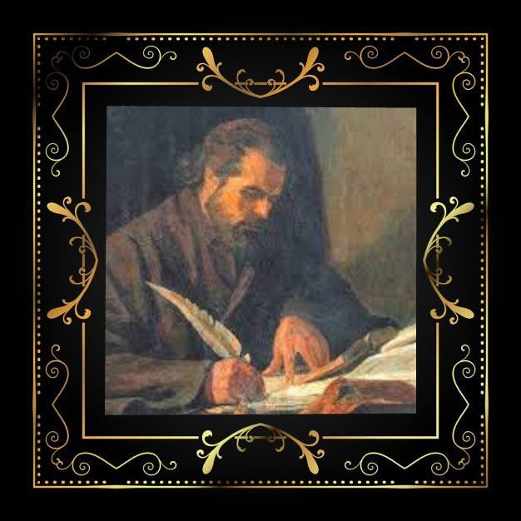
PAISIY HILENDARSKY
(1722-1773)
CONSIDERED THE FOUNDER OF THE BULGARIAN REVIVAL. AUTHOR OF THE BOOK “SLAVIC – BULGARIAN HISTORY”.

Slide 12
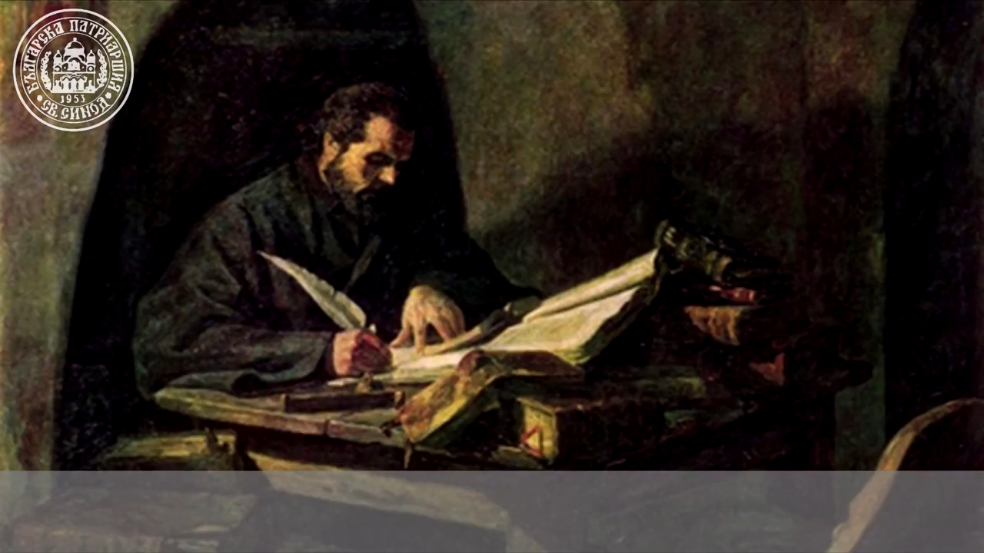
PAISIUS OF HILENDAR

Slide 13
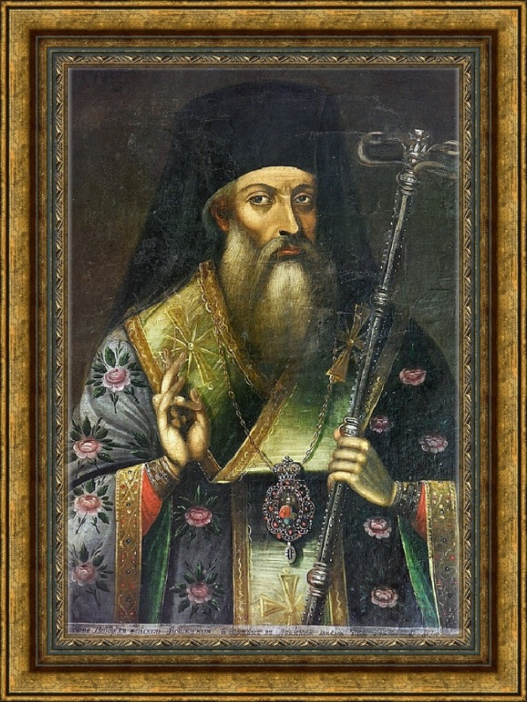
SOFRONIY VRACHANSKY
(1739-1813)
BULGARIAN PRIEST, BISHOP OF THE REGION OF VRATSA. FOLLOWER OF THE PAISIY HILENDARSKI’S IDEAS.

Slide 14
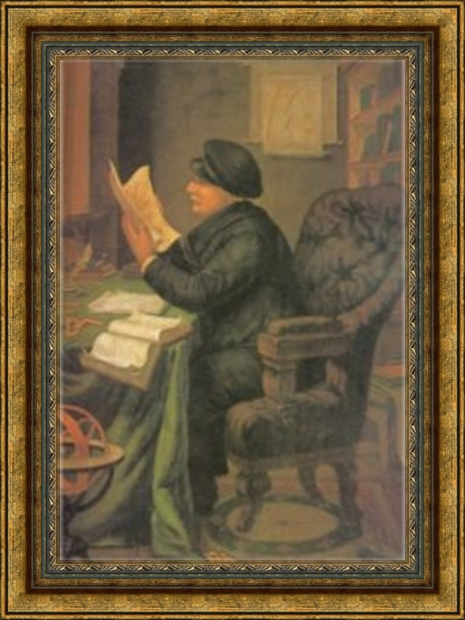

PETER BERON
(1799-1871)
SCIENTIST-ENCYCLOPEDIST, EDUCATOR, PHILOSOPHER, NATURALIST. AUTHOR OF FISH ABC BOOK (1824) - THE FIRST BULGARIAN BOOK OF THAT TYPE.

Slide 15
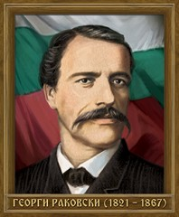
GEORGI RAKOVSKY
(1821-1867)
FOUNDER OF THE ORGANIZED FIGHT FOR THE LIBERATION OF BULGARIA, PUBLICIST, JOURNALIST AND ETHNOGRAPHER.

Slide 16
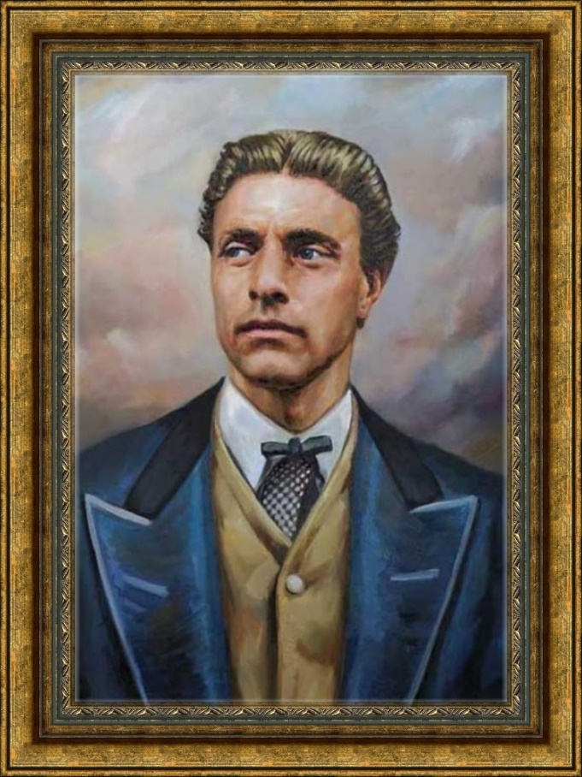
VASIL LEVSKI
(1837-1873)
"THE APOSTLE OF FREEDOM" . IDEOLOGIST AND ORGANIZER OF THE BULGARIAN NATIONAL REVOLUTION. FOUNDER OF THE INTERNAL REVOLUTIONARY ORGANIZATION.

Slide 17
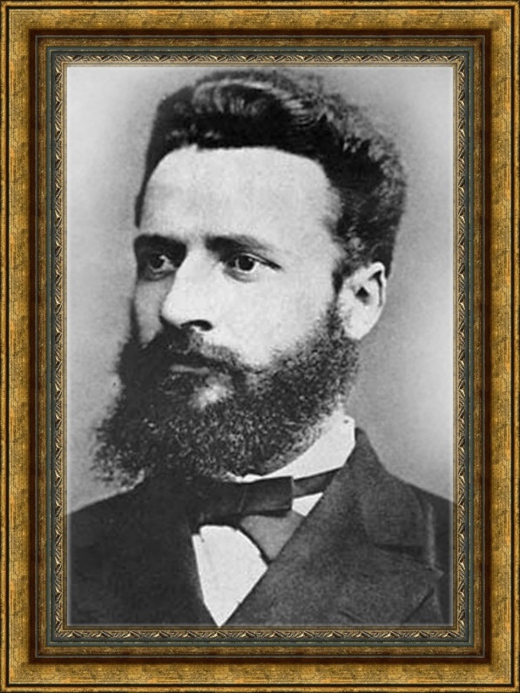
HRISTO BOTEV
(1848-1876)
NATIONAL HERO, REVOLUTIONERY, POET AND PUBLICIST.
NOWADAYS – PATRON OF OUR SCHOOL.

Slide 18
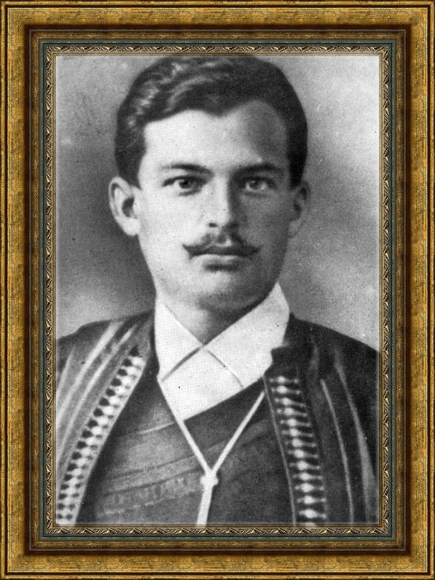
Georgi BenkovskY
(1843-1876)
REVOLUTIONARY, HEAD OF THE APRIL REBELLION IN 1876 IN THE IV TH REVOLUTIONARY DISTRICT.

Slide 19
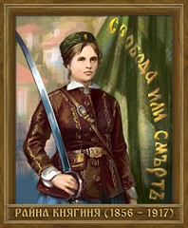
RAINA KNYAGINIYA
(1856-1917)
WELL-EDUCATED WOMAN. TEACHER AND MIDWIFE . EBROIDER OF THE MAIN FLAG OF THE PANAGYURISHTE REVOLUTIONARY DISTRICT DURING THE APRIL REBELLION.

Slide 20
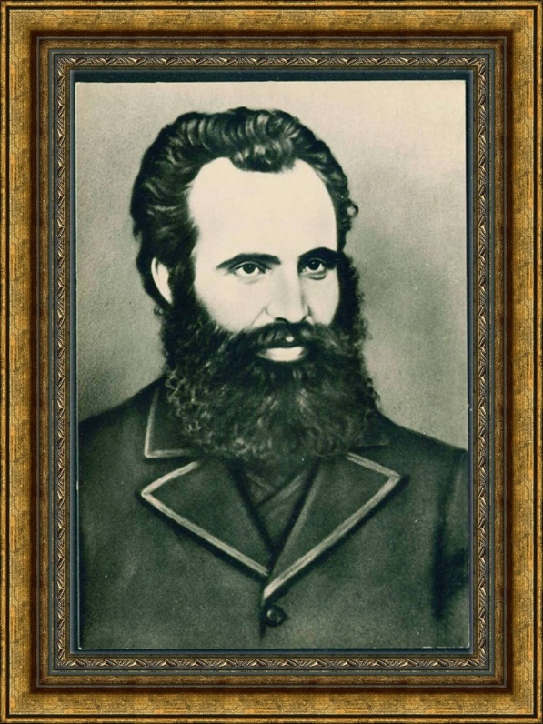
LYUBEN KARAVELOV
(1834-1879)
POET, WRITER, JOURNALIST, ETHNOGRAPHER. PERSON OF ENCYCLOPEDIC KNOWLEDGE.

Slide 21
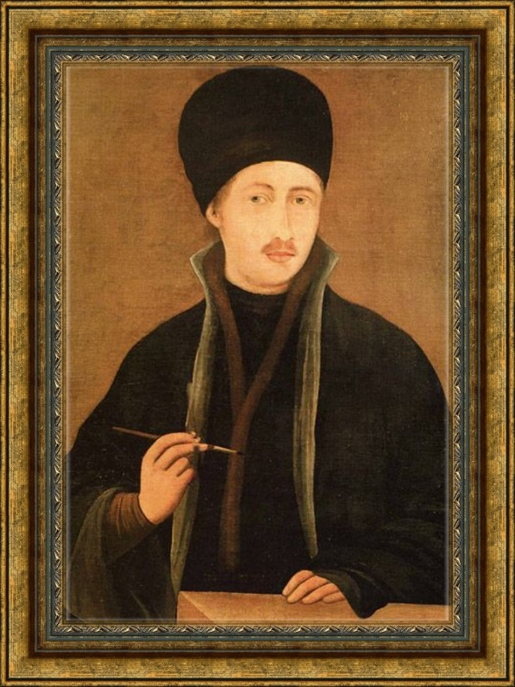
ZAHARI ZOGRAPH
(1810-1853)
THE BIGGEST ICONOGRAPHER FROM THE ART SCHOOL IN THE TOWN OF SAMOKOV. FOUNDER OF THE BULGARIAN REALISTIC ICON PAINTING.

Slide 22
III. RECENT TIME

Slide 23
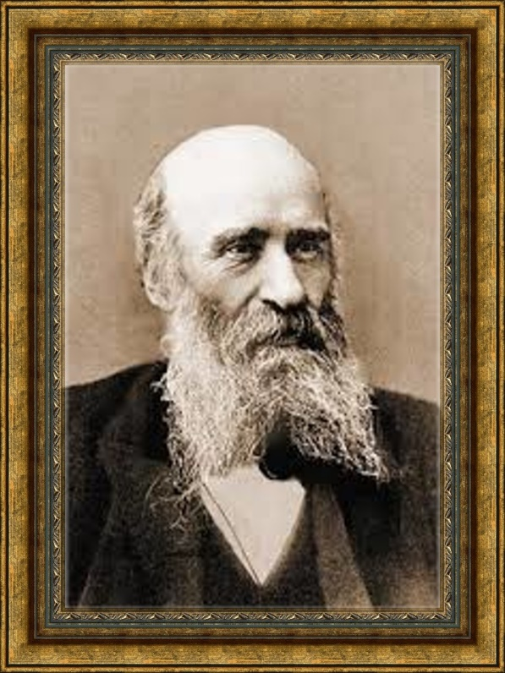
PROF. MARIN DRINOV
FOUNDER OF THE BULARIAN HISTORICAL SCIENCE. THE FIRST PRESIDENT OF THE BULGARIAN ACADEMY OF SCIENCE - BAN.

Slide 24
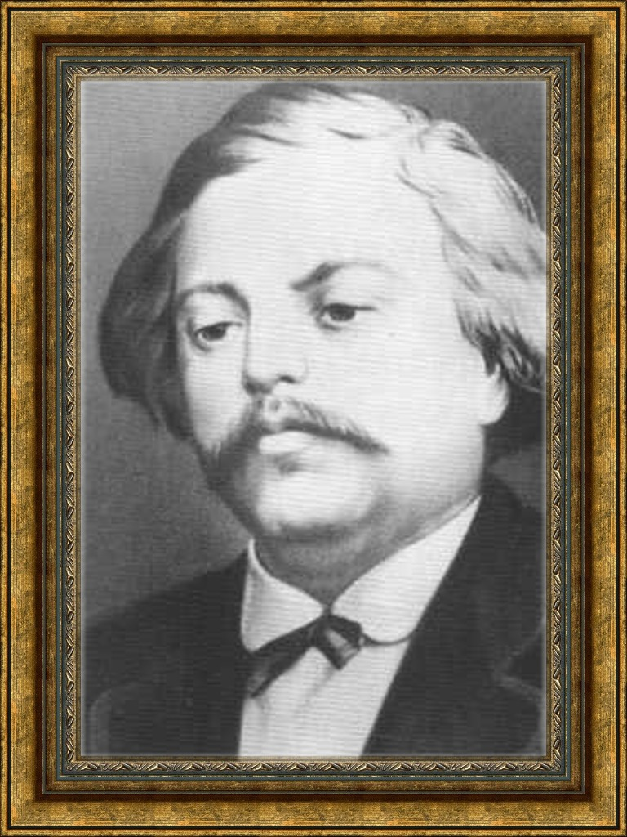
DOBRY CHINTULOV
(1822-1886)
POET, COMPOSER AND TEACHER.
ONE OF THE SPIRITUAL LEADERS OF THE BULGARIAN REVIVAL.
BORN IN SLIVEN.

Slide 25
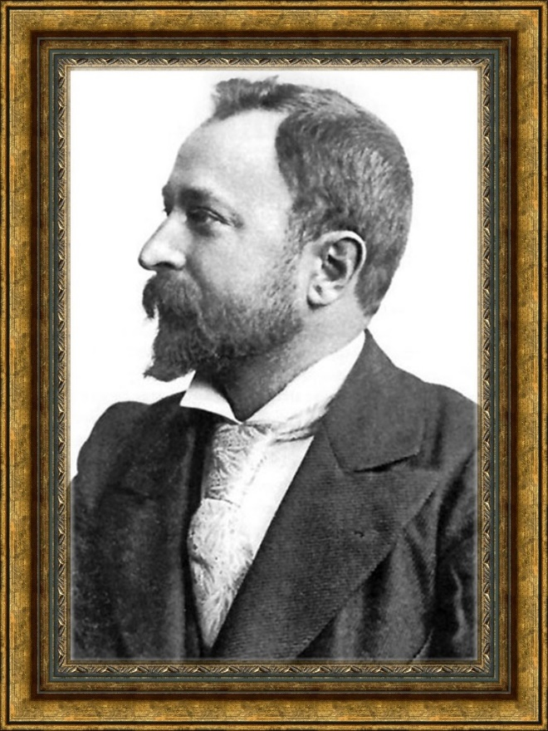
ALEKO KONSTANTINOV
(1822-1886)
WRITER, LAWYER, PUBLICIST. FOUNDER OF THE ORGANIZED TOURISM IN BULGARIA.

Slide 26
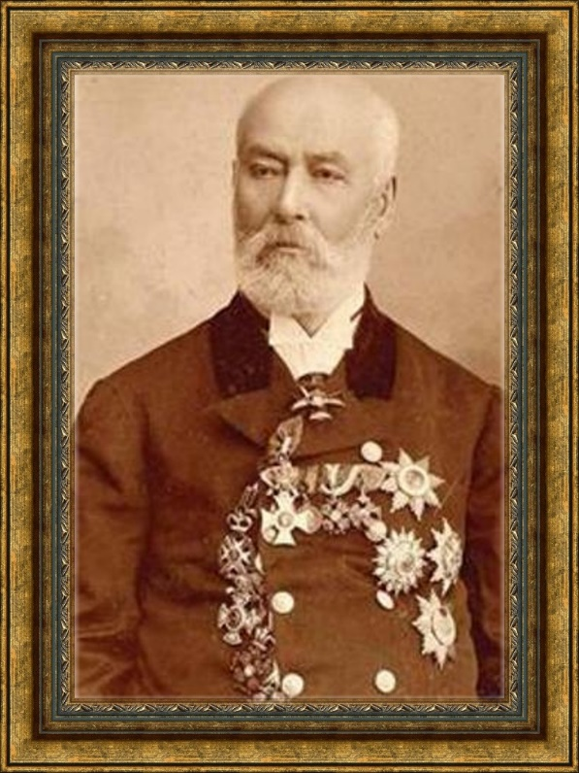
NAJDEN GEROV
(1823-1900)
WRITER, LINGUIST, SCIENTIST. CREATOR OF THE FIRST CLASS SCHOOLS IN BULGARIA.

Slide 27
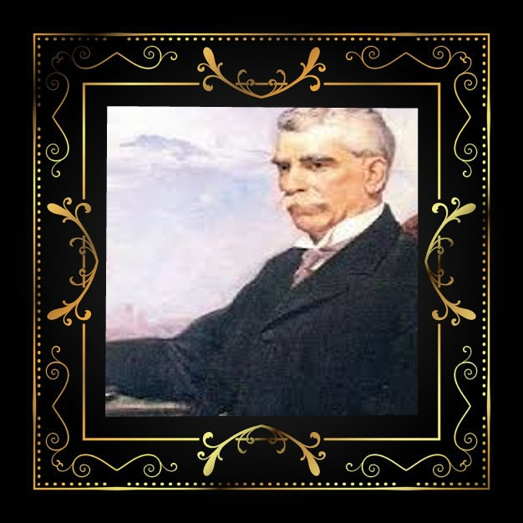
IVAN VAZOV
(1850-1921)
POET, WRITER AND PLAY-WRITER. THE PATRIARCH OF BULGARIAN LITERATURE.

Slide 28
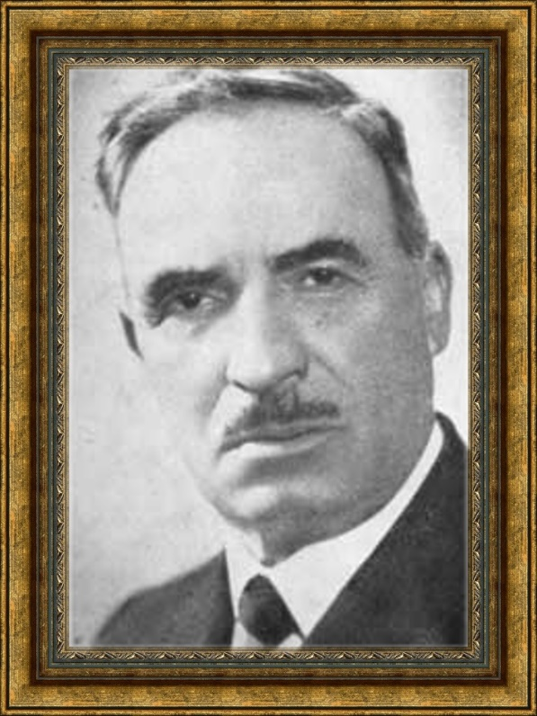
Elin Pelin
(1877-1949)
CLASSIC OF BULGARIAN LITERATURE , CALLED "SINGER OF THE BULGARIAN VILLAGE"

Slide 29
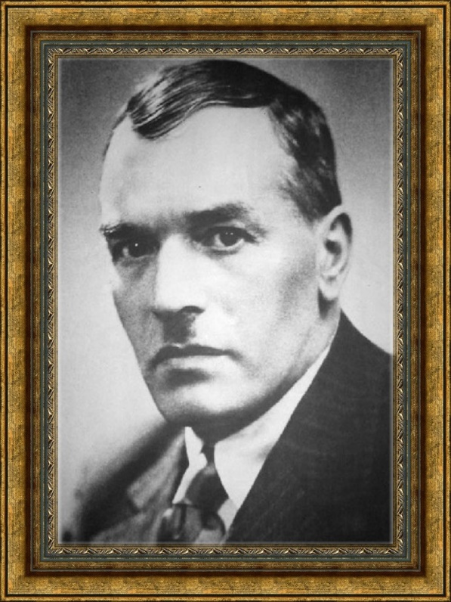
YORDAN YOVKOV
(1880-1937)
WRITER, CLASSIC OF BULGARIAN LITERATURE.

Slide 30
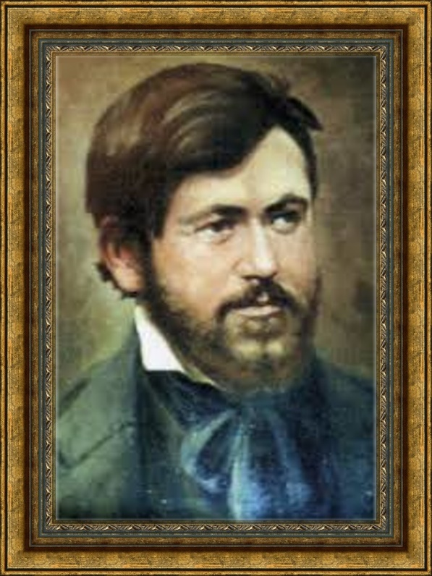
DIMCHO DEBELYANOV
(1887-1916)
POET, AUTHOR OF LYRICAL AND SATIRICAL POEMS, PUBLISHED IN DIFFERENT PERIODIC ISSUES.

Slide 31
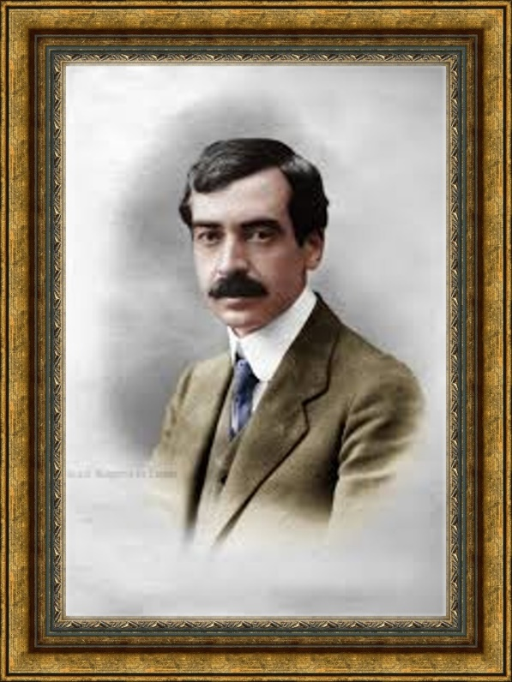
PEYO YAVOROV
(1878-1914)
POET, SYMBOLIST, PLAY-WRITER. CONSIDERED TO BE ONE OF THE BIGGEST EUROPEAN POETS OF THE XX CENTURY.

Slide 32
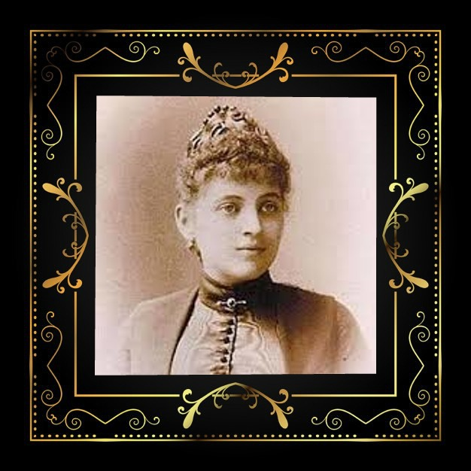
MARA BELCHEVA
(1868-1937)
POETESS AND TRANSLATOR. PERSON OF ENCYCLOPEDIC KNOWLEDGE.

Slide 33
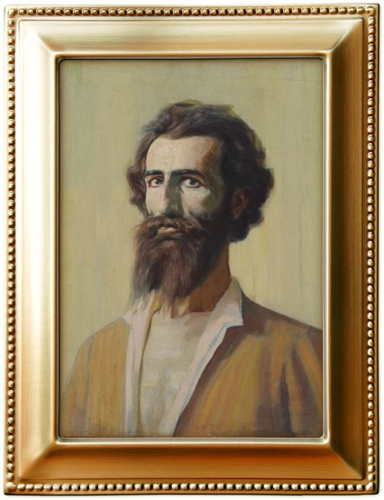
VLADIMIR DIMITROV – MAYSTORA
(1882-1960)
ONE OF THE BIGGEST NAMES IN BULGARIAN REALISTIC PAINTING.

Slide 34
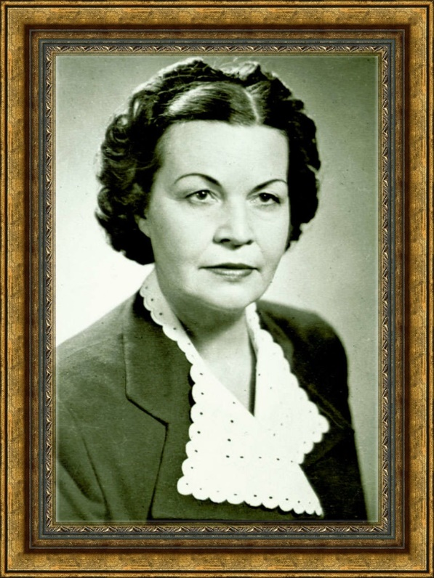
ELISAVETA BAGRYANA
(1893-1991)
POETESS AND TRANSLATOR, AUTHOR OF CHILDREN'S BOOKS. SHE WAS CALLED "THE FIRST LADY OF BULGARIAN LITERATURE “

Slide 35
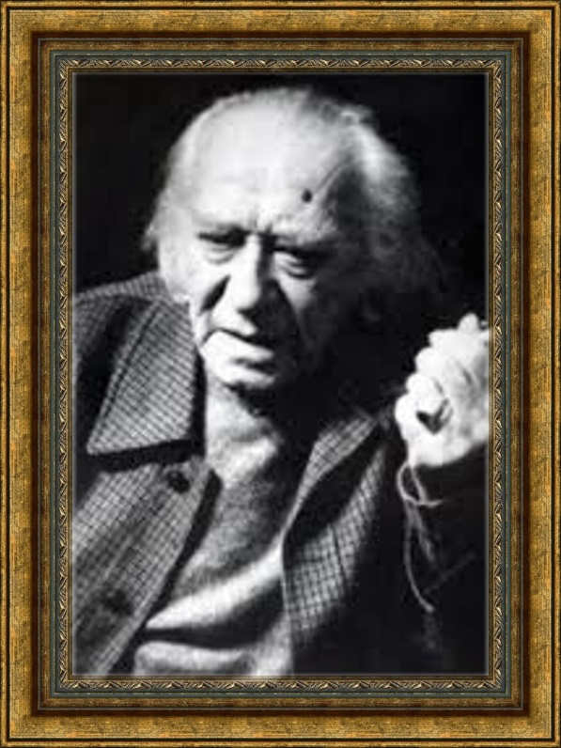
DECHKO UZUNOV
(1899-1986)
ONE OF THE BIGGEST MASTERS OF CONTEMPORARY BULGARIAN PAINTING.

Slide 36
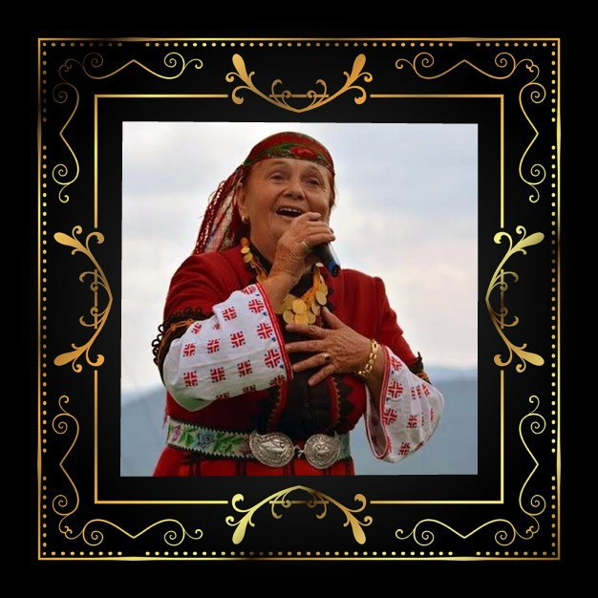
VALYA BALKANSKA
FOLK SINGER FROM THE RHODOPES. HER PERFORMANCE OF THE SONG
“ DELYO HAIDUTIN" IS FLYING OUT IN SPACE.

Slide 37

VALYA BALKANSKY

Slide 38
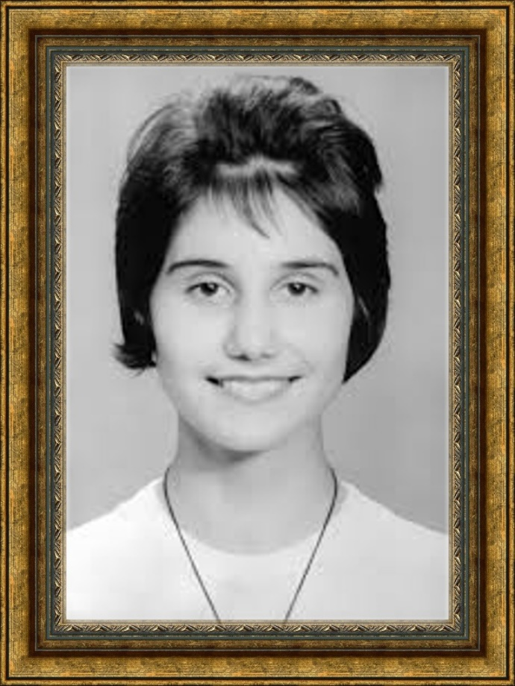
PETYA DUBAROVA
(1962-1979)
THE INFANT-PRODIGY OF BULGARIAN POETRY.

