Slide 1

BULGARIAN CUSTOMS

Slide 2
BULGARIAN CUSTOMS
are specific to Bulgarians. They are constantly repeated actions of the people related to the worship of God, holy martyrs, nature, human health and the pursuit of evil spirits. Now all customs and traditions are our national cultural heritage.

Slide 3
SPRING HOLIDAYS

Slide 4
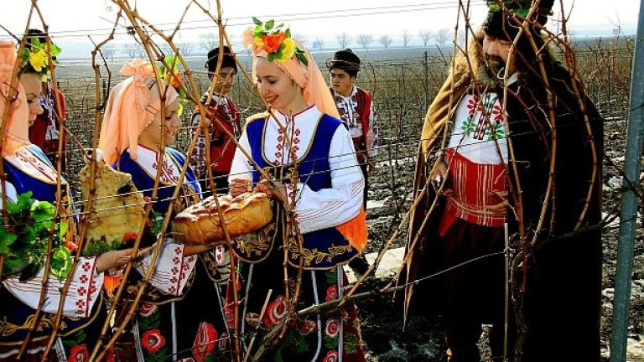
Day of Trifon Zarezan - 14th February
The day on which the vines "cry" is in honor of the vine and the vine-growers themselves. On that day the farmers, dressed in national costumes, go to the vineyard and cut the sticks of one of the vines. The pruned areas of the vineyard are watered with wine and brandy to produce more and more beautiful grapes.

Slide 5
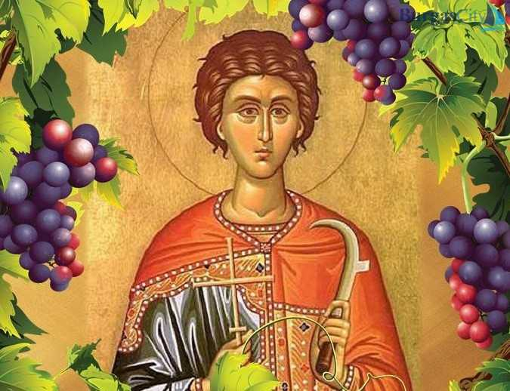
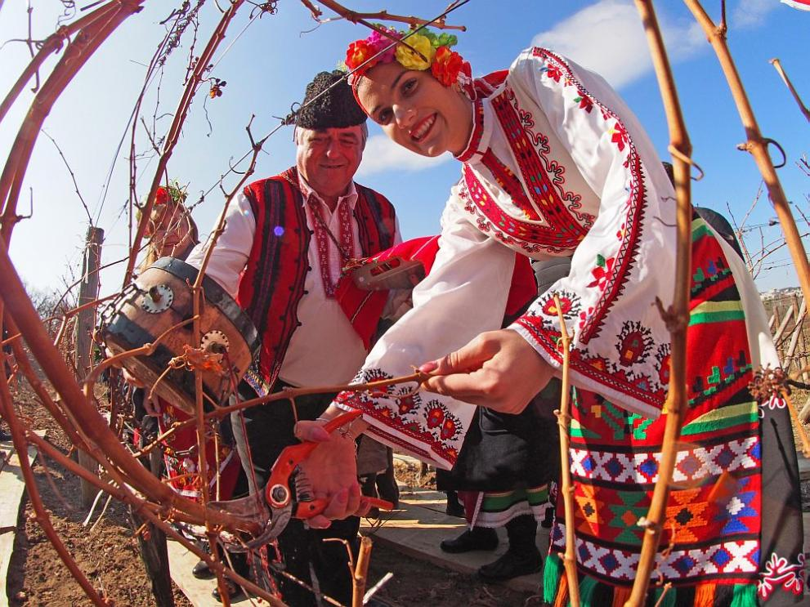
Trifon's Day- 14 February

Slide 6
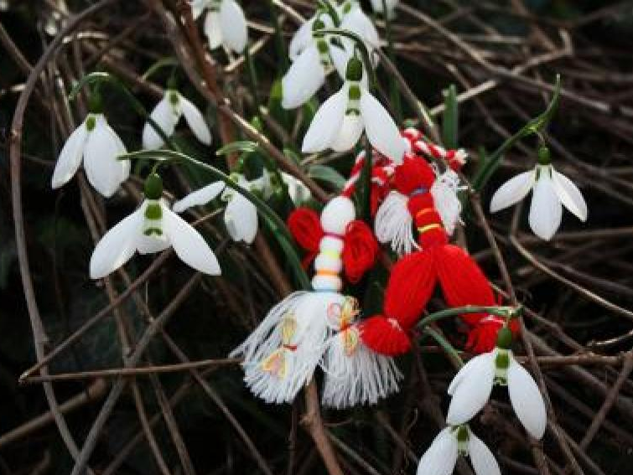
Baba Marta- 1st March
In old times people believed that with the awakening of Nature, the evil forces were awakened. Red and white martenitsi were used to deal with the baddies. The common belief is that by wearing martenitsa people ask the grumpy old lady Baba Marta for mercy. The white color is a symbol of longevity and purity, and the red prevents from illness. From these times the most typical image of martenitsa was born - Pizho and Penda, a little red boy and a white girl. Martenitsas are removed when a stork, swallow, or flowering tree appears.

Slide 7
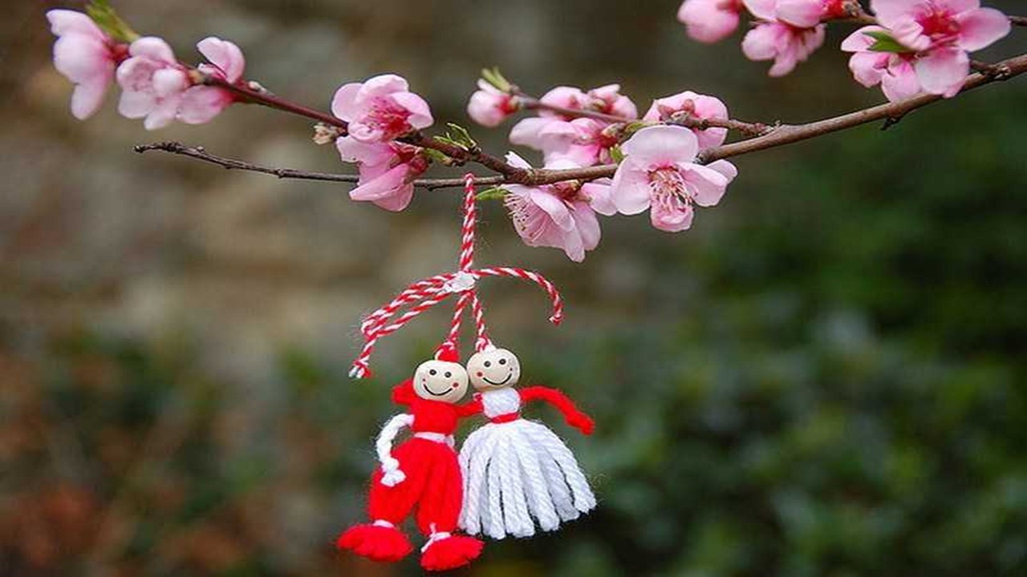
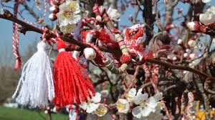
Baba Marta- 1st March

Slide 8
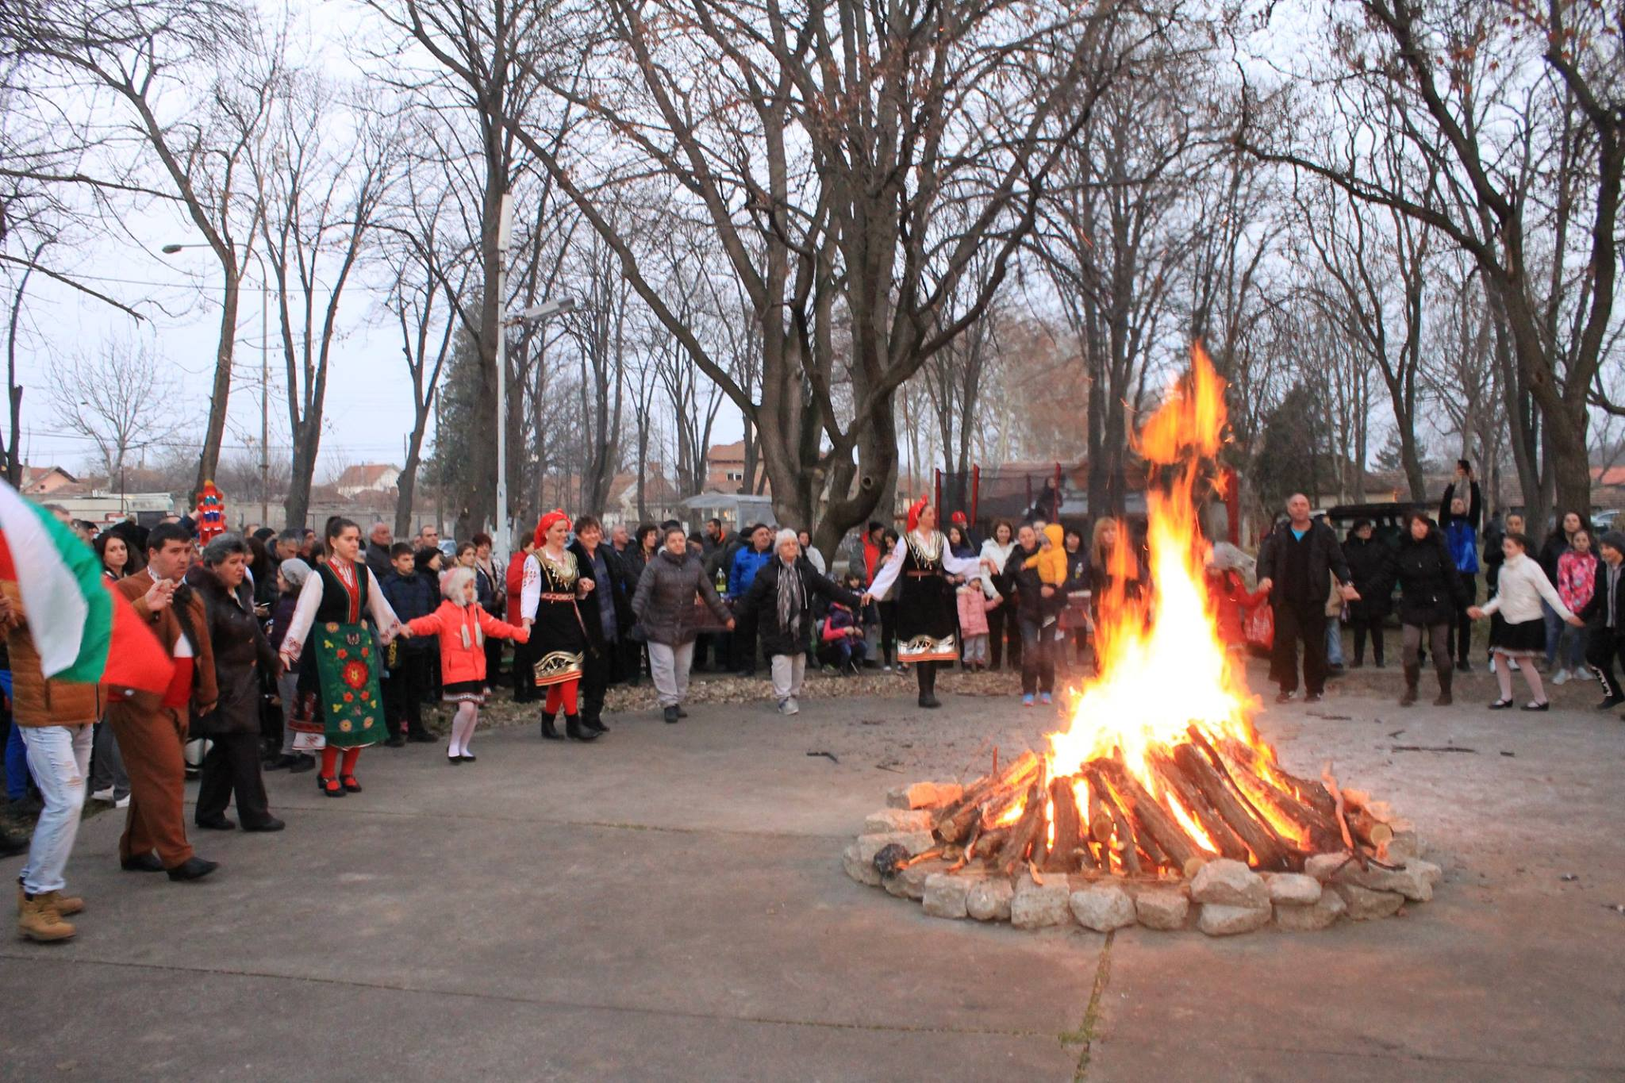
SYRNY ZAGOVEZNI
With this holiday, Bulgarians mark the week between the two pre-Lenten times. It is called that way because during this week the Church allows to eat only milk and egg dishes from all blessed foods. The week ends on Sunday with the Zagovezny national holiday, when the last meat food is eaten before the Lent. People gather together around a fire . Young men jump over it. After that all people dance .

Slide 9
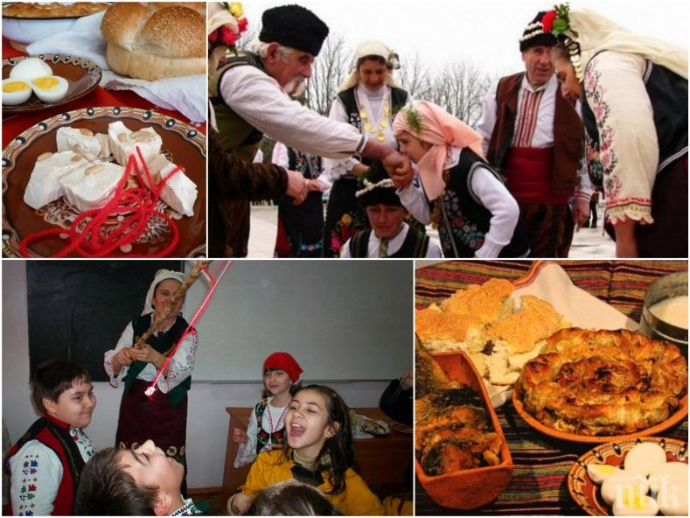
MESNI ZAGOVEZNI – THE DAY OF FORGIVENESS
In the evening people build fires and the children jump over them for health. After that, the whole family gathers, and before sitting down to the festive table, each family member asks forgiveness from the grandparents for his mistakes during the year. The first to ask are the children , then their parents. They say: “Forgive me!’ The answer is “I forgive you!” The evening ends by eating halva.

Slide 10
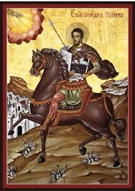
Todorovden - Horse Easter
It is celebrated on the first Saturday of Easter Long Lent. It is also called Horse Easter because on this day horses are honored by a special bread, baked in the form of a horseshoe. The bread is taken to the church to consecrate and then is given throughout the village. At noon, there are horse races.

Slide 11
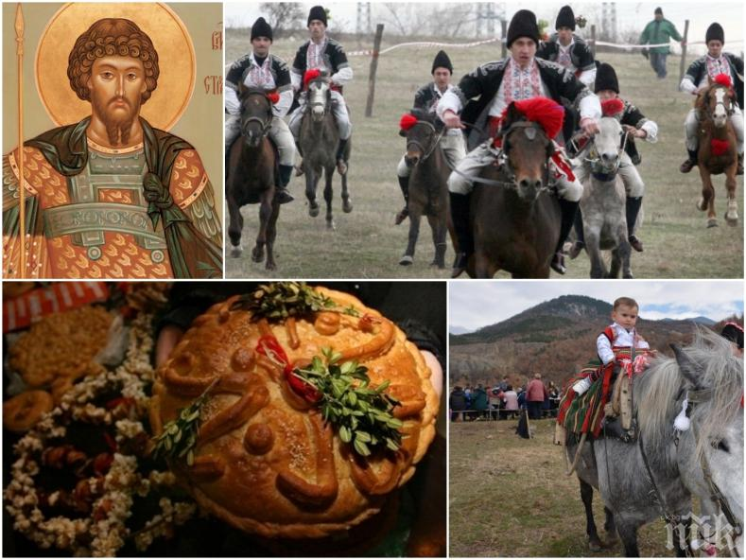
Todorovden - Horse Easter

Slide 12
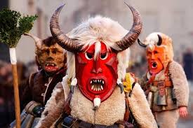
Kuker customs
The most dynamic and colorful Bulgarian custom are the Kuker games, which take place 50 days before Easter. The main idea is to fight the evil , which wakes up after the long winter. A Kuker can only be a young single or just married man, physically fit and very strong, who can wear a heavy suit. Kuker masks are always goats and sheepskins. They depict scary animals to fight evil spirits. While visiting the houses, the Kuker leader blesses:”Let our dances bring you prosperity and happiness! Let your gold coins be as many as the stars in the sky, let your children be as many as the bees in the hive! Let the evil be buried deep into the ground and let people have a good life!”

Slide 13
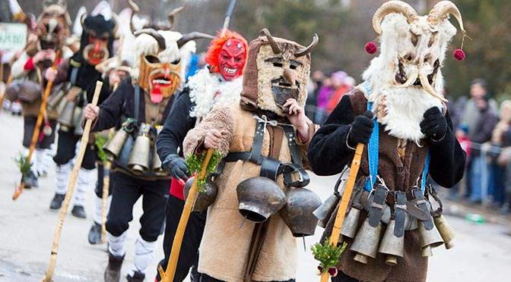
Kuker customs

Slide 14
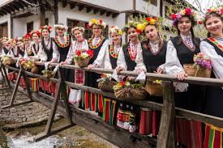
Lazarovden – The day of St.Lazar
Lazarovden is celebrated 8 days before Easter. It is the most romantic holiday for young girls who are old enough to fall in love. At the age of 17-18, girls can become lazarki . They gather together in the centre of the village, dressed in special costumes, their heads decorated with flowers, and go to the river. They take some water and start to predict the future -who will be their beloved husband. That’s why Lazarovden is really important for the young girls, who are old enough to get married.

Slide 15
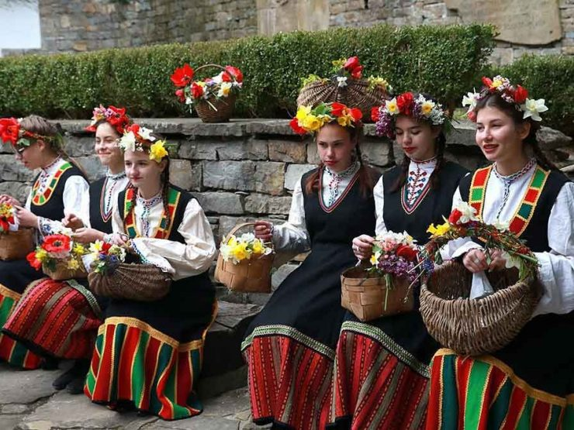
Lazarovden –The day of Saint Lazar

Slide 16
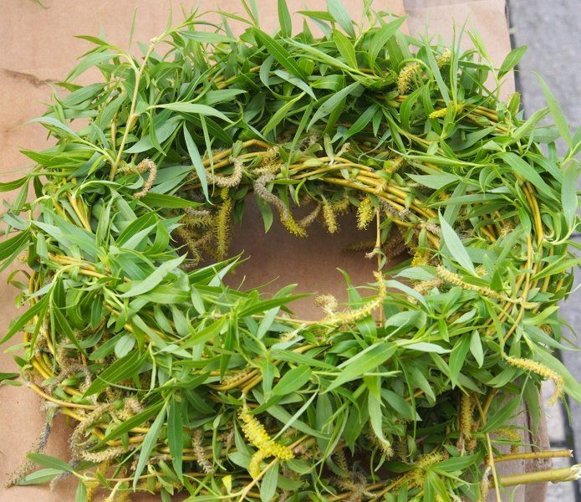
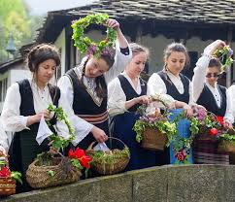
TSVETNITSA - FLOWERS’ DAY
Feast of flowers and spring. On this day, prayer is held in the church and willow branches are blessed. They are given to believers and everyone takes them to their home for health. People decorate the gates of their homes with willow wreaths. The willow twigs symbolize the palm trees - with which Jesus Christ was welcomed in Jerusalem. All men, women and children, whose names mean a flower or a tree, celebrate the Flowers’ day.

Slide 17
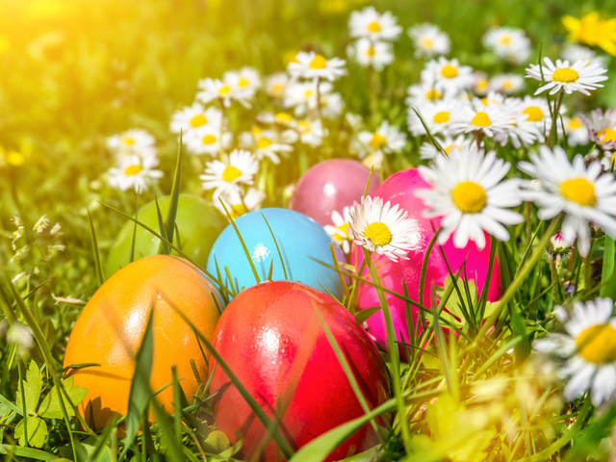
Velikden - Easter
The brightest spring holiday is Easter, associated with the Resurrection of Christ. The whole passionate week before the Resurrection is connected with many church rituals that follow the path of Christ to Immortality. On Holy Thursday, when Christ is bearing His Cross, eggs are painted red and Easter bread – kozunak is baked. On the feast day they are given to relatives and friends for health. On Easter, the 45-day long Lent ends, and for the first time, blessed meat foods can be eaten. The family gathers at a festive table, fighting for the strongest egg: the person who has fought the other eggs , will be the strongest during the year.

Slide 18
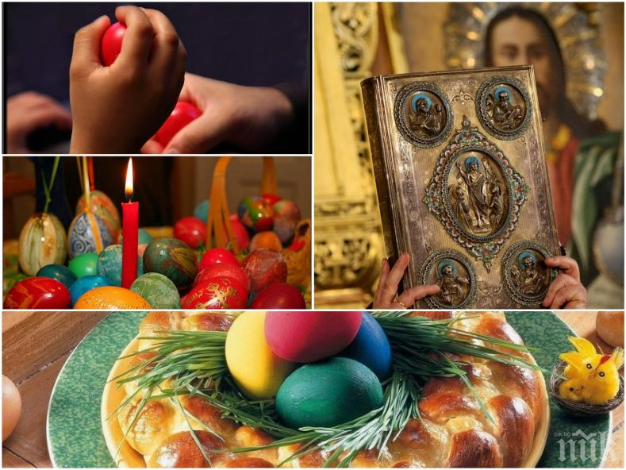
Easter

Slide 19
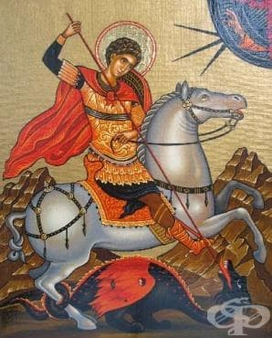
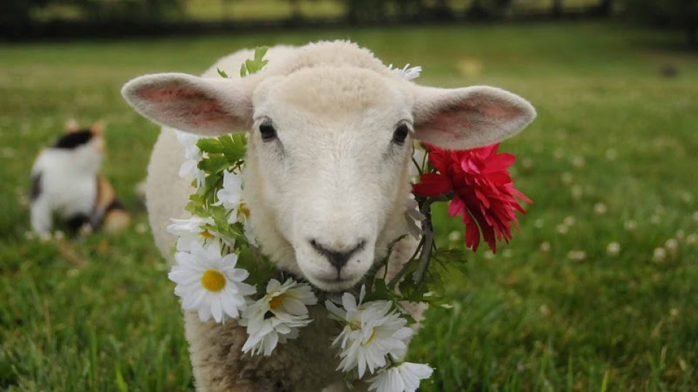
Gergyovden - Saint George's Day
On this feast, a lamb is sacrificed to the sacrifice of St. George, the patron saint of sheep and shepherds. St. George's special ring-shaped buns are also baked - one for the beehive, one for the table and the other which is given to relatives for health. The buns are richly decorated with symbols.
In the morning before the ritual is performed, the home owner goes to the fields and buries a red egg kept since Easter. He cuts off a green wheat-ear, which he takes home to protect the fields from hailstorms, after which the sheep are fed with grass and the doors of the houses are decorated with geranium.

Slide 20
SUMMER HOLIDAYS

Slide 21
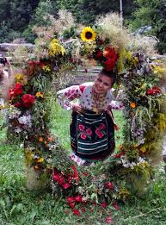
ENYOVDEN – JUNE 24TH
An old Bulgarian holiday, which is celebrated on June 24 every year. The holiday coincides with the summer equinox and is connected with the cult to the Sun. The Eastern Slavs celebrate the holiday with a traditional night bath in the night before Ivan Kupala, as they call Enyovden. They also build a fire, jump over it and dance around. Herbs have the greatest power just during that night.

Slide 22
AUTUMN HOLIDAYS

Slide 23
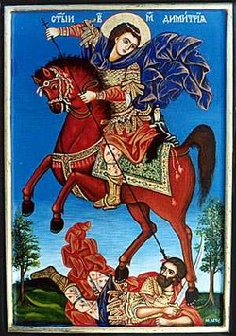
DIMITROVDEN– ST. DIMITAR’S DAY - OCTOBER 26th
A national and Orthodox holiday, commemorated in memory of St. Demetrius of Thessaloniki. He was born in the 3rd century in Thessaloniki and his father was the Mayor of the town. As governor of Thessaloniki, Dimitar openly professes and glorifies the Christian religion.. Greeks, Bulgarians, Serbs and Russians compete for the protection of the Saint Dimitar.

Slide 24
WINTER HOLIDAYS

Slide 25
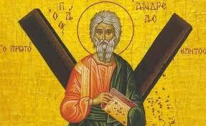
ANDREEVDEN– ST. ANDREY’S DAY - NOVEMBER 30TH
It is believed that since Andreevden the day begins to grow little by little, by a single grain of millet. The day is associated with the ritual practice on the eve of this holiday - to brew different pots of grain - wheat, peas, corn, beans and lentils - in order to grow bigger and to have a good harvest.

Slide 26
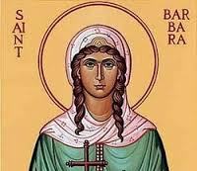
VARVARA – December 4th
Saint Varvara is a Christian martyr, born at the end of the 3rd century and died in 305 or 306.
Her memory is honored both in the Orthodox Church and in the Catholic Church on December 4.

Slide 27
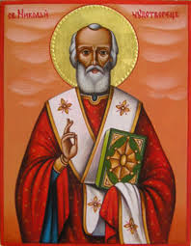
NIKULDEN - SAINT NIKOLAY’S DAY – DECEMBER 6TH
St. Nikolay’s day is one of the important Orthodox holidays. It is dedicated to St. Nikolay Mirlikiyski, who is the patron saint of sailors, travelers, merchants and bankers and all people called Nikolay, Nikolina etc. The day is a national holiday and is celebrated in all families. In the tradition of the holiday fish dishes are served, most often - stuffed carp with walnuts.

Slide 28
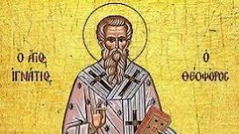
IGNAZHDEN – ST. IGNATIUS’ DAY - DECEMBER 20TH
The day is dedicated to the memory of St. Ignatius the Epiphany, and is celebrated on December 20th. Usually, with Ignazhden, the Christmas holidays begin. In Eastern Bulgaria this day is the first Christmas dinner with no meat. There is a common belief that since Ignazhden the birth-pains of Virgin Mary start.

Slide 29
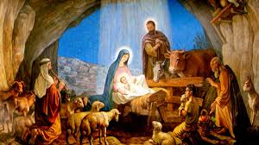
Christmas Eve and Christmas
Christmas (Christmas) is one of the brightest Christian holidays. With it comes the fulfillment of the promise of Our Savior to restore the broken relationship between God and man.

Slide 30
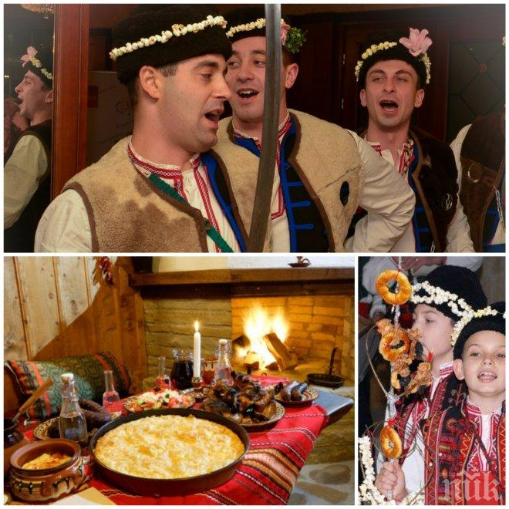
SURVAKI – January 1st
Survaki, Surva, Vasilyovden, New Year (January 1,) is a Bulgarian national holiday marking the beginning of the new calendar year. It is known in all Bulgarian ethnic territories. The young girls put the first bite of the special round loaf of bread under their pillow, believing that whom they dream of, he will be their future husband .

Slide 31
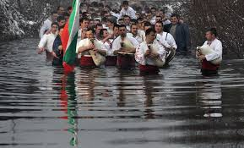
EPIPHANY-SAINT YORDAN’S DAY
According to the Orthodox calendar, the feast day of Yordan marks the baptism of Jesus Christ by John the Baptist in the Yordan River. On this day, wherever there is a river, people perform a special ritual – the local priest throws the blessed Christian cross in the water. The young men jump into it and compete for the cross. The belief is the person who gets the cross, will be healthy all year.

Slide 32
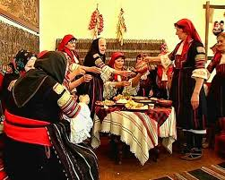
BABINDEN – JANUARY 8th
Babinden is a Bulgarian holiday celebrated on January 8th in honor of the midwife in the village. The holiday is related to family customs. It is pagan by origin.

Slide 33
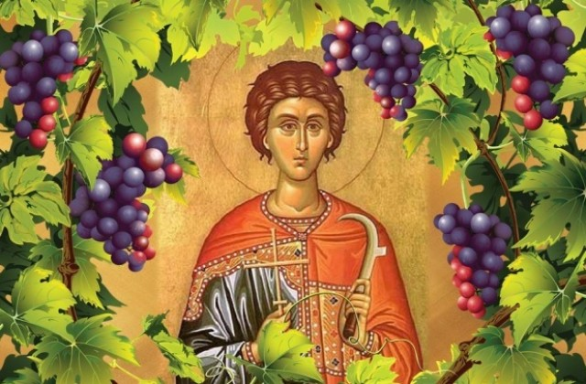
THE TRIFON’S DAY
On this day, the church celebrates the martyr Trifon, famous as a saint healer. There are many legends about him. One tells how, at the age of 17, he healed the daughter of the Roman emperor Gordian and earned enviable fame.

