Slide 1
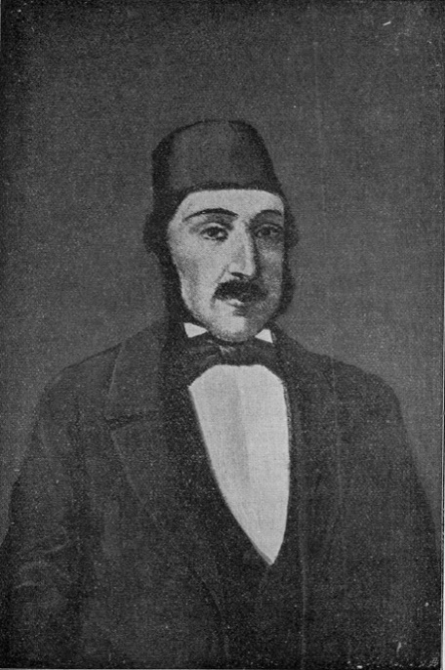
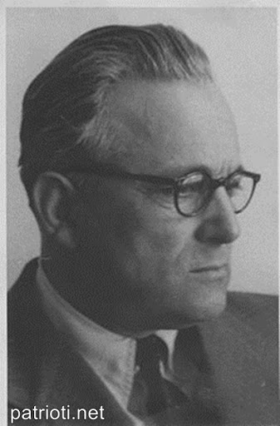
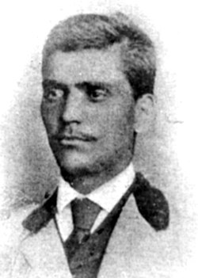
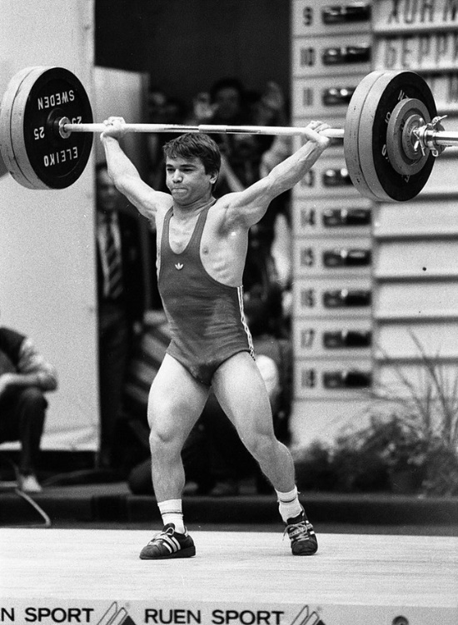
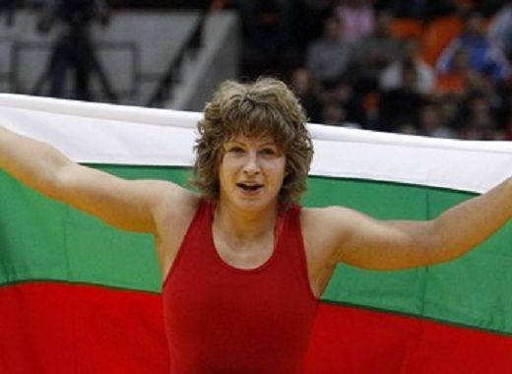
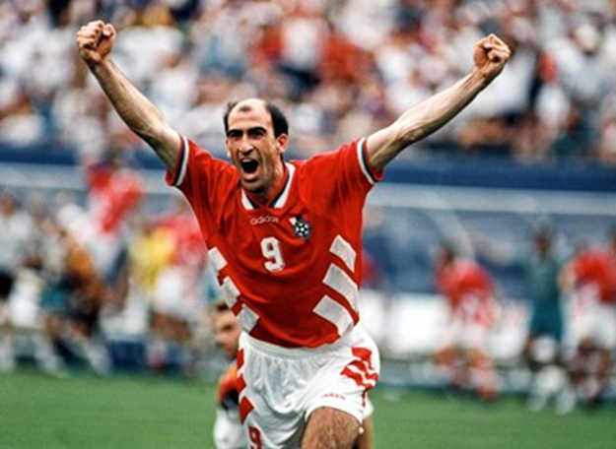
FAMOUS PERSONS RELATED TO THE TOWN OF SLIVEN

Slide 2

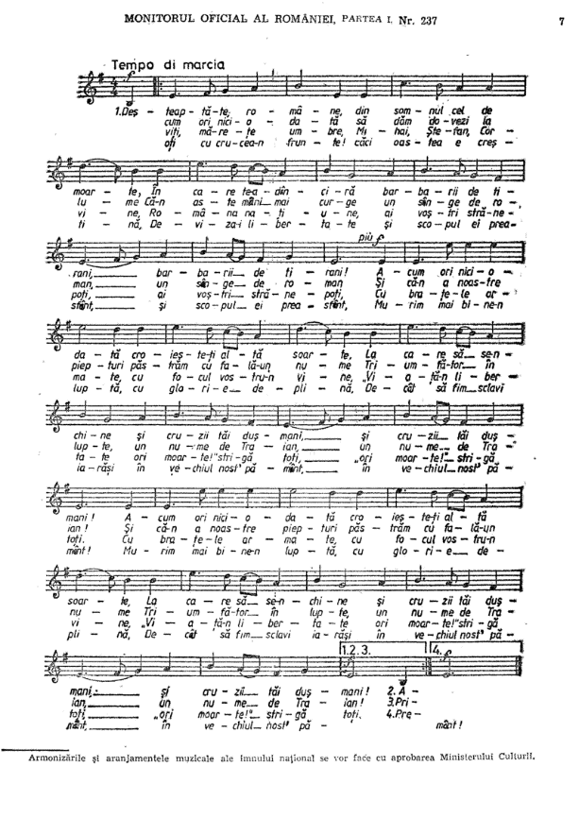

Anton Pan
(1796-1854)
Born in Sliven
Author of the music of the Romanian anthem
Wallachian writer, poet,
composer and a folklorist of Bulgarian origin

Slide 3
Aleksi Kvartirnikov
(1893-1977)
Born in the city of Sliven.
Graduated from high school in Varna Higher
Technical School in Graz, Austria
He has designed many buildings and facilities
Civil Engineer
Lecturer and rector
Public figure and politician
More important among which are:

Slide 4
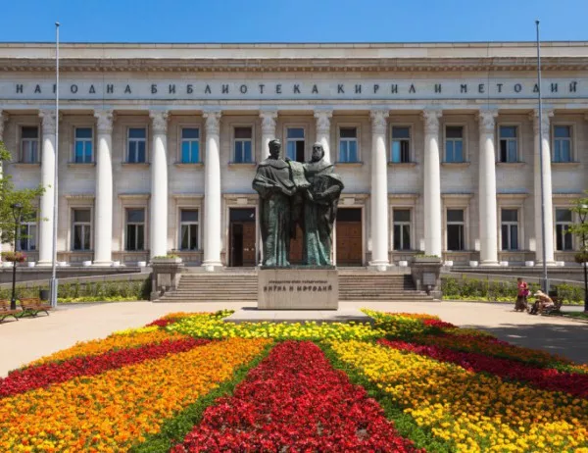
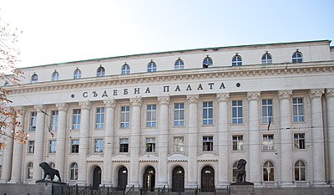
The courthouse in the capital
The National Library
In Sofia

Slide 5
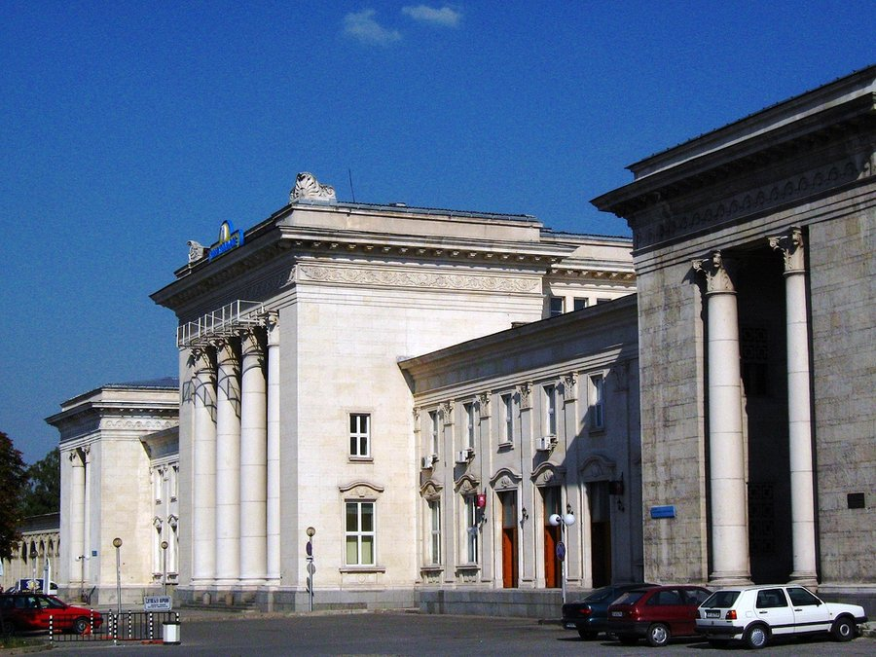
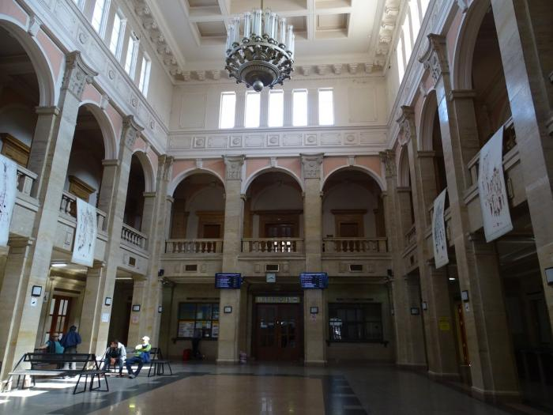
Railway station in Ruse

Slide 6
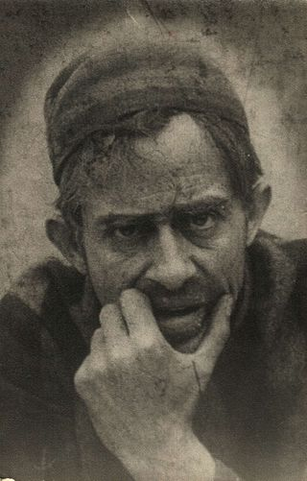
Vasil Gendov
(1891-1970)
Born in the city of Sliven.
He graduated from the Higher Theater School in Vienna, specialized in Berlin,
He is the founder of the Bulgarian film art
He created the first film about Vasil Levski
Bulgarian director, actor
and playwrightauthor of the first Bulgarian film "A Bulgarian is a gallant"

Slide 7
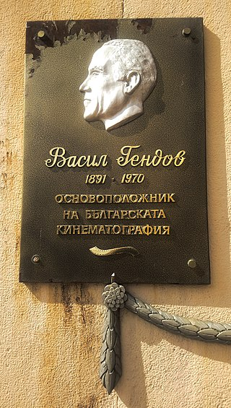
Memorial plaque of Vasil Gendov in the center of Sliven

Slide 8
Georgi Ikonomov
(1846-1876)
Born in Sliven
vocabulary at the Caravel Printing House in Bucharest
Participant in the April Uprising
Bulgarian revolutionary

Slide 9
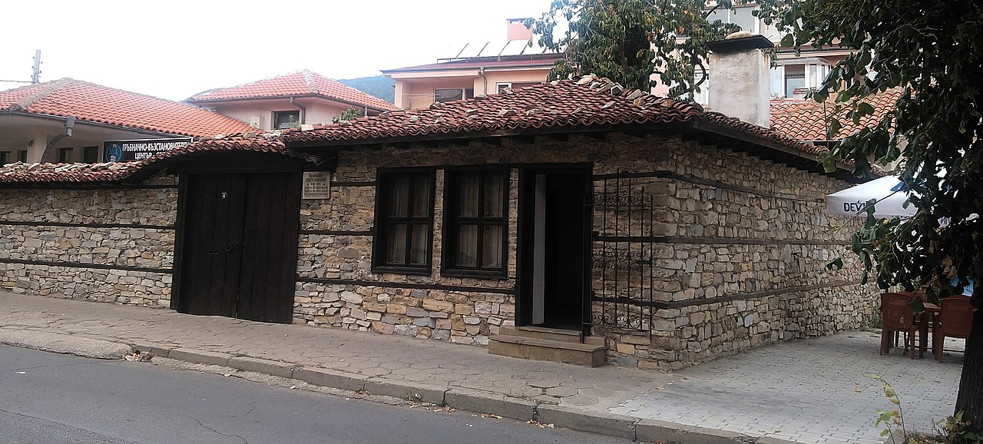
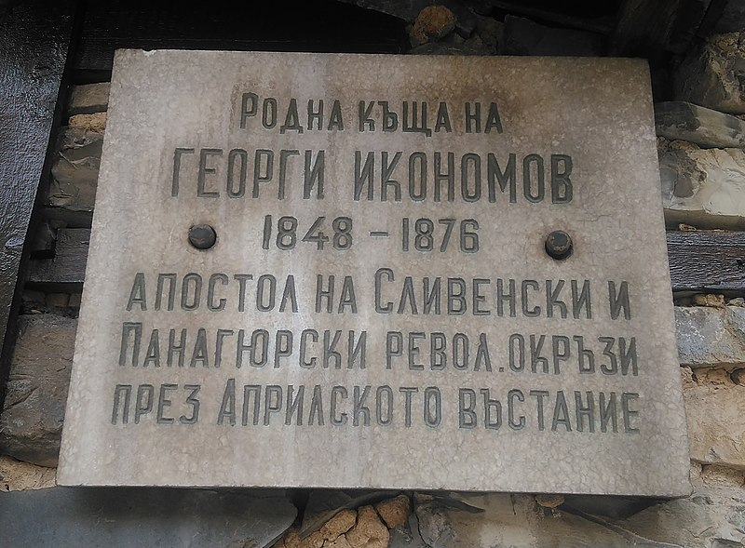
Ikonomov's house in the Sliven district of Klutsohor

Slide 10
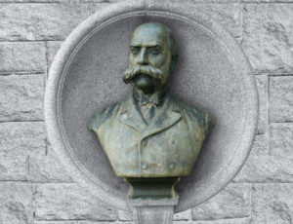
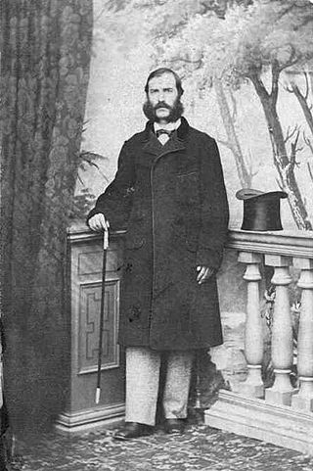
Georgi Mirkovich
(1826-1905)
Born in Sliven
He studied in Sliven and Kotel under Sava Dobroplodni
He studied medicine in Montpellier, France and Pisa, Italy
Doctor and manager of the Sliven hospital for a period of ten years
He founded the first Red Cross society in Bulgaria
He has also been the headmaster of the Sliven Boys' High School for two yearsthe
first doctor in Bulgaria to start treating with the method of homeopathy
Bulgarian doctor,
revolutionary,
educator and public figure

Slide 11
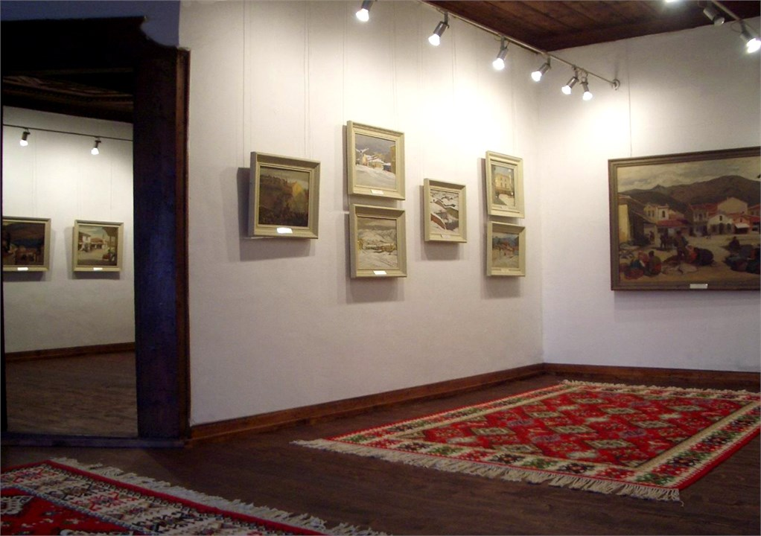
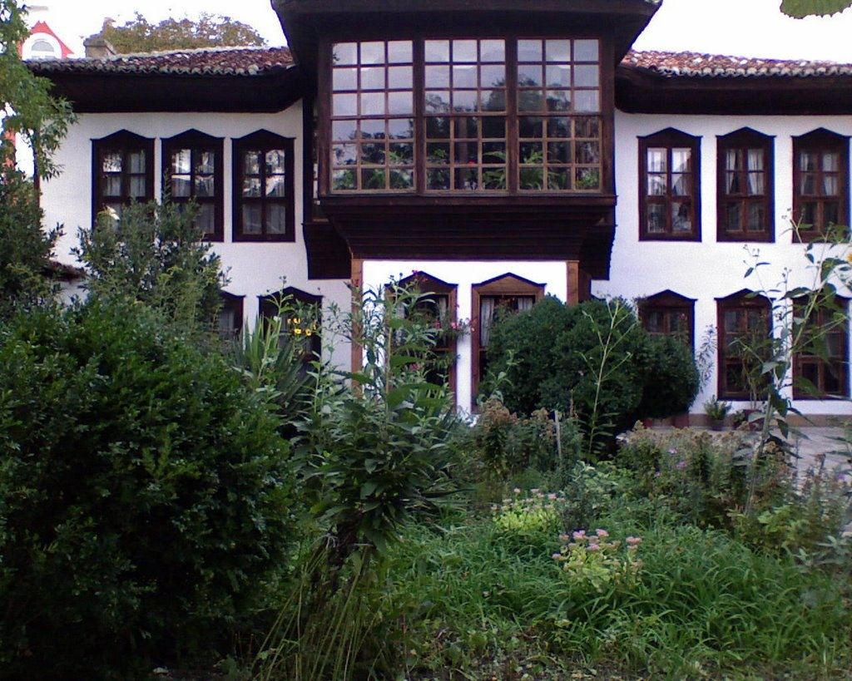
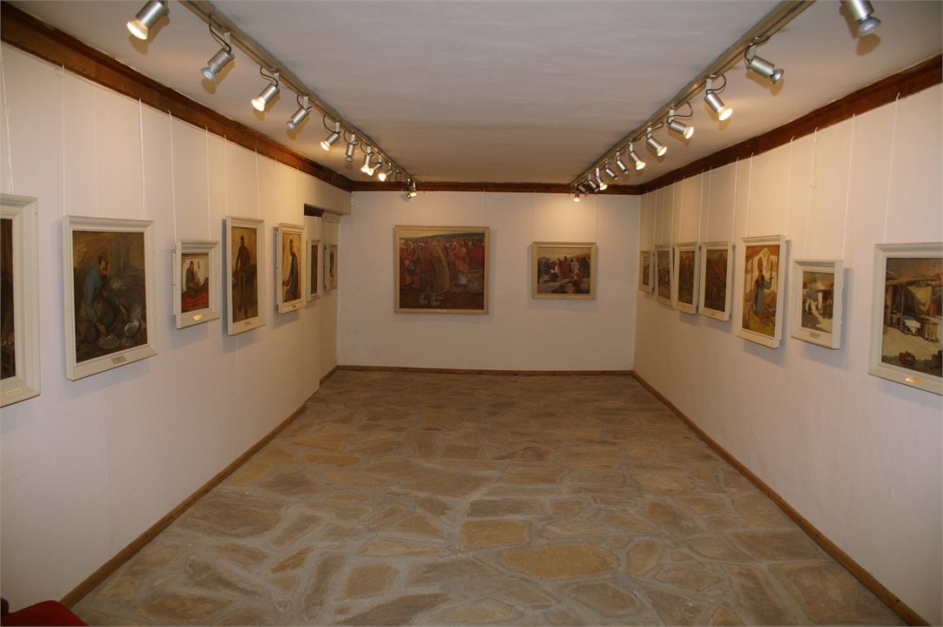
Georgi Mirkovich's house in Sliven, now turned into a gallery

Slide 12
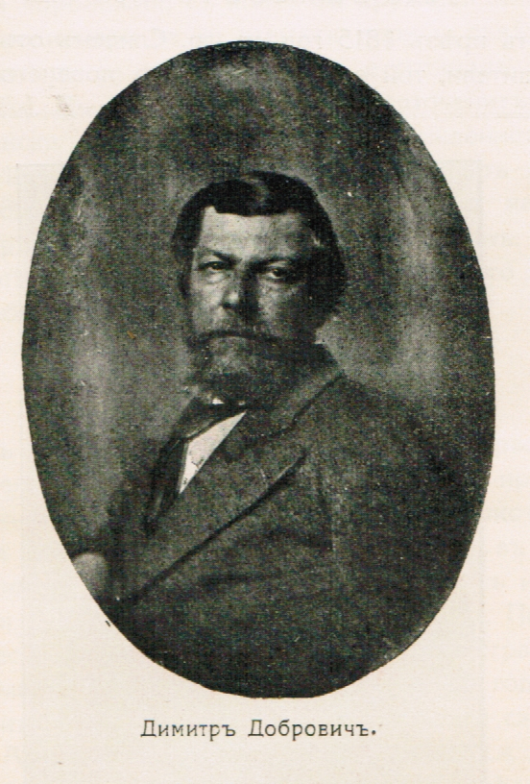
Dimitar Dobrovich
(1816-1905)
Born in Sliven
studied at the Greek school in Kuruçeşme, Istanbul
He studied high school in Athens
He graduated from the Academy of Fine Arts in Rome
the first Bulgarian artist
with academic education.

Slide 13
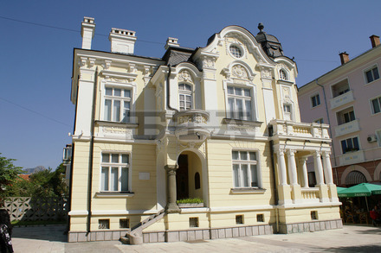
art gallery in Sliven is called Dimitar Dobrovich

Slide 14
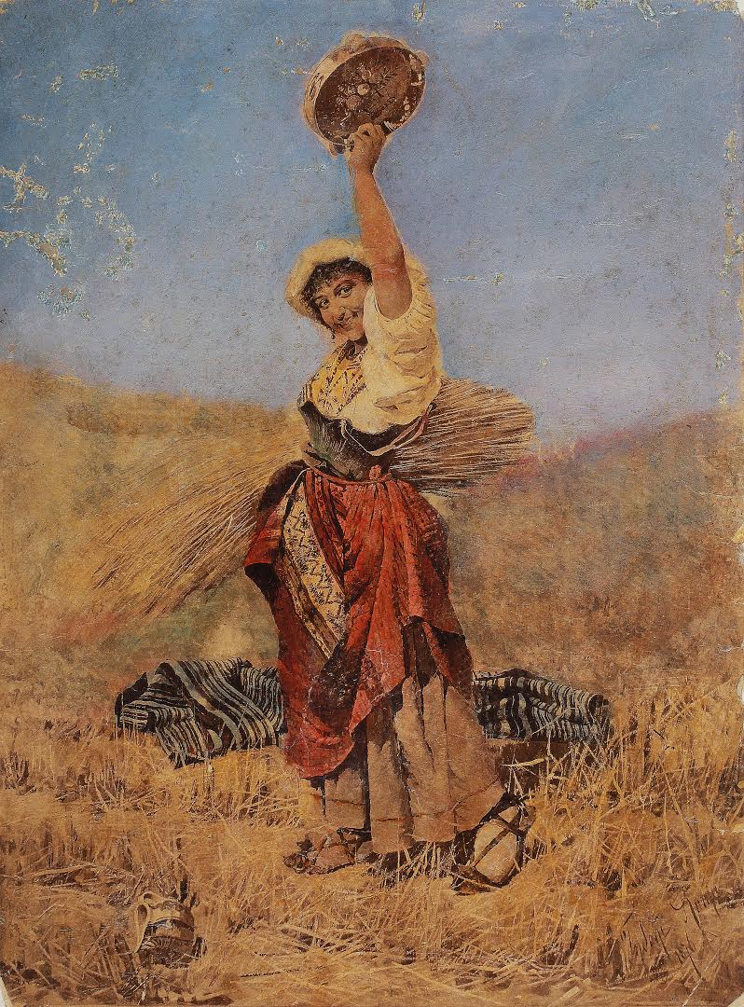
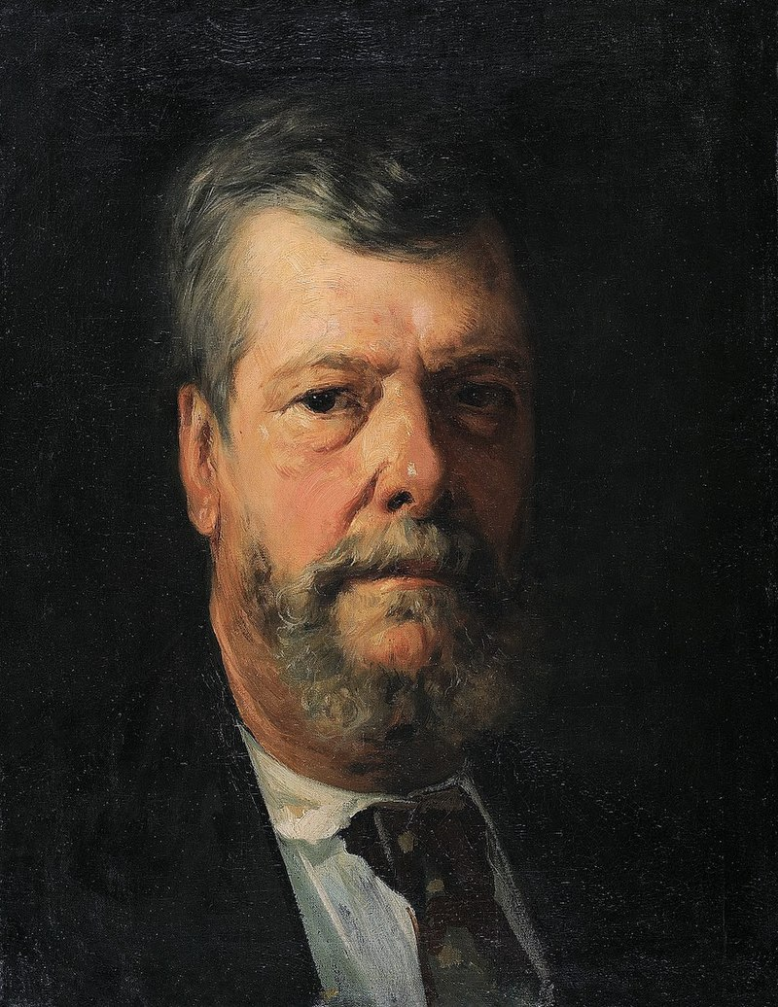
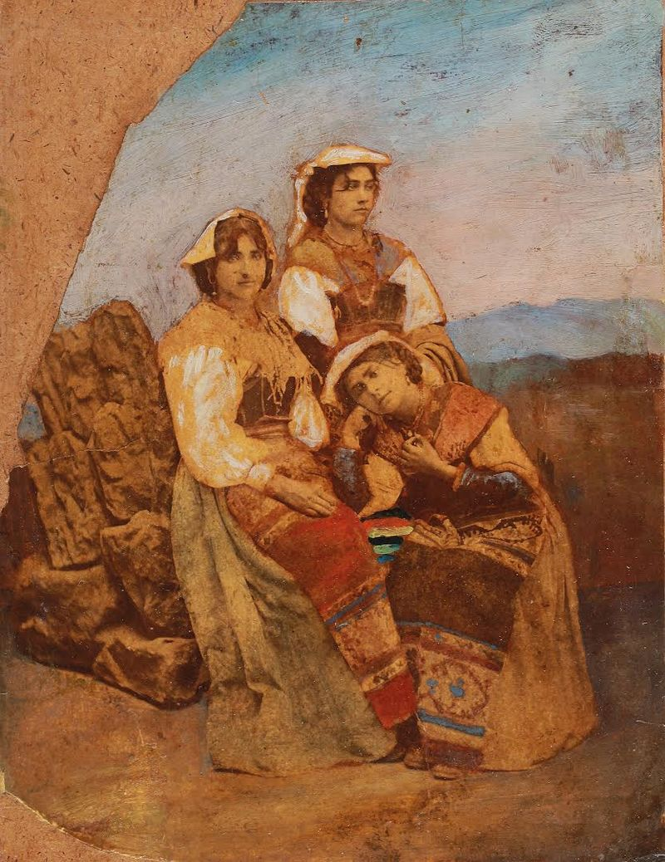
Paintings by Dimitar Dobrovich
Italian girls
self-portrait
Italian reaper

Slide 15
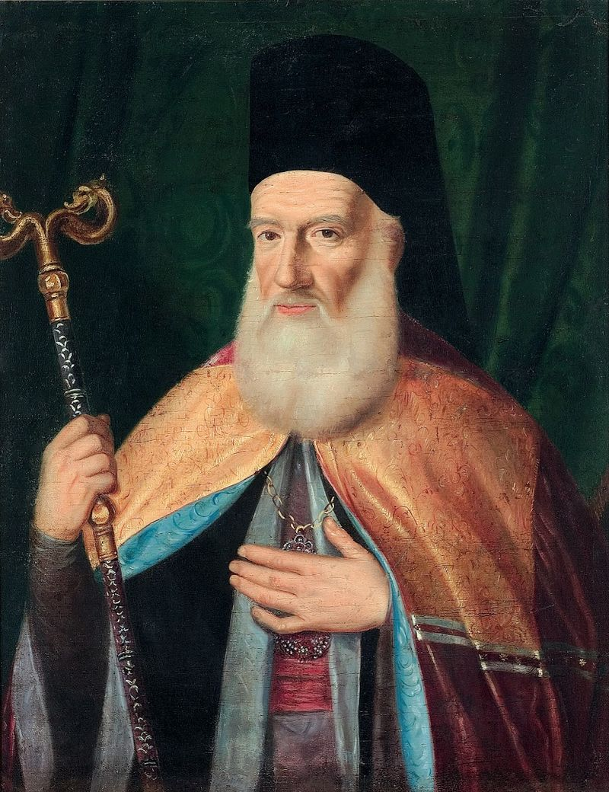
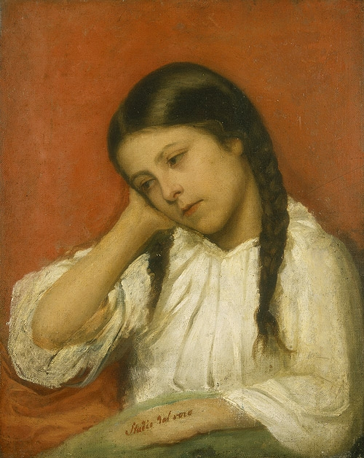
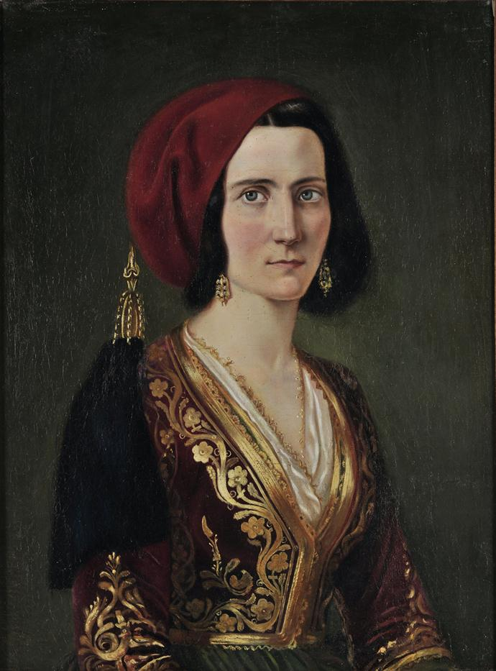
Paintings by Dimitar Dobrovich
Portrait of a girl
„ A girl in a Greek costume“

Slide 16
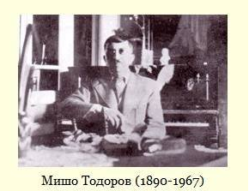
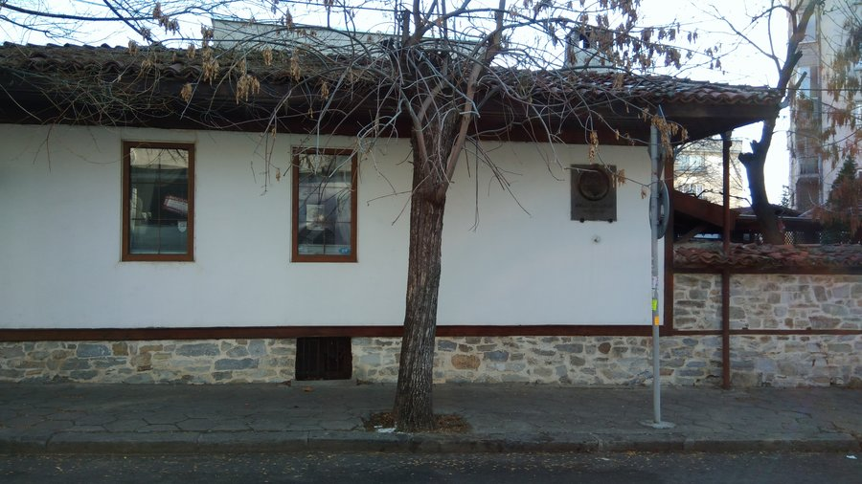
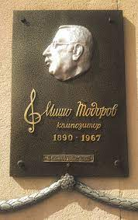
Mischo Todorov
(1890-1967)
Born in Sliven
He studied music in Geneva, Switzerland and Dresden, Germany
works as a music teacher at the Sliven Boys' High School
Bulgarian composer,
pianist, conductor
House of Misho Todorov

Slide 17
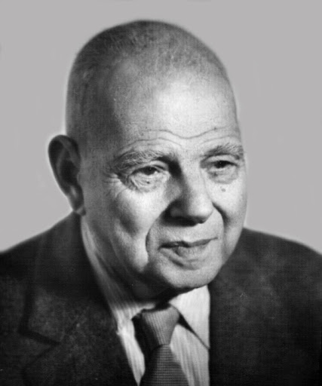
Prof. Dr. Dimitar Tabakov
(1879-1973)
Born in Sliven
He graduated from the Sliven Boys' High School
He graduated from Sofia University
He specializes in Strasbourg
Bulgarian scientist, mathematician
Author of many textbooks in mathematics

Slide 18
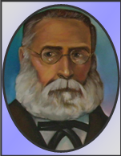
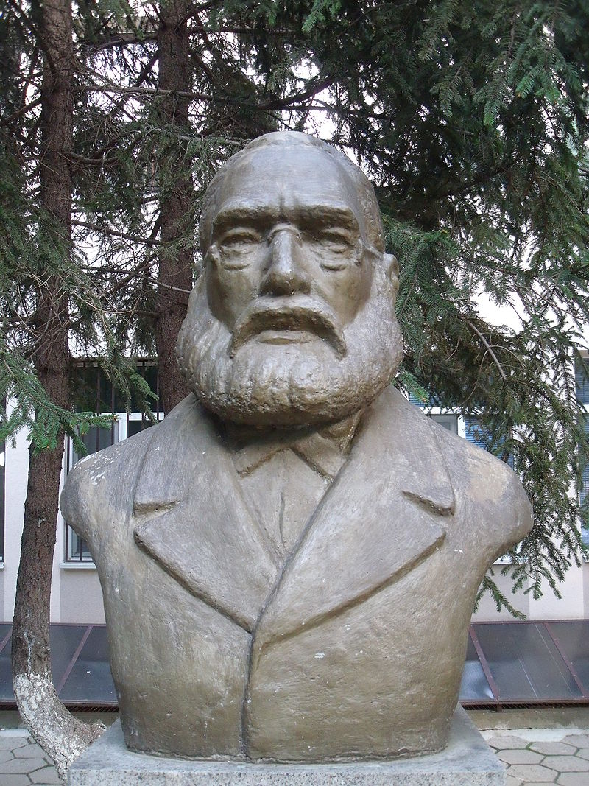
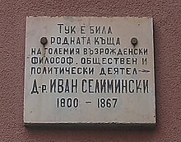
Doc Ivan Seliminski
(1799-1866)
Born in Sliven
He graduated from the Greek high school in the city of Kidonia, Asia Minor
He graduated in medicine in Athens
revivalist,
public figure and doctor

Slide 19
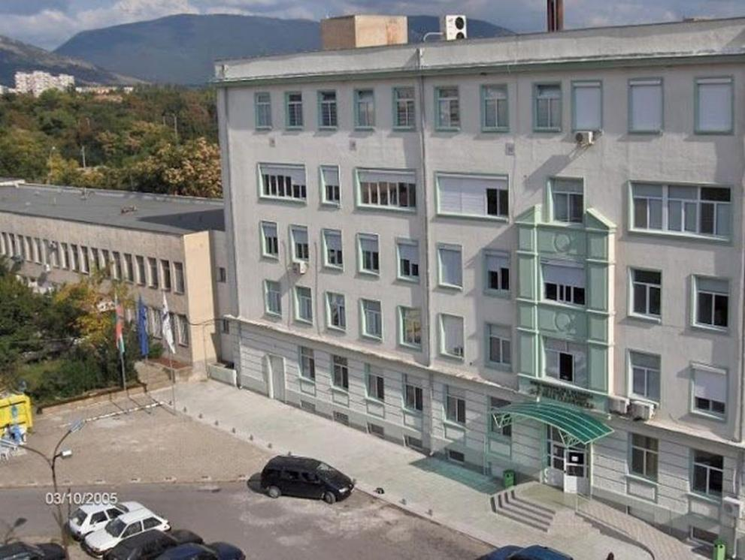
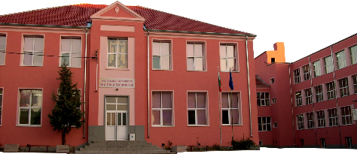
School and hospital in Sliven are named after Dос. Ivan Seliminski

Slide 20
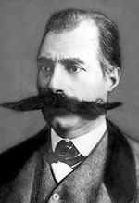
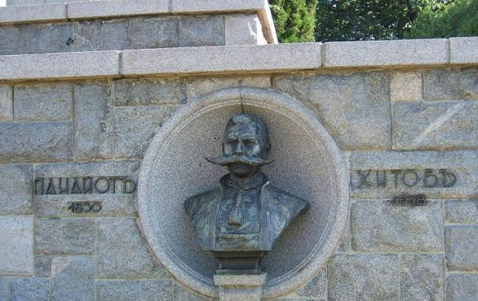
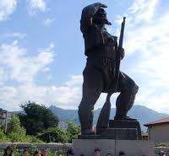
Panayot Hitov
(1830-1918)
Haidutin, revolutionary and voivode

Slide 21
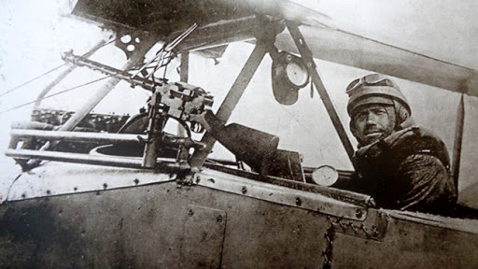
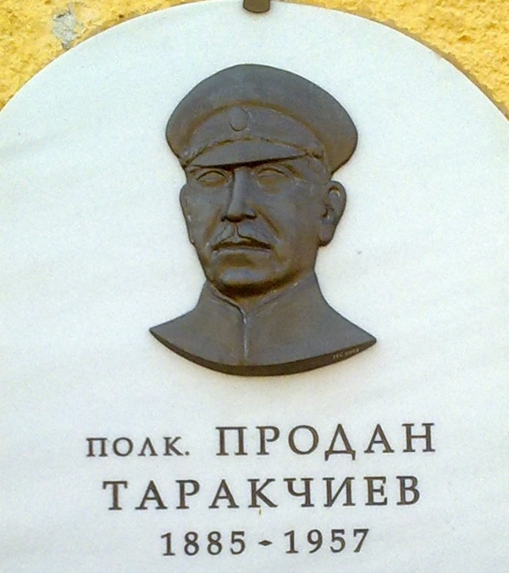
Prodan Tarakchiev
(1885-1957)
Born in Sliven
He studies at the Second Primary School "Hristo Botev“
He graduated from the military school
Bulgarian officer, among the first Bulgarian pilots
and creators of the Bulgarian military aviation.

Slide 22
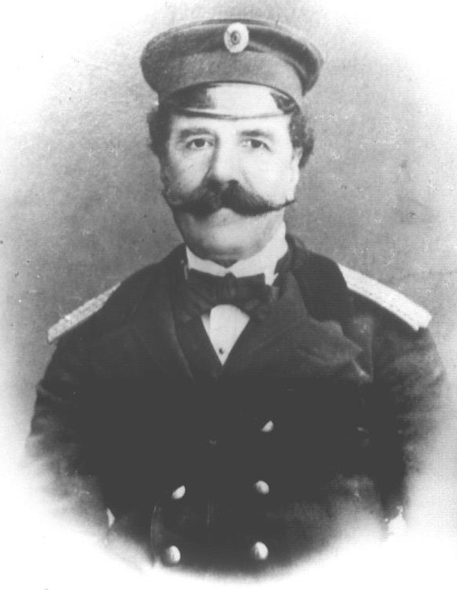
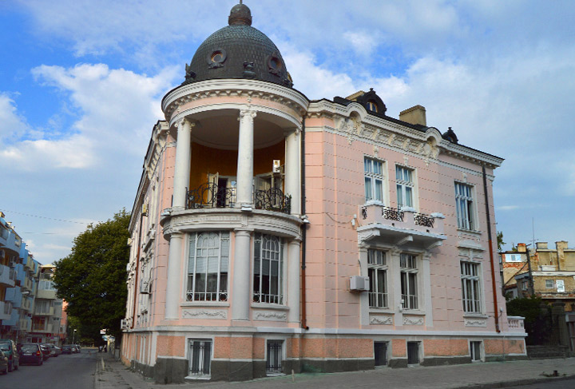
Sava Dobroplodni
(1820-1894)
Bulgarian writer,
theatrical figure, public figure and teacher
The library in Sliven bears his name

Slide 23
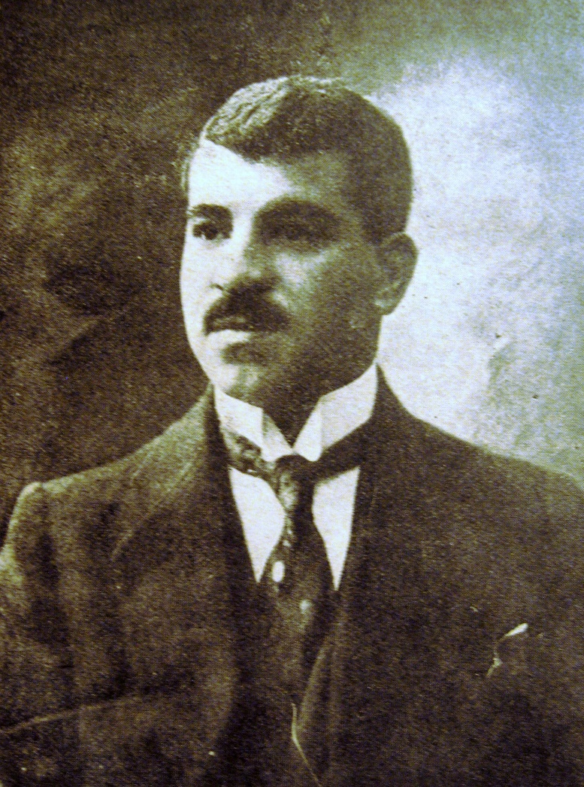
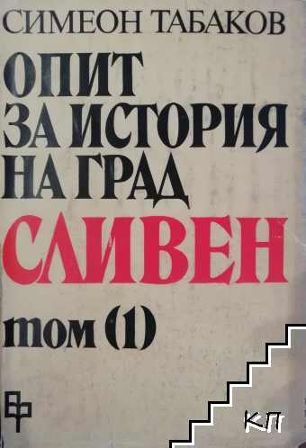
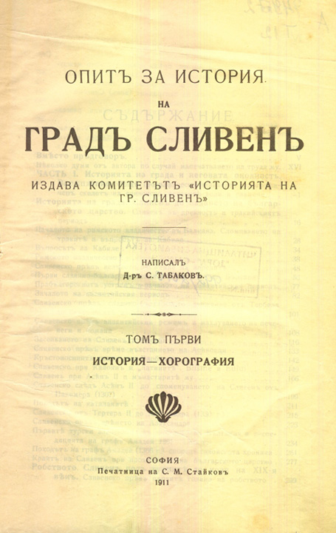
Simeon Tabakov
(1880-1918)
Author of a three-volume history of the town of Sliven
Bulgarian diplomat,
lawyer and local historian.

Slide 24
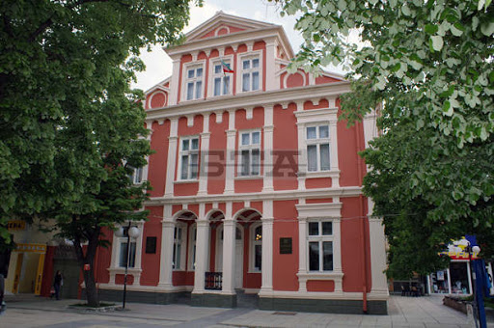
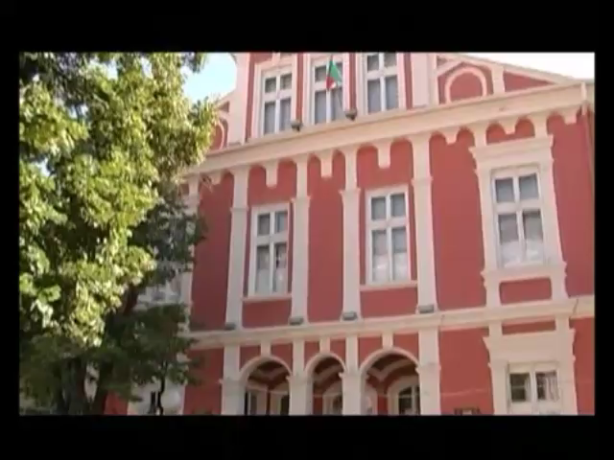
The Historical Museum in Sliven is named after Simeon Tabakov

Slide 25
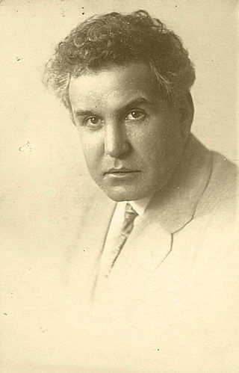

Sirak Skitnik
(1883-1943)
Gallery Sirak Skitnik
the Bulgarian writer and artist

Slide 26



Paintings by Sirak Skitnik

Slide 27
Born in Sliven after 1900

Slide 28


Violeta Gindeva – Bulgarian actress
Vasil Vasilev- Zueka- Bulgarian actor
He graduated from our school

Slide 29



Damyan Damyanov
(1935-1999)
Bulgarian poet
Memorial fountainin
memory of Damyan Damyanov

Slide 30


Radoy Ralin
(1922-2004)
Bulgarian poet, writer and satirist

Slide 31


Stanka Pencheva
(1929-2014)
Kevork Kevorkyan
Bulgarian journalist
poet, journalist,
magazine editor, translator

Slide 32

Georgi Ivanov
Winner of a gold medal at the World Athletics Championships for juniors (2004)
Bulgarian athlete,
gunner, Olympian.

Slide 33


Nurair Nurikyan
two-time Olympic championand weightlifting coach

Slide 34

Stanka Zlateva
Winner of two Olympic silver medals from Beijing (2008) and London (2012)
Bulgarian wrestler

Slide 35


Yordan Lechkov
He won fourth place at the 1994 FIFA World Cup in the United States with the Bulgarian national football team and participated in the 1996 European Football Championship in England.
Bulgarian national football player

